Slide 1
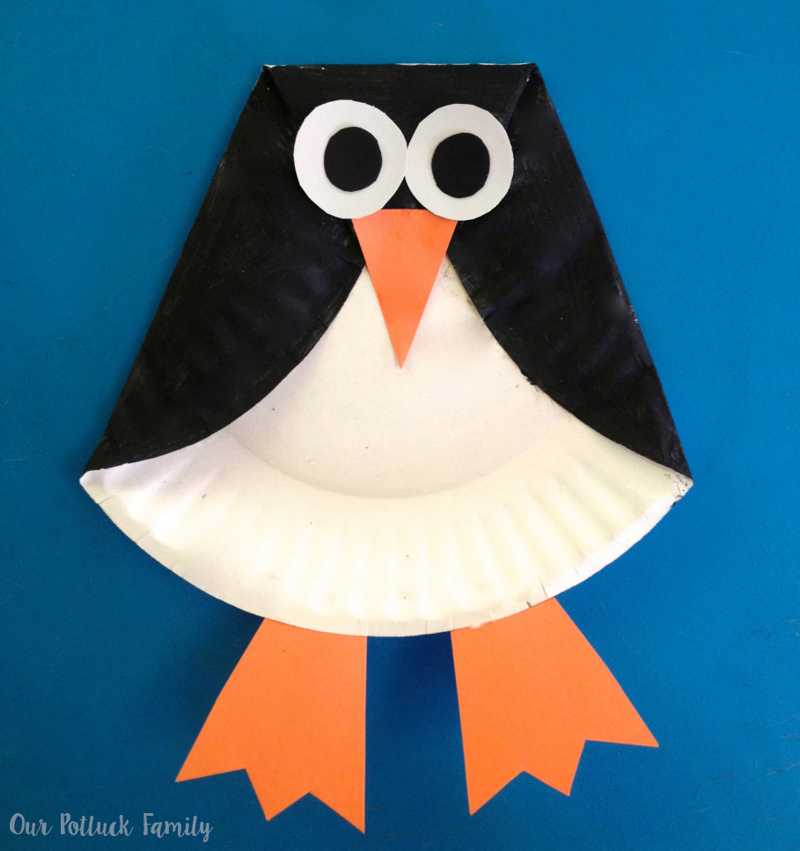
Paper Plate Penguin
Supplies :
Paper plate
Black craft paint
Paintbrush
Glue
Scraps of paper (orange, black, white)
Begin by folding in the sides of the paper plate and folding down the top. Glue in place.
Paint the folded in/down portions of the plate black and allow to dry.
Cut a beak and feet from scraps of orange paper. Glue those in place.
Cut eyes from scraps of black and white paper. Glue those in place.

