Slide 1
2020 Year in Review
Notes:
Tracey

Slide 2
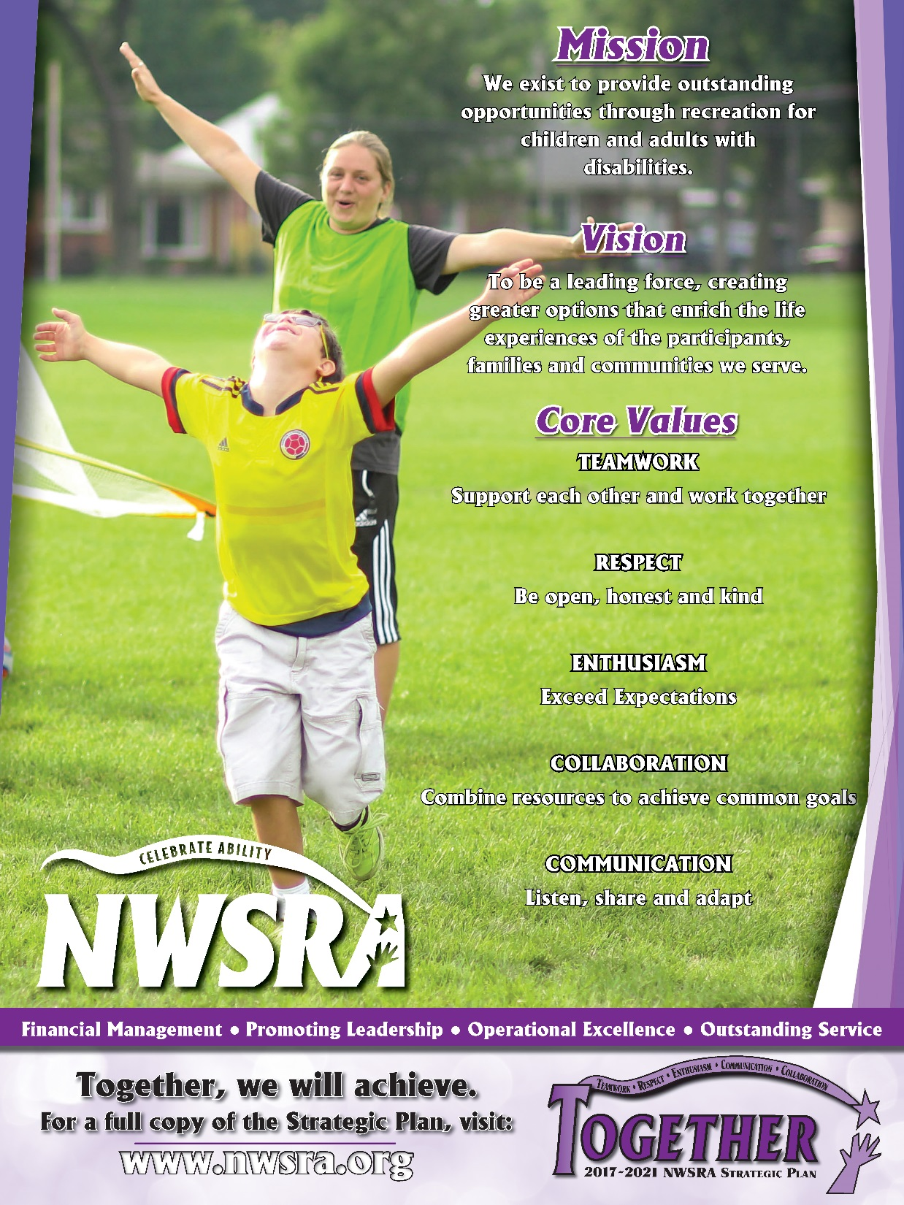
4th full year of Comprehensive Strategic Plan
Notes:
Tracey

Slide 3
Legislation and Advocacy
Reached out to Legislators regarding Special District funding, Paycheck Protection Program, HEROES Act, and CARES Act funding
Hosted Transportation Needs, Obstacles and Accommodations Meeting with Legislators and community organizations in partnership with Connect to Community
Educated Legislators on new NWSRA initiatives including the NWSRA Activity Center and Virtual Programming
Introduced background information on NWSRA programs and services to new Legislators
Notes:
Tracey

Slide 4
Long Range Planning/Financial Stability
Incorporated hybrid Accrual/Cash reporting in Quarterly Financial Reports
Completed Year 3 of SLSF Development Plan
Created COVID-19 Budget to address changes to income and expenditures
Incorporated anticipated replacement or repair expense for condo space and NWSRA vehicle fleet into Capital Replacement Plan
Long-term planning to address part-time staff minimum wage increase through 2025
Notes:
Tracey

Slide 5
Staff Certifications
Notes:
Brian –

Slide 6
Full-Time Longevity
1 Staff:
20-24 Years
36 Full Time Staff
13 Staff: 5-9 Years
2 Staff: 15-19 Years
4 Staff: 10-14 Years
1 Staff: 25+ Years
Notes:
Brian

Slide 7
Team Advancement
Promoted/Lateral Move within Agency
Accepted position within the field: Park District/SRA/Other or Retired
Accepted position outside of Park District/SRA
New Staff Hires
Morgan Wirkus
Nicole Derrig
Brianna Assad- January 2020
Victoria Gonzalez
Jacki Moore
Liz Thomas
Clariza Kotsovos
Lauren Jevaney
Emily Nock
Anita Trzebunia- January 2020
Dustin King
Erica Patricca
Cortney Lucente
Georgia Klotz
Megan Edwards
Jocelyn Wright
Notes:
Tracey

Slide 8
Training and Certifications
10 staff trained in Club Wellness, a fitness and nutrition program
5 staff certified to be Chair One Yoga Instructors
2 staff completed a course to be Sibshop Generation One Facilitators
Notes:
Tracey

Slide 9
Notes:
Tracey

Slide 10
Staff Training
Conferences and Workshops
Autism Movement Therapy
Human Services Conference at Harper College
IPRA Supervisor’s Symposium
In-House Training
Ergonomics, Patron Transfers and Back Safety
IPRA State Conference
American Therapeutic Recreation Association (ATRA) Annual Conference
Reasonable Suspicion Drug and Alcohol Training for Supervisors
CPR/First Aid
Bloodborne Pathogens Training
PDRMA Online Workshops
Crisis Prevention Institute Non-Violent Crisis Intervention Training (CPI)
Recognizing and Responding to Seizures
Crisis Communication
PDRMA Risk Management Institute
Illinois Therapeutic Recreation Summit
IAPD Legislative Conference and Legal Symposium
PDRMA Core 6 Strategies
Illinois Transition Specialist Conference
Defensive Driving
Driving Audits
APIE+D process in Therapeutic Recreation
Incident/Accident Reporting
Behavior Management
Customer Service
Notes:
Tracey

Slide 11
Local, State and National Involvement
Tracey Crawford
American Academy for Park and Recreation Administration, Leadership Academy Board of Regents, IPRF Board Member, American Therapeutic Recreation Association (ATRA) Board Member
Andrea Griffin
National Delegate for Women in Leisure Services (Chi Chapter), ITRS Awards Committee Chair. Member of Northwest Suburban Autism Consortium, North/Northwest Cook County & Lake County Work Group, Rolling Meadows Community Events Foundation, American Therapeutic Recreation Association (ATRA) Leadership Committee, Kent State Inclusion Advisory Board and Mount Prospect Junior Woman's Club
Rachel Hubsch
President of Women in Leisure Services (Chi Chapter), ITRS Conference Committee member and member of Wheeling Township Advisory Council and The Rotary Club of Schaumburg Hoffman Estates
Brian Selders
IPRA C & M Section, ITRS Marketing Group, ATRA newsletter task force
Cathy Splett
Rotary Club of Buffalo Grove, IPRF Fundraising Committee
Darleen Negrillo
IPRA A&F Human Resources Group Chair, PDRMA Claims Committee Member,
Northwest Human Resource –NHRC Council Member
Through active participation in a variety of committees, task forces, presentations and conferences on local, state and national levels, NWSRA staff played key roles in the development of the profession.
Notes:
Tracey
NOTE: Manny was Secretary for IPRA Diversity Section, Nicole was IPRA Therapeutic Section Rep & Membership Council Rep

Slide 12
Notes:
Tracey

Slide 13
Human Resources
Full time staff received mandatory training on the following human resource topics:
State Covid-19 Training
Sexual Harassment
Return to work procedures & updates
Individual Professional Development Plans
Total of 20
Recreation Specialists: 10
Coordinators: 3
Managers: 2
Outsiders: 5
*To streamline operations and reduce expenditures, the Sr. Manager of Recreation position was eliminated in 2020.
Notes:
Tracey

Slide 14
Recruitment
Implemented new application system
Implemented virtual on-boarding process
Updated & Improved new hire procedures
Continued communication with schools and community organizations
Notes:
Brian

Slide 15
Notes:
Brian

Slide 16
Programming
In 2020, staff evaluated all programs to:
Create definitions for program categories to assist when creating new programs
Determine the programs where the APIE+D process would be used in virtual programs
Determine which programs could be implemented virtually and in person
Notes:
Tracey

Slide 17
New Programs & Enhancement to Existing Programs
Dedication to innovation
Teamed up with Supporting Illinois Brothers and Sisters for virtual Sibshops
Created one on one specialty programs
Created a line up of 35 virtual general recreation programs offered monthly, offered 3 virtual clubs and 5 special events monthly. Created 60 opportunities a month for clients to join virtual collaborative programs.
Incorporated Club Wellness and Chair Yoga into programs
Notes:
Tracey

Slide 18
Notes:
Tracey

Slide 19
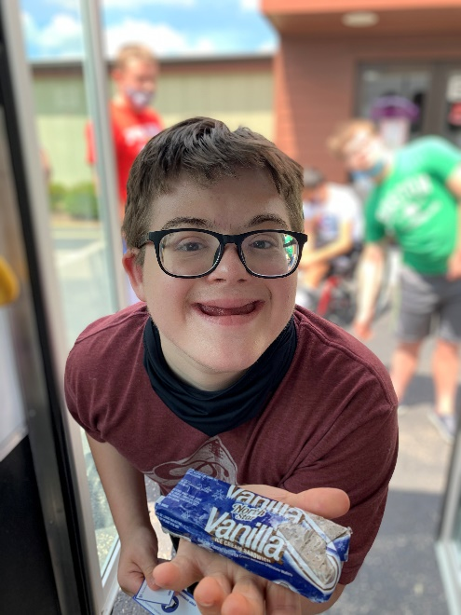
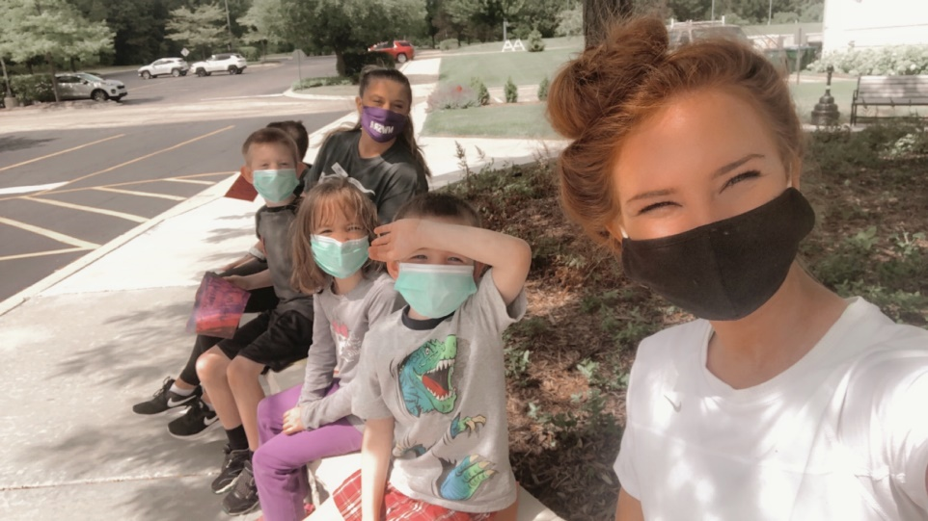
Day Camp
COVID day camp offerings:
8 Camp Locations with in 17 member district
8 camper max per site with 2 Full Time staff
All participants had to pass an assessment to ensure social distancing
All participants must wear a mask indoors or when not able to maintain 6 feet distance outside
Notes:
Tracey
Insert pictures with masks

Slide 20
Additional Services
Mailed/delivered variety of Activity Boxes
Curbside Bus Visits to residents
Online Activity Center
Mailed/delivered Activity Packets
Full Time Staff Recipe Book (online and print versions)
Weekly 1:1 Wellness Check-ins
Fitness Zoom/ Phone Calls
Return to program resource area
Creation of individualized behavior management plans
Notes:
Tracey

Slide 21
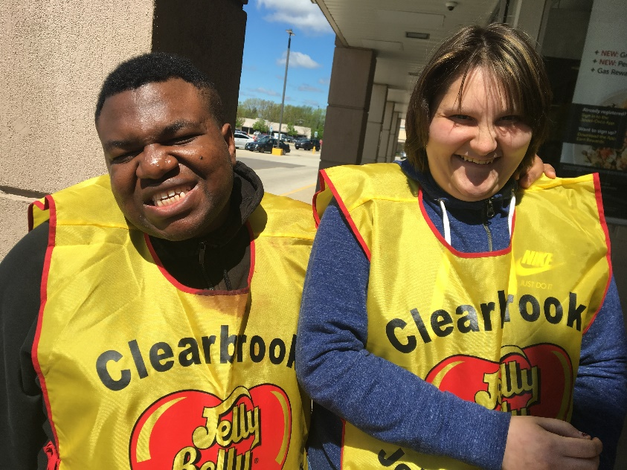
Additional Services (continued)
Inclusion Services: hours at sites
360 &
33 new families
Wellness Check Ins:
1739 calls made & 4276 minutes
Individual Tours of PURSUIT, Snoezelen and Dream Lab: 299 (In Person and Virtual)
Notes:
Tracey

Slide 22
Notes:
Brian

Slide 23
Marketing Efforts
New Publications
Social Media
Facebook increase of over 1,100 followers
Over 690 minutes of viewership/month on Youtube page
Approximately 2,700 visits through Google Search per month
Online/Mobile:
Additional Marketing
Monthly Virtual Programming Brochures
Over 5,200 impressions through Twitter per month
1,400 installs of NWSRA mobile app
New Videos:
They Need Us, and We Need You- SLSF videos
Constant Contact-6,719 contacts
Designs and posters at Buffalo Grove and Wheeling Programming spaces
Monthly In Person Programming Brochures
Delicious Dishes Recipe Book
NWSRA Activity Packet
New Special Event marketing materials (Trunk or Treat, Zurich Fun Fair, Talent Show, etc.)
Online Coronavirus Centers for Board and Public
Online Activity Center
Monthly Virtual Programming
Implementation of various new online registration forms (fillable and online)
New SLSF fundraising events (Trivia Night, High 5 Challenge, etc.)
High 5 Challenge videos
Celebrate Ability Virtual Gala videos
New programming space tours- Dream Lab, Snoezelen Mt. Prospect, Buffalo Grove and Wheeling Programming spaces
NWSRA Virtual Programming video
Gold Medal Fashion Show video
Featured on PBS American Portrait- 30th Anniversary of ADA
Featured in IAPD/IPRA Parks and Recreation Magazine- Taking the Digital Leap
Received three awards from ATRA: Organization/Institution Citation, Individual Citation and Certificate of Recognition
Instagram increase of over 300 followers
Leisure Education video
Notes:
Brian

Slide 24
Outreach 49 new families registered
Cooperative programs and services hosted with:
Amita Health
Buffalo Grove Park District - Broadway Buddies
Sibshops
Chicago District Golf Association (CDGA)
River Trails OCR
Clearbrook
Prospect Music LLC
Increased recognition among community organizations through:
Attendance at 18 expos and events and 5 large community presentations, 1500 impressions
Website linking
Cross promotion of services and events
Inclusion trainings- 79 individuals at 5 Park Districts
Ability awareness events- 96 Preschools and 1 Park District
Tours of PURSUIT, STAR Academy and Snoezelen Sensory rooms- 299 individuals
Staff attended meetings with PATHS-NSSEO, Northwest Suburban Autism Consortium, City of Support, North/Northwest Lake County Work Group
Notes:
Brian

Slide 25
Outreach (continued)
Partnered with local School Districts and Libraries through:
Website linking
Electronic backpacks
Inclusion in e-newsletters
Delivery of paper brochures and online brochures
Staff provided trainings at:
Connecting our Community
IPRA Conference
ATRA Conference
ITRS Young Professionals Group
Notes:
Brian

Slide 26
Technology
Wheeling and Buffalo Grove Programming Spaces Installed with televisions, computer labs, WiFi, printing and scanning, wired and wireless telephones and remote access capabilities
Installed new copiers- saving 40% on toner costs moving forward
New switches, computers, printers, iPads, wireless access points and other hardware installed
Hosted ADA accessibility trainings with Promet for Park Districts
Finalization of CiviCRM database and staff training
Firewalls updated to latest standards
Enhanced remote access capabilities due to COVID-19
Notes:
Brian

Slide 27
New Virtual fundraising events promoted
Bi-monthly SLSF Impact e-newsletter now reaching over 6,700 individuals
SLSF Education Corner- education for Board Members on giving initiatives
Enhanced print and online newspaper presence
New SLSF Event Videos created
SLSF event online calendar submissions
New stories web page focusing on participants
New Spring and Annual Appeals
Updated event print materials
Notes:
Brian

Slide 28
Notes:
Brian

Slide 29
$80,312.13 - Accessible Transportation
$8,000 - Athletics
$15,500 - Inclusion
$15,611.80 - Scholarships
$82,754.39 - General Programming
Purchased furniture for the NWSRA Programming Space at Buffalo Grove
Provided the necessary funds to complete the Sensory Garden at Hanover Park Park District
Completed 3rd year of 2018-2020 Development Plan
Notes:
Brian

Slide 30
Notes:
Brian

Slide 31
Hosted 5 out 6 golf outing events
57 NWSRA Families donated their program credits to SLSF
Successfully hosted the Celebrate Ability Virtual Gala
Created Additional Fundraising Initiatives
Increased Social Media Presence
Received over 71% of grants submitted
Notes:
Brian

Slide 32
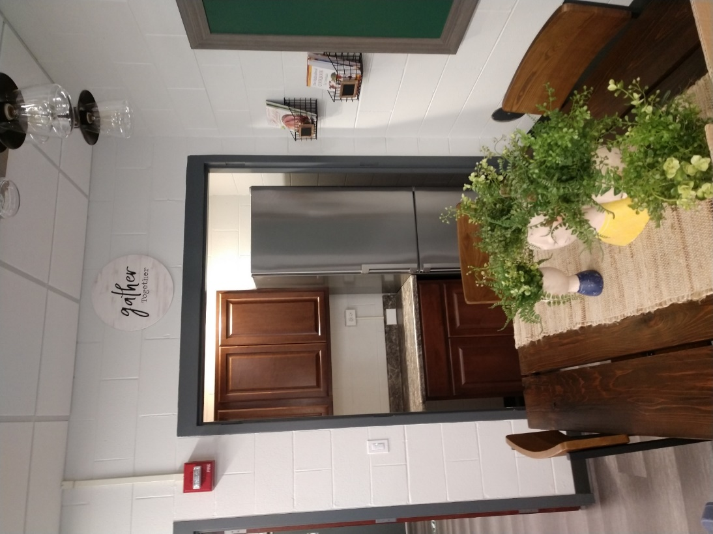
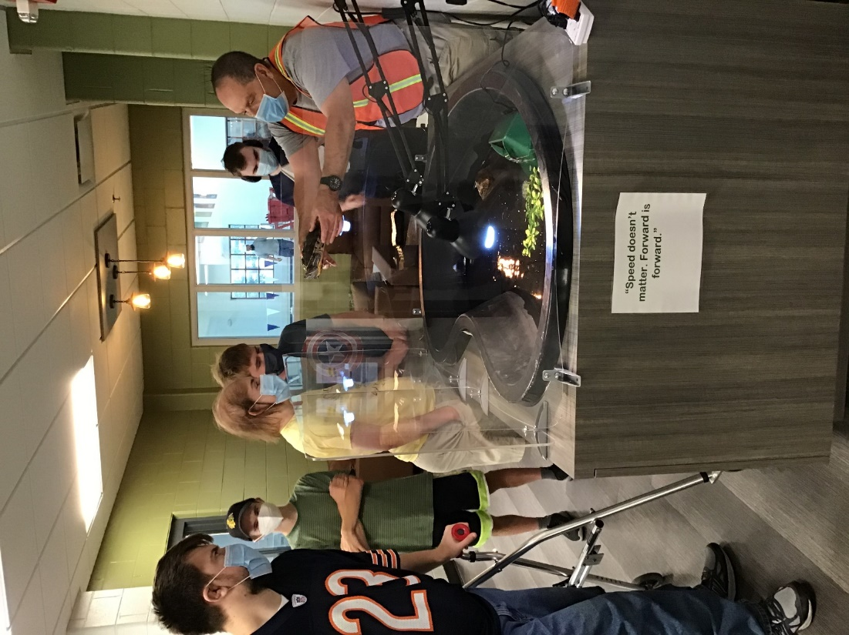
Wheeling Programming Space Opened
Notes:
Tracey

Slide 33
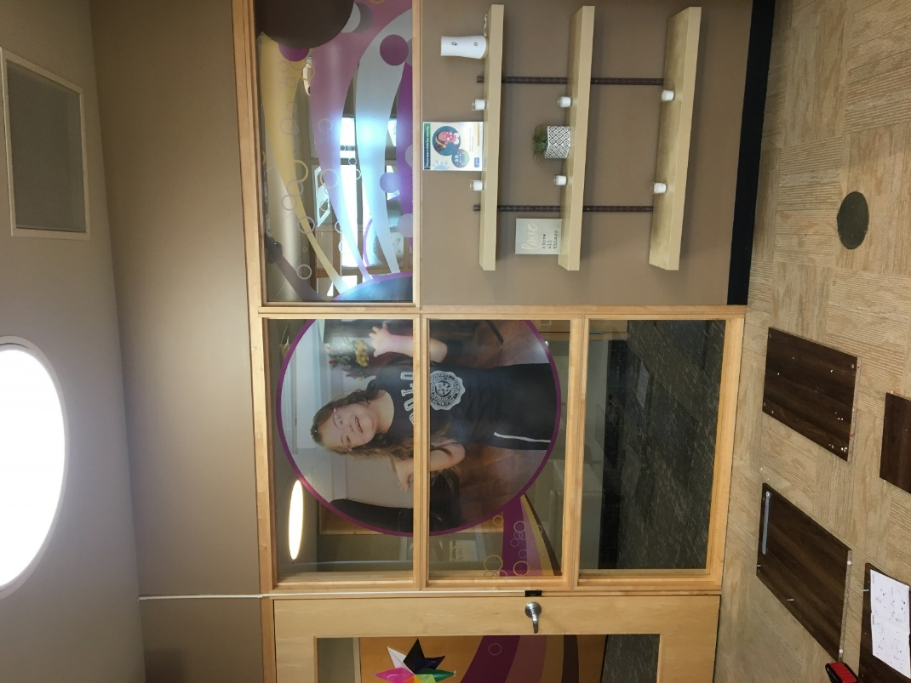
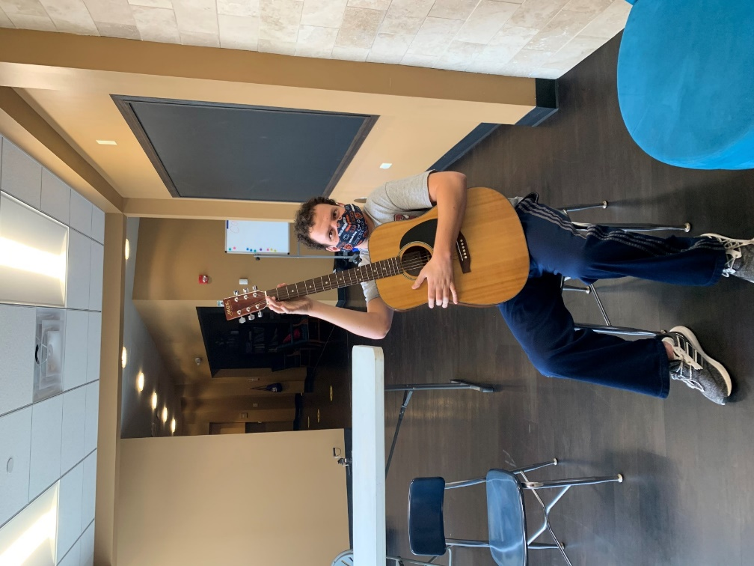
Buffalo Grove Programming Space Opened
Notes:
Tracey

Slide 34
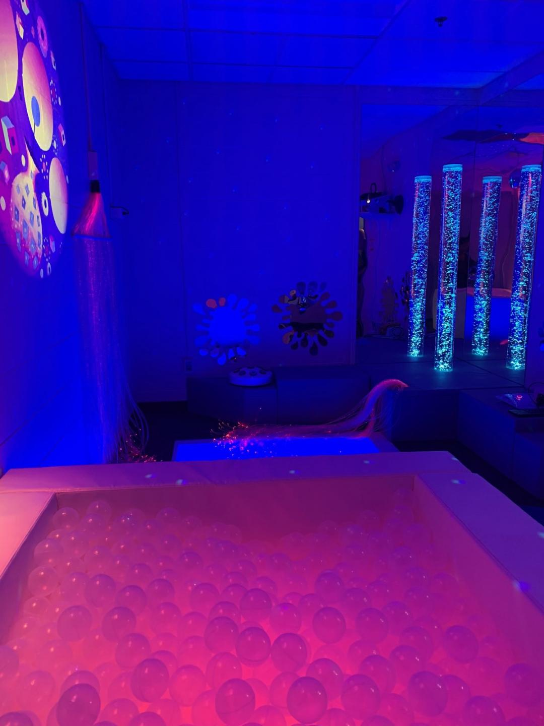
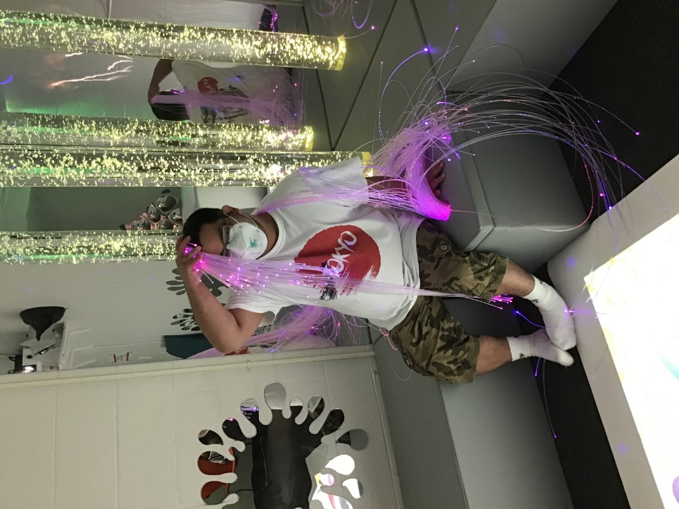
Mt Prospect Snoezelen Room Opened
Notes:
Tracey

Slide 35
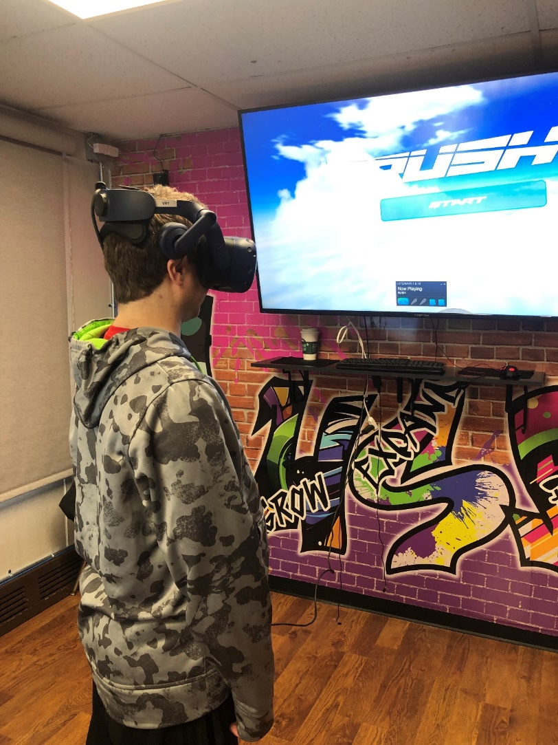
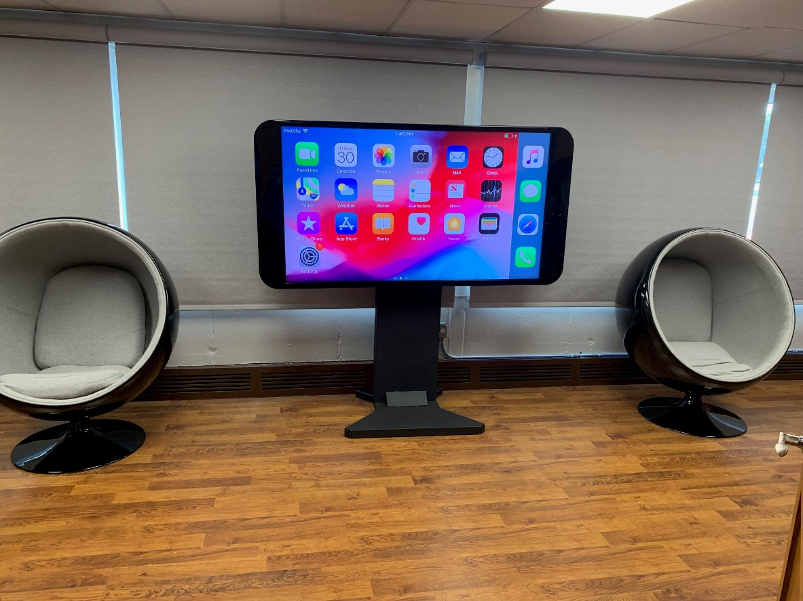
Dream Lab Accessible Technology Center Opened
Notes:
Tracey

Slide 36
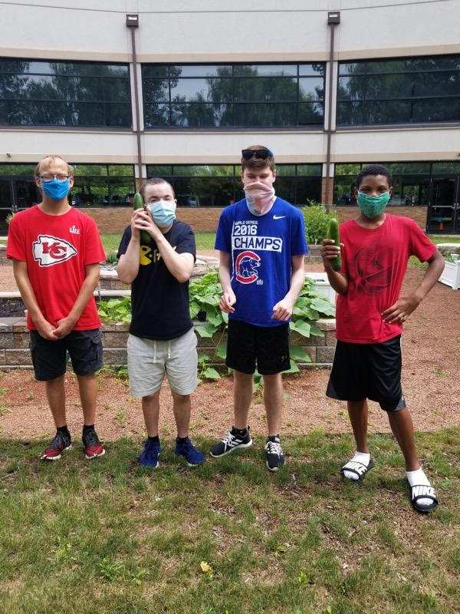
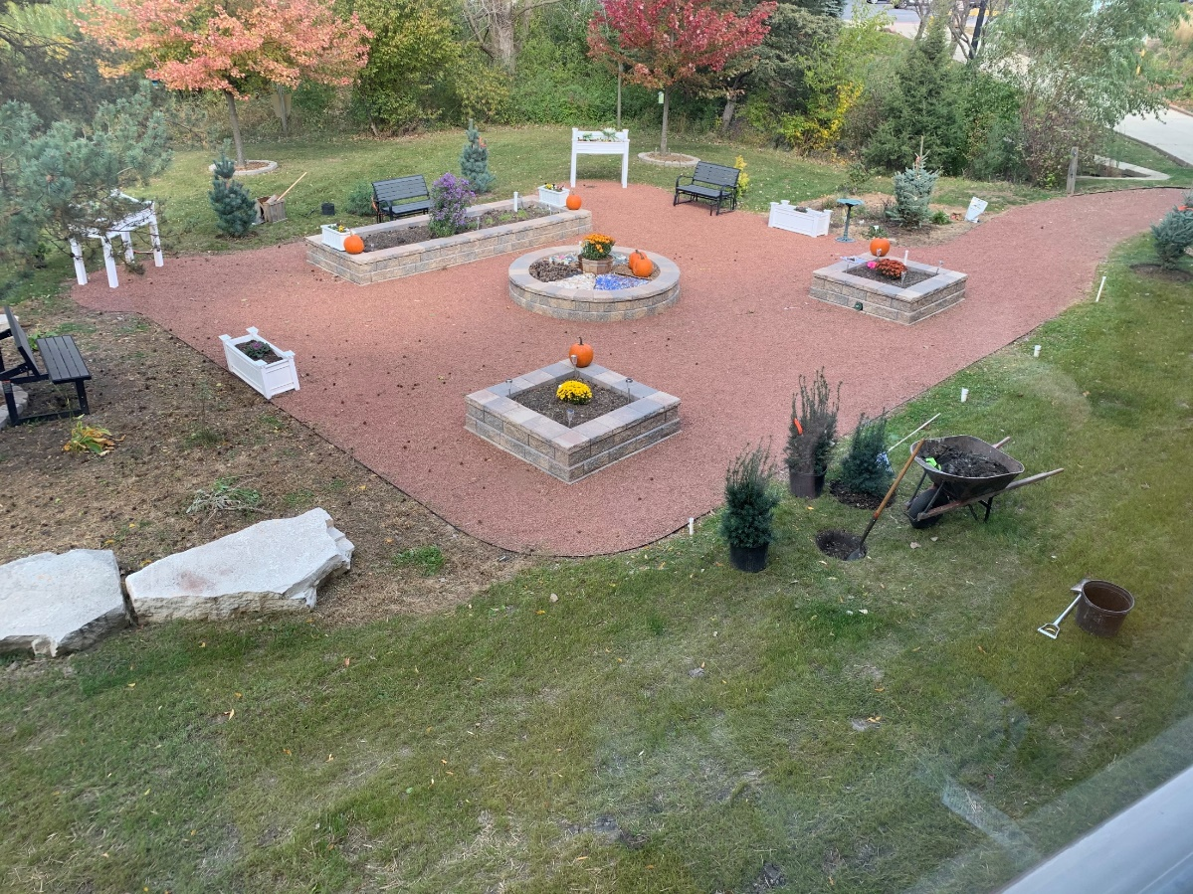
Community Sensory Garden Opened
Notes:
Tracey

Slide 37
2021 Goals
Notes:
Tracey

Slide 38
Programming
Create more opportunities for siblings through training and leading of Sibshops
Analyze offerings and participation to identify emerging needs and direction for future growth
Transportation feasibility study
Investigate, research and define senior programs
Define regional programming opportunities in conjunction with transportation hub system
Notes:
Tracey

Slide 39
Marketing & IT
Build brand awareness in the community and with our member districts and establish marketing minded leadership within the NWSRA staff.
Ensure functionality and enhance efficiency of work systems through effective, networked IT solutions.
Notes:
Brian

Slide 40
Outreach
Utilize information gathered to expand collaborative opportunities and partnerships
Target new opportunities for expos/presentations and other vehicles for outreach
Notes:
Brian

Slide 41
Supervision/Management/HR
Focus on retention of Recreation Team.
Review the professional development opportunities for current FT employees to continue growth in preparation of potential advancement opportunities
Build training to enhance and improve
PT employee skills
Offer new and innovative training opportunities through collaboration with other community agencies
Enhance two-way communication and identify necessary areas for growth and change through internal feedback efforts (full-time & part-time employees, volunteers).
Notes:
Tracey

Slide 42
Recruitment
Focus on enhancing our presence in the community to recruit employees for all programs
Increase our footprint on Social Media to enhance varies ways to recruit younger employees
Notes:
Brian

Slide 43
Training and Certifications
Provide professional development opportunities for all full time employees who have remained at NWSRA for over one year
Include topics required by Distinguished Accreditation and PDRMA standards.
Manage the certification (*CTRS, CPRP, QIDP) requirements of all eligible full time employees.
Notes:
Tracey

Slide 44
NWSRA 2020 Revenue and Expense Analysis
Notes:
Tracey

Slide 45
Notes:
Tracey

Slide 46
Notes:
Tracey

Slide 47
Planning Ahead
Strategic Planning
Implement action steps according to 2017-2021 Comprehensive Strategic Plan for 2021
Programming
Create Transportation Hub System and guidelines for Door-to-Door Transportation
Expansion of NWSRA Programming Spaces
Researching NWSRA programming Space in Hoffman Estates
Exploring senior programming options
Distinguished Agency
Prepare for Distinguished Agency Accreditation process to take place in 2021
Develop Comprehensive Strategic Plan for 2022-2026
Notes:
Tracey

