Slide 1
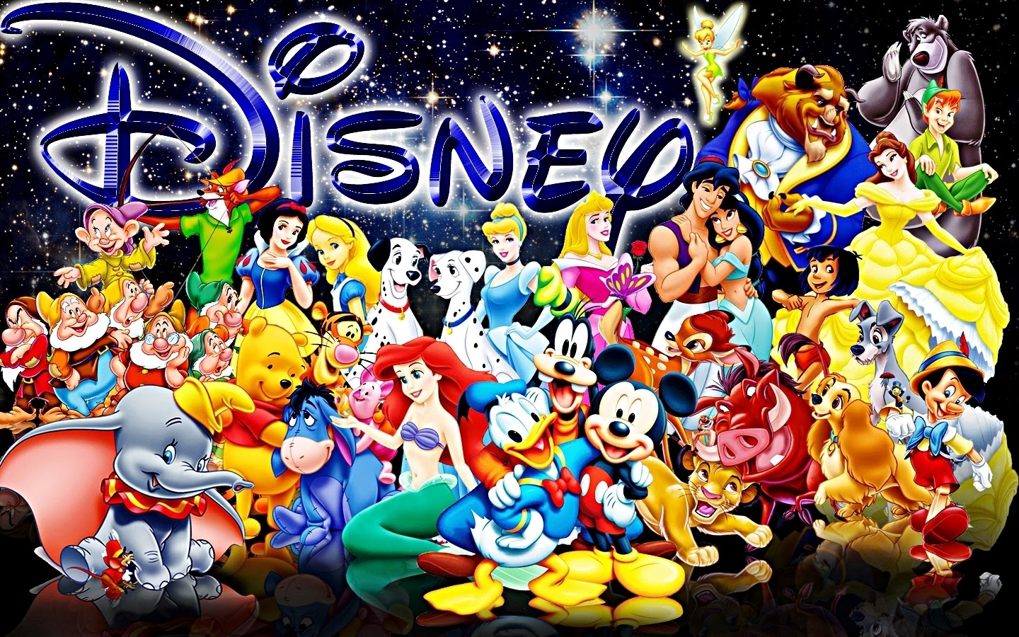
Welcome to Disney Trivia

Slide 2
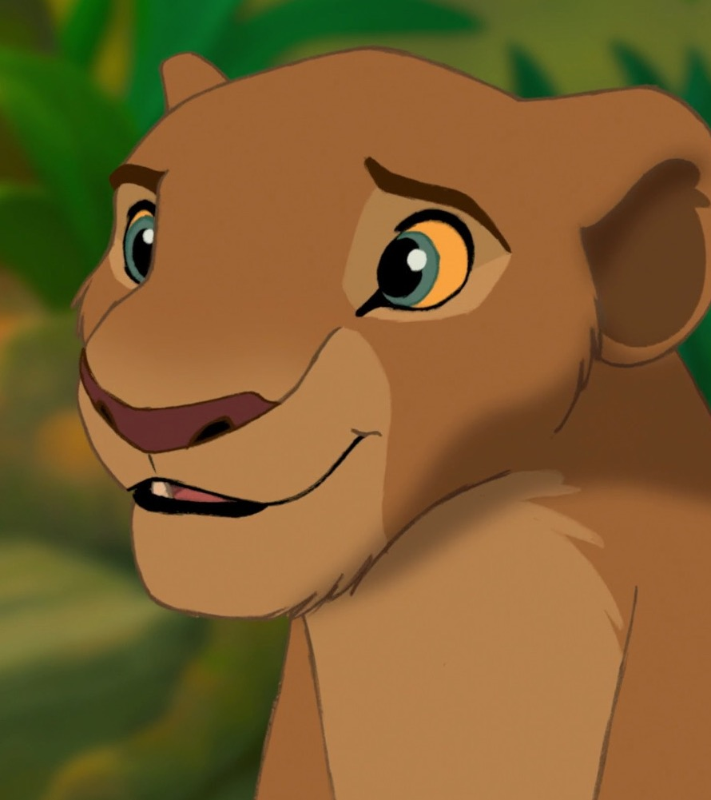
What is Simba’s mother’s name?
Nala
Sarabi
OR

Slide 3
Sarabi is Simba Mother

Slide 4
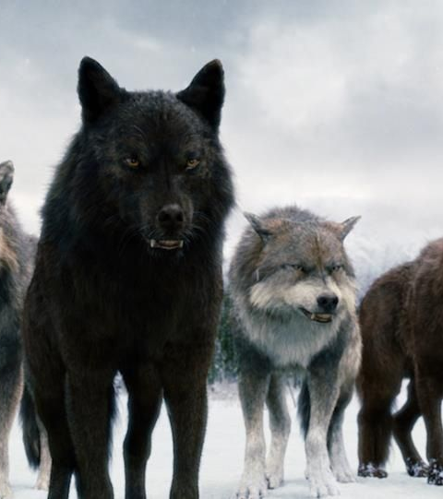
What animal was Tarzan raised by?
Wolves
Gorillas

Slide 5
Raised by Gorillas

Slide 6
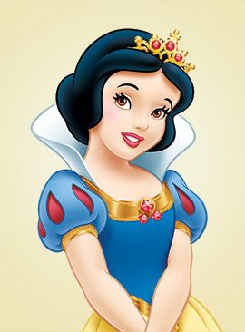
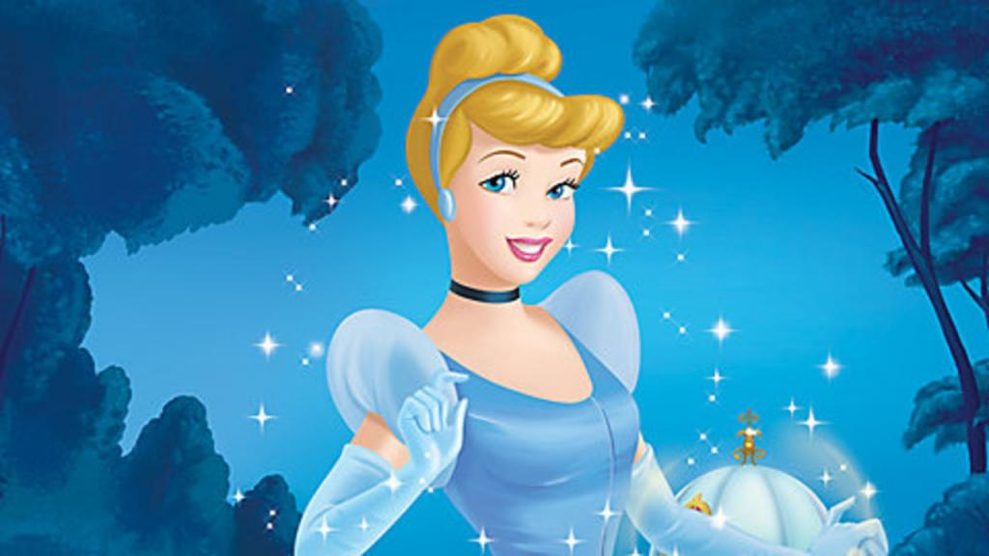
Who was the first Disney princess?
Snow White
Cinderella

Slide 7
Snow White was the first Disney Princess

Slide 8
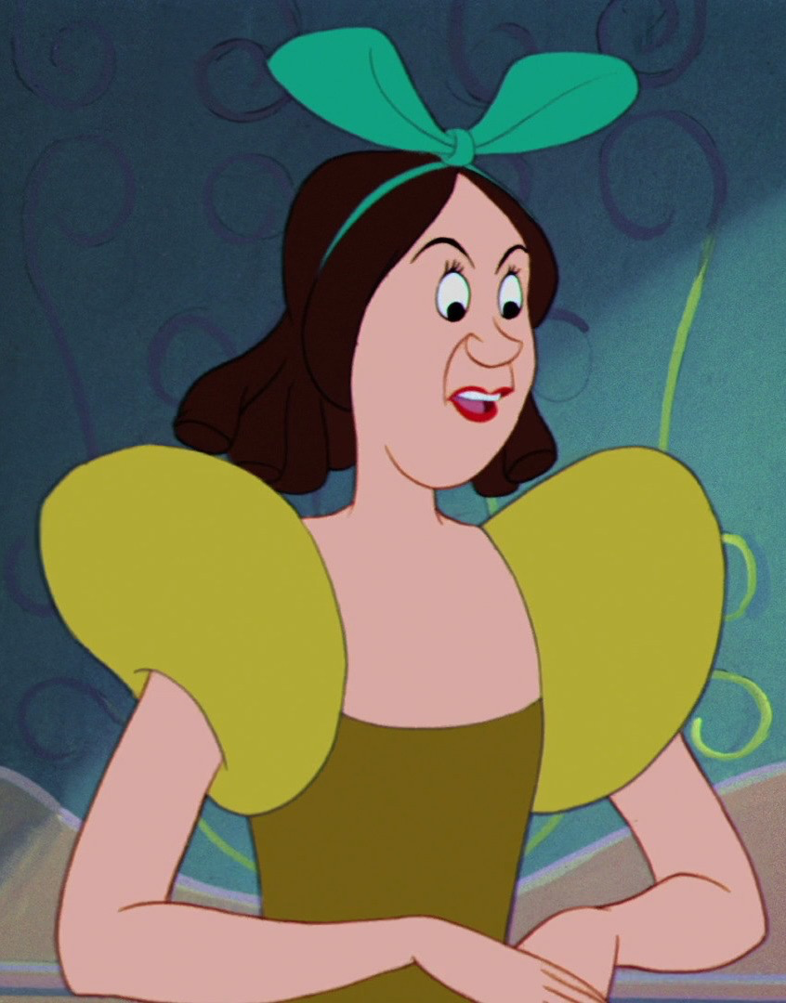
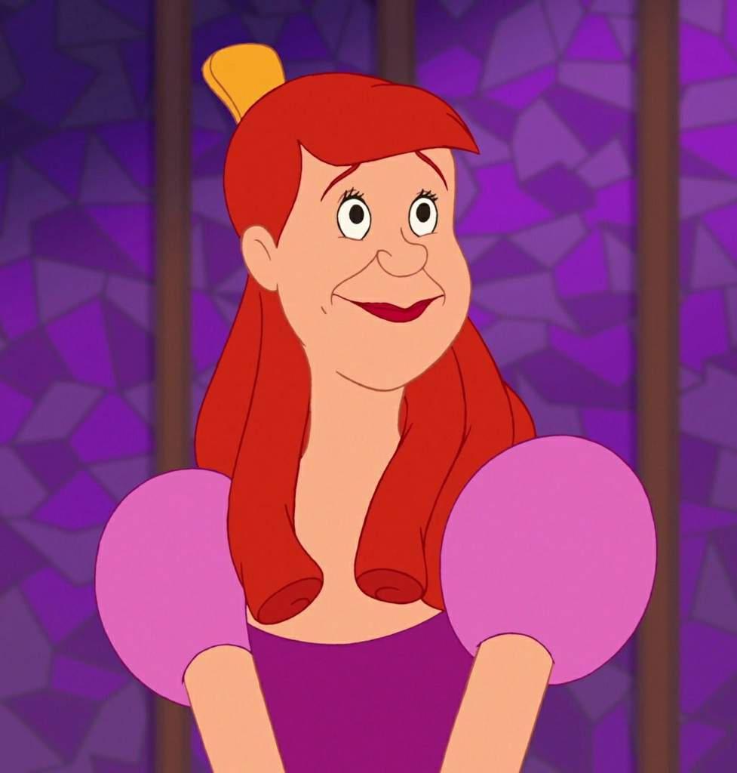
What are the names of Cinderella’s evil stepsisters?
Anastasia and Drizella
OR
Beatrice and Daphine

Slide 9
Anastasia and Drizella are the names of Cinderella Stepsisters

Slide 10
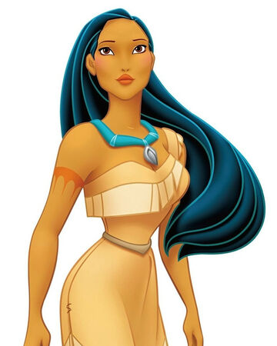
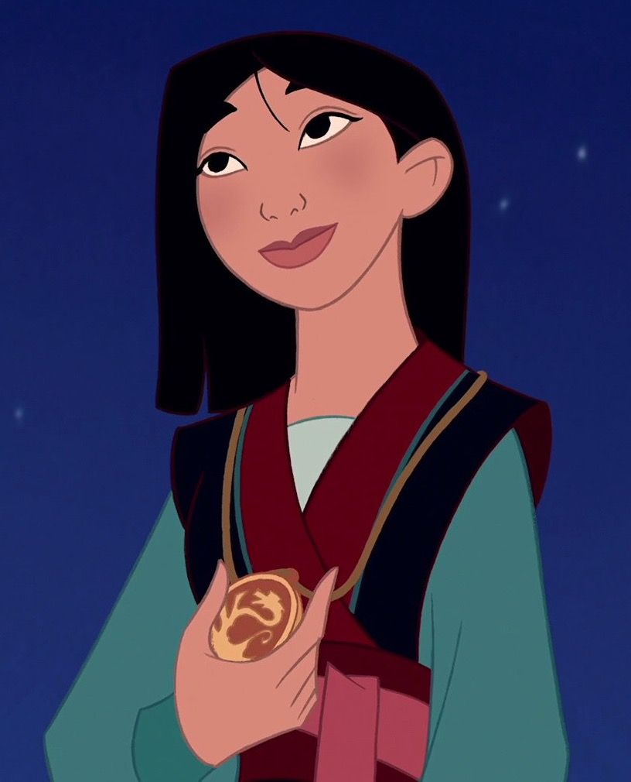
Which official Disney Princesses is not actually a princess?
Mulan
OR
Pocahontas

Slide 11
Mulan is not an official Disney princess

Slide 12
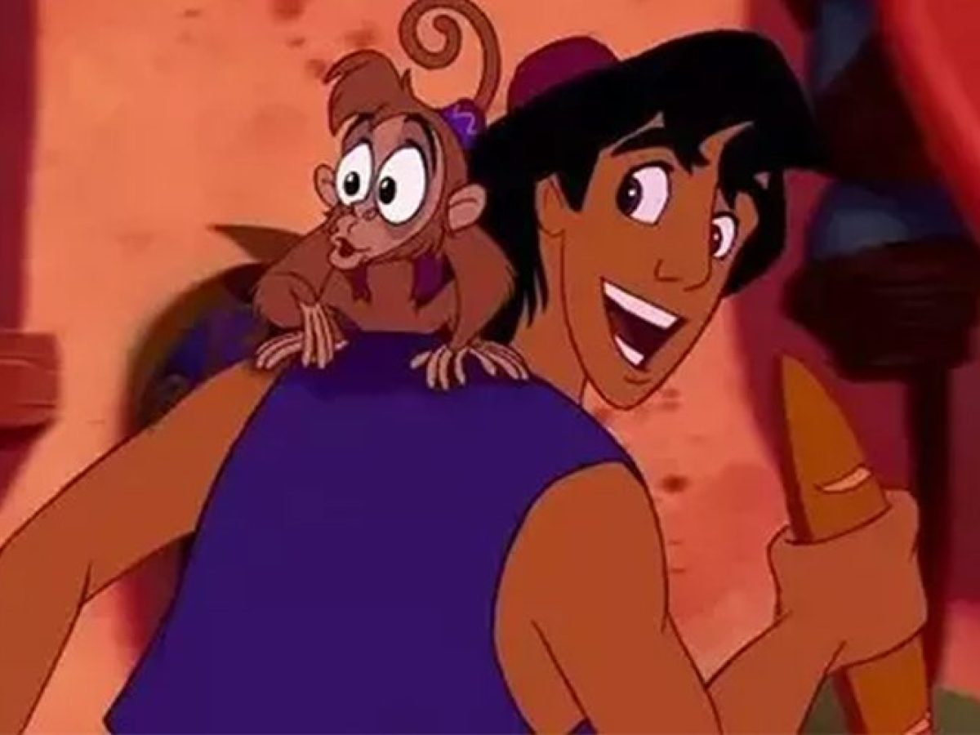
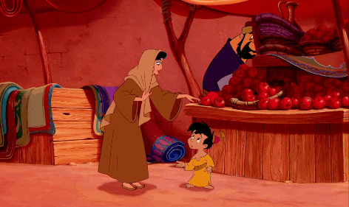
What do Aladdin and his monkey Abu steal from the marketplace when you’re first introduced to them in the movie?
A Loaf of bread
OR
An Apple

Slide 13
Aladdin took a loaf of bread

Slide 14
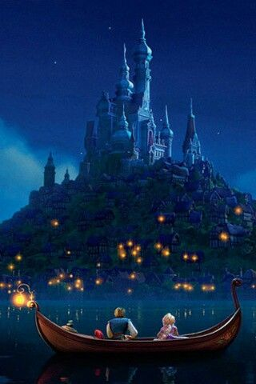
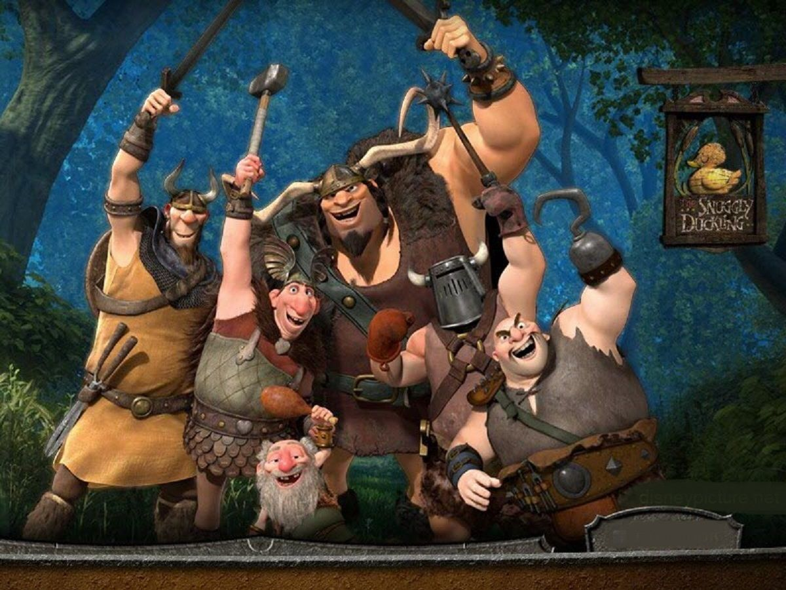
What is the name of the pub that Flynn brings Rapunzel to in “Tangled?”
The Snuggly Duckling
OR
Gothel’s Pub

Slide 15
The Snuggly Duckling

Slide 16
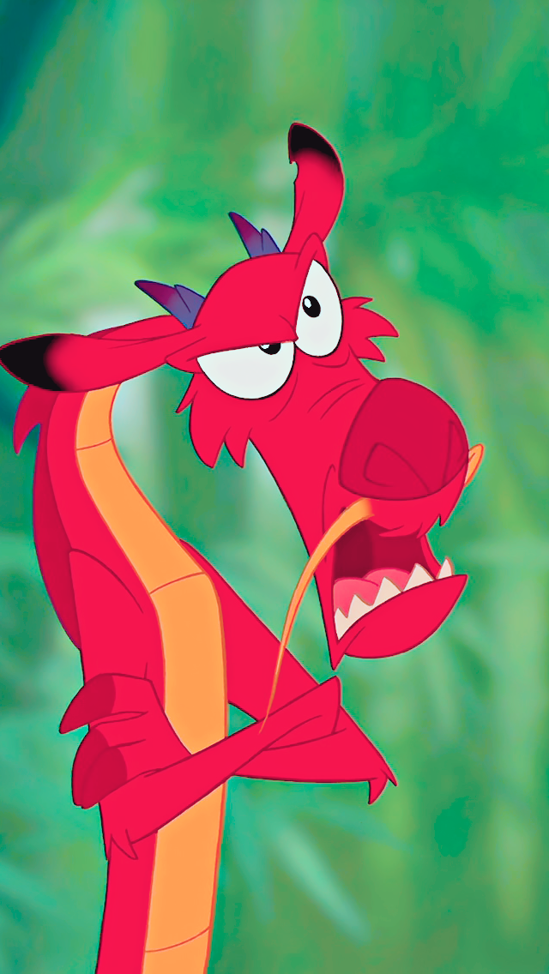
What is the name of Mulan’s pet dragon?
Mushu
OR
Chim Poe

Slide 17
Mulan pet dragon name is Mushu

Slide 18
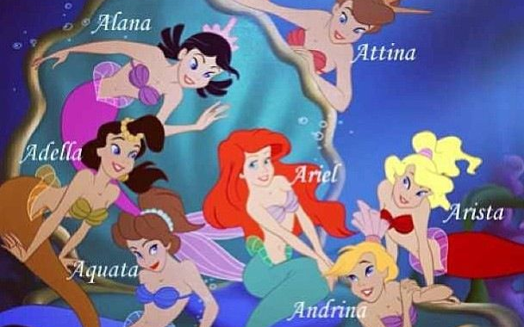
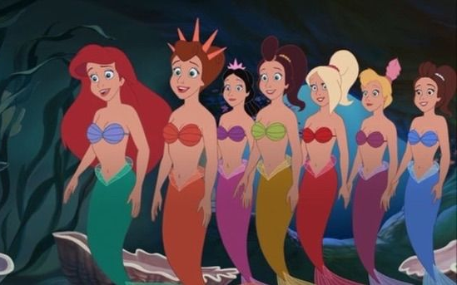
How many sisters does Ariel have?
Six
OR
Seven

Slide 19
Ariel has 6 sisters

Slide 20
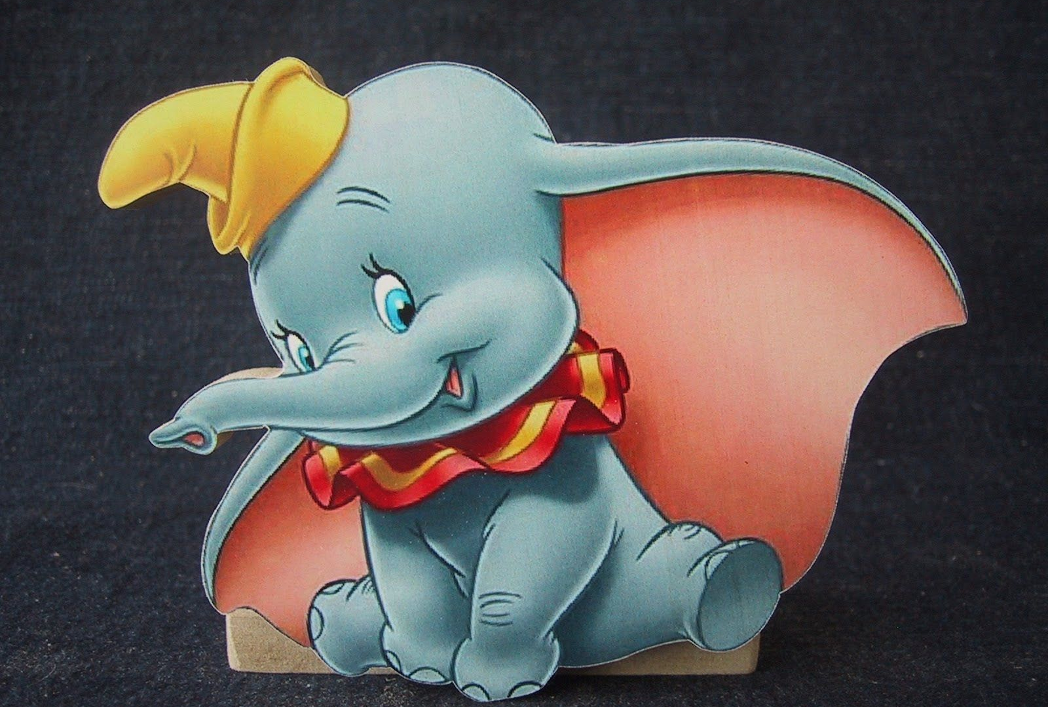
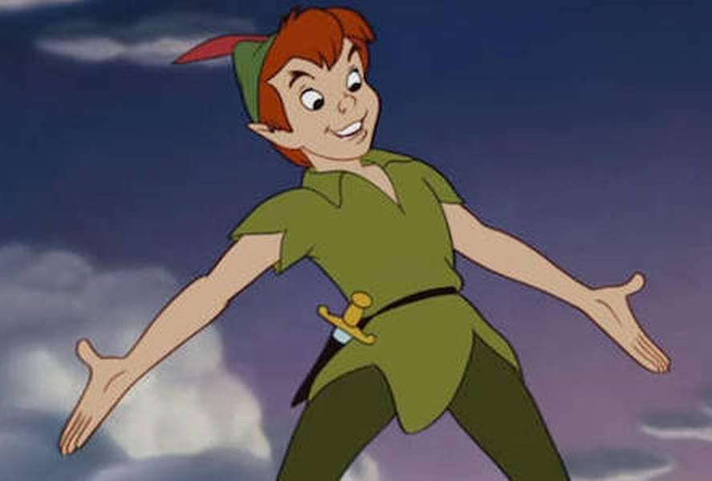
“You can fly” a famous song belongs to which movie?
Peter Pan
OR
Dumbo

Slide 21
“You Can Fly” is with Peter Pan Movie

Slide 22
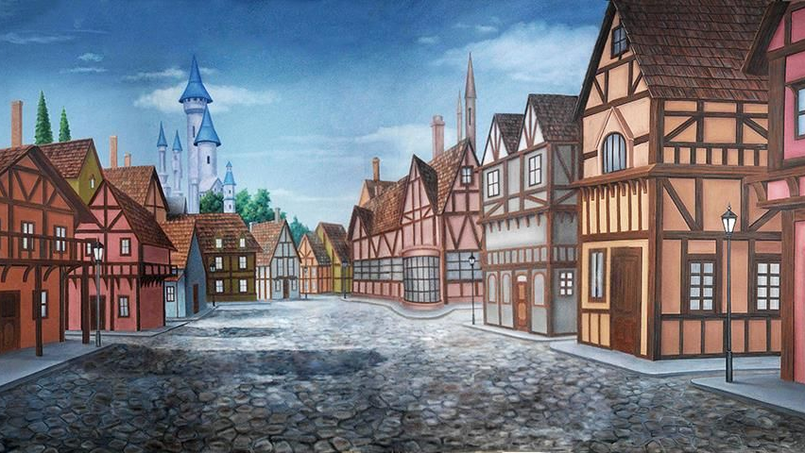
Belle belongs from which country in Beauty and the Beast?
France
OR
Ireland

Slide 23
Beauty and the Beast is filmed in France

Slide 24
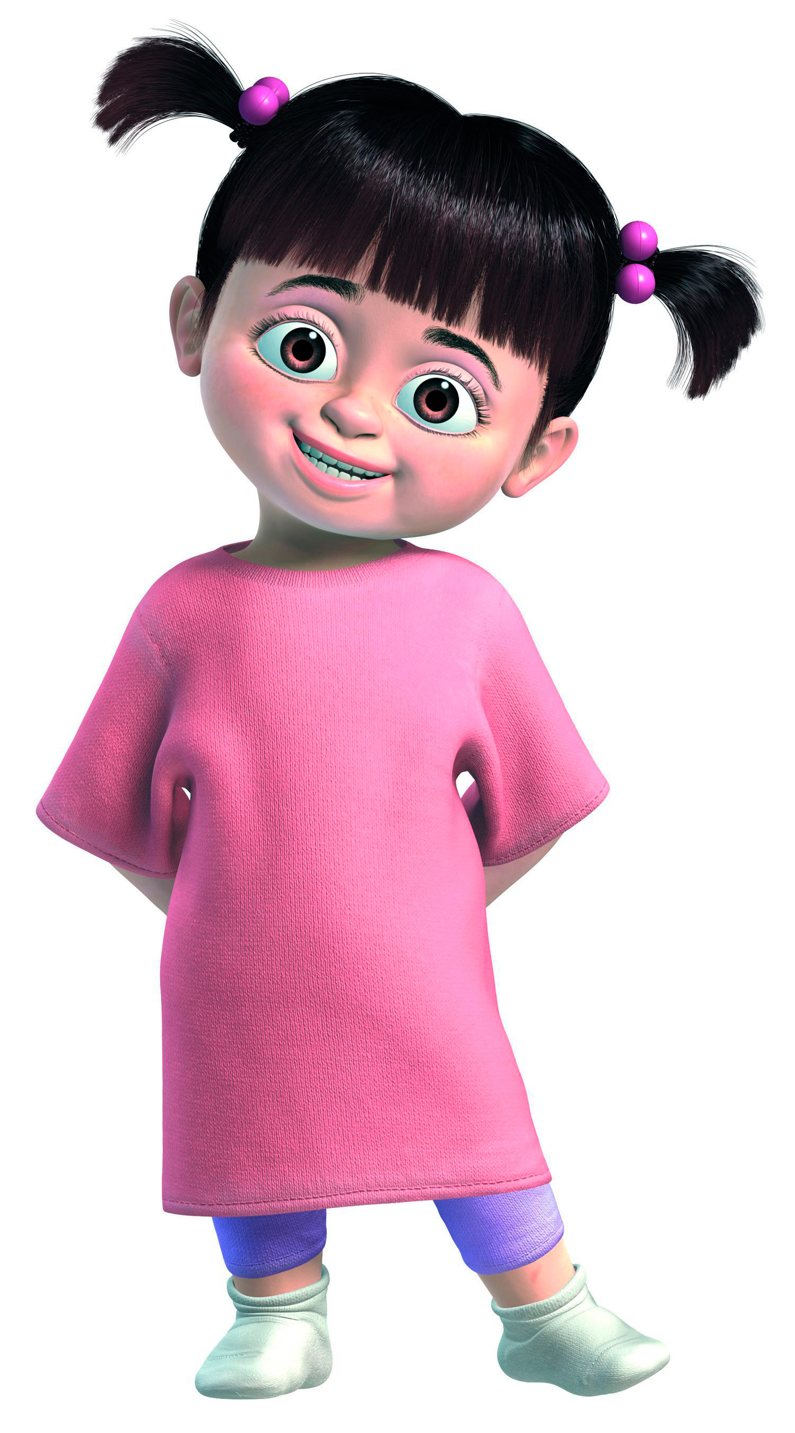
What is Boo real name?
Mary
OR
Sarah

Slide 25
Boo real name is Mary

Slide 26
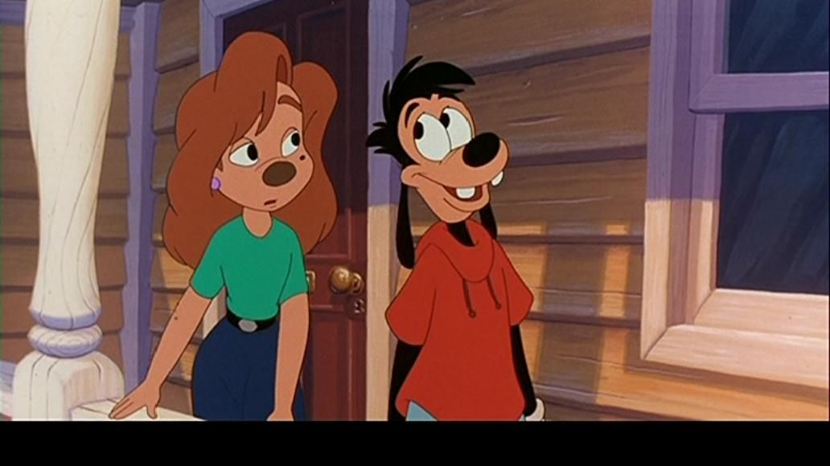
What is the name of the girl Max was in love with in A Goofy Movie?
Roxanne
Or
Jazmine

Slide 27
Roxanne is the girl Max is in love with

Slide 28
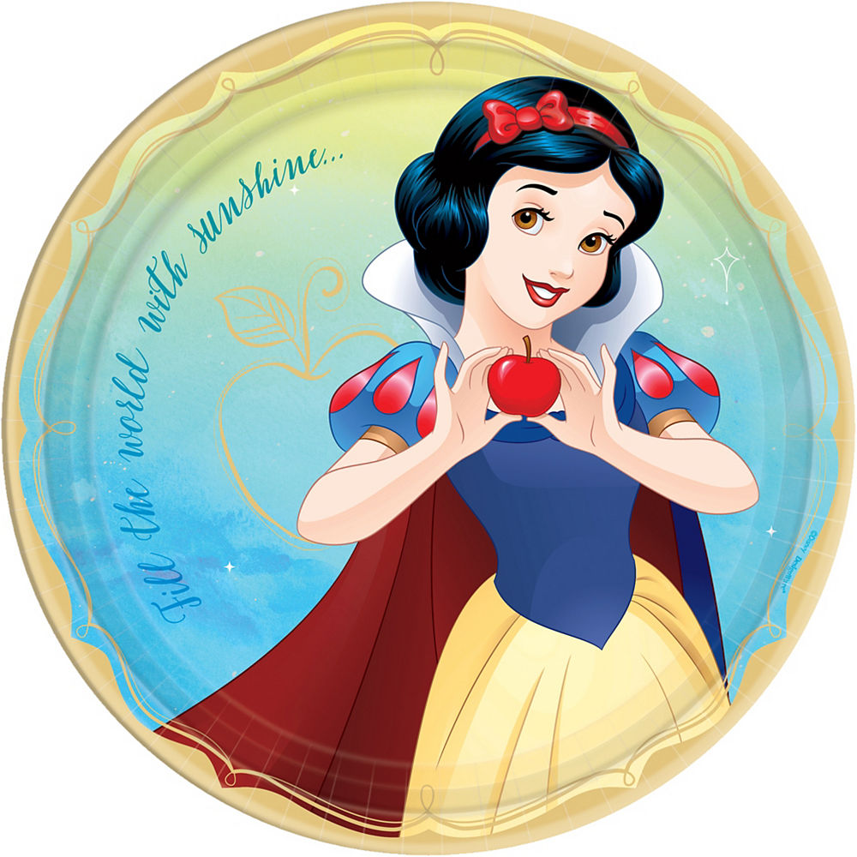
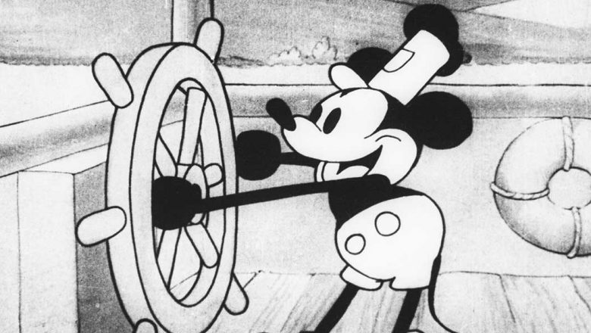
What was the first film ever created by Disney?
Steamboat Willie
Or
Snow White

Slide 29
Steamboat Willie

Slide 30
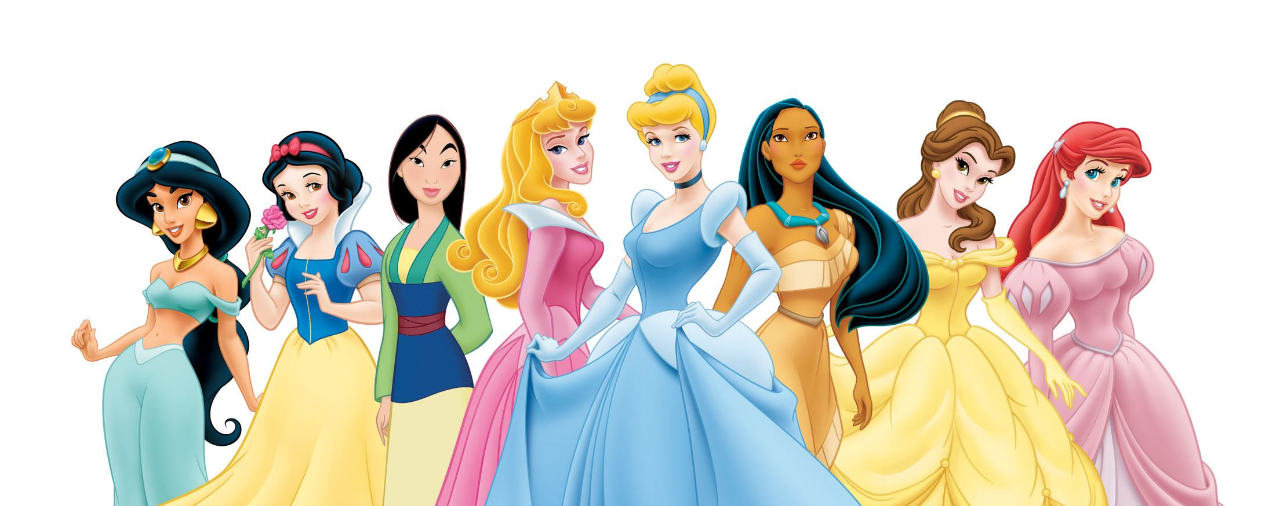
Who is the youngest Disney princess?
Jazmin
Snow White
Mulan
Aurora
E. Cinderella
F. Pocahontas
G. Belle
H. Ariel

Slide 31
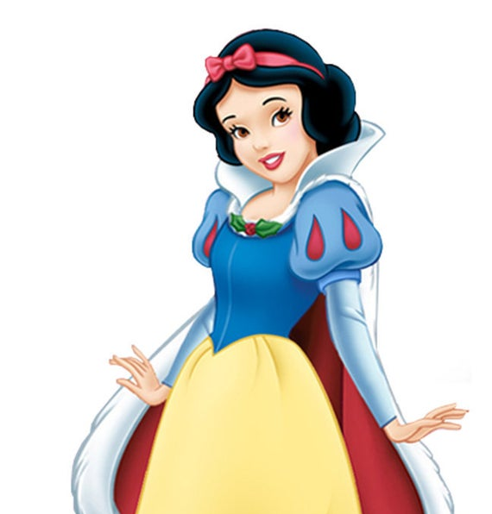
Snow White is the youngest princess

Slide 32
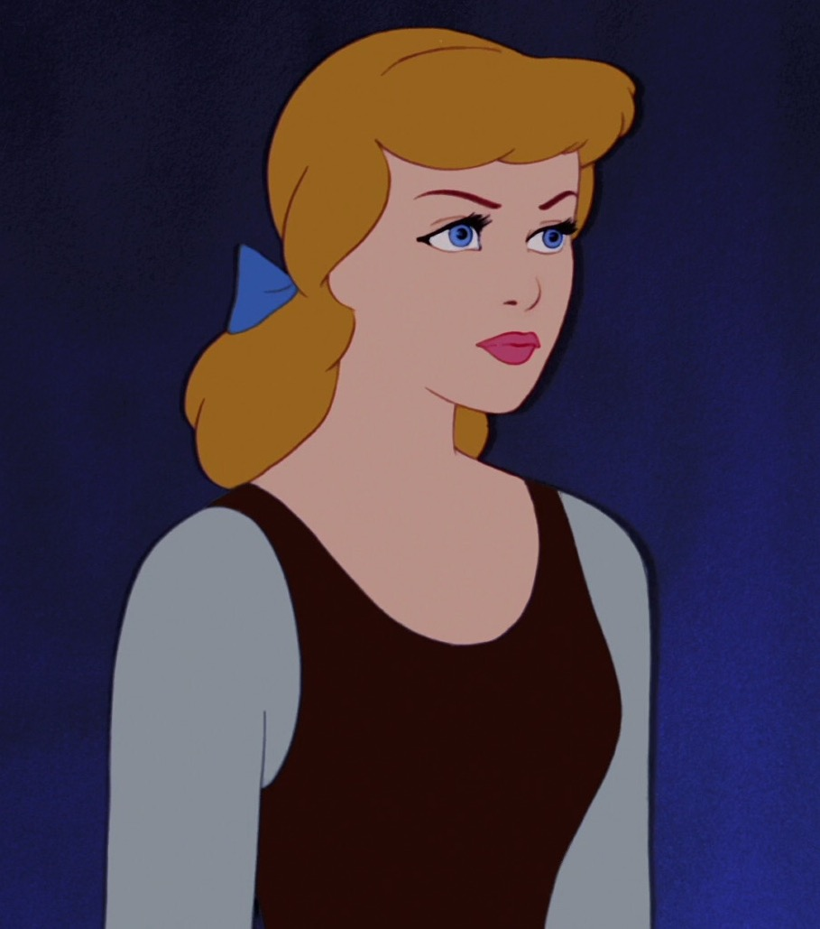
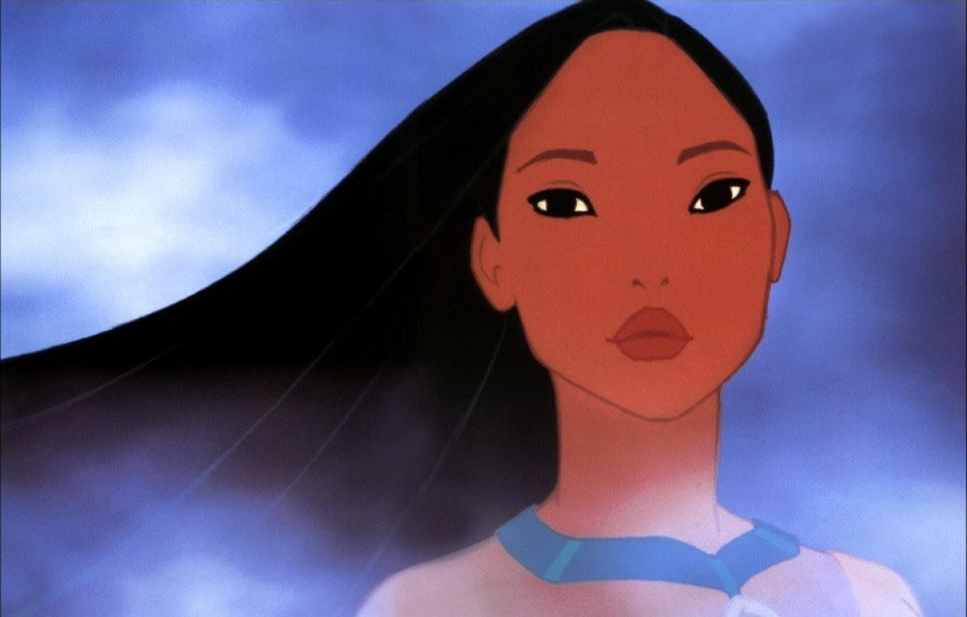
Which Disney princess is based on a real person?
Pocahontas
OR
Cinderella

Slide 33
Pocahontas is based on a real person

Slide 34
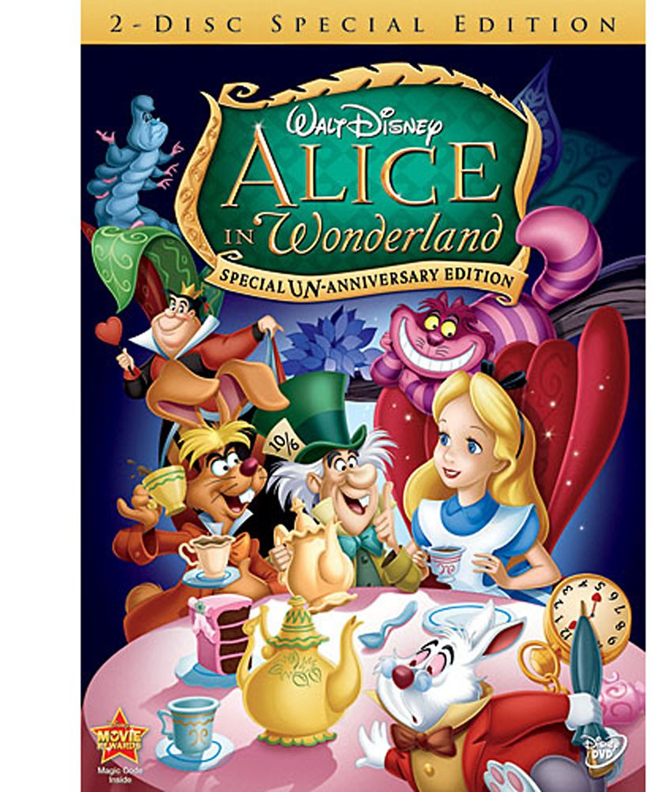
The first Disney movie that won the Oscar award for best picture?
Alice in Wonderland
OR
Beauty and the Beast

Slide 35
Beauty and the Beast was the first aminated for best picture

Slide 36
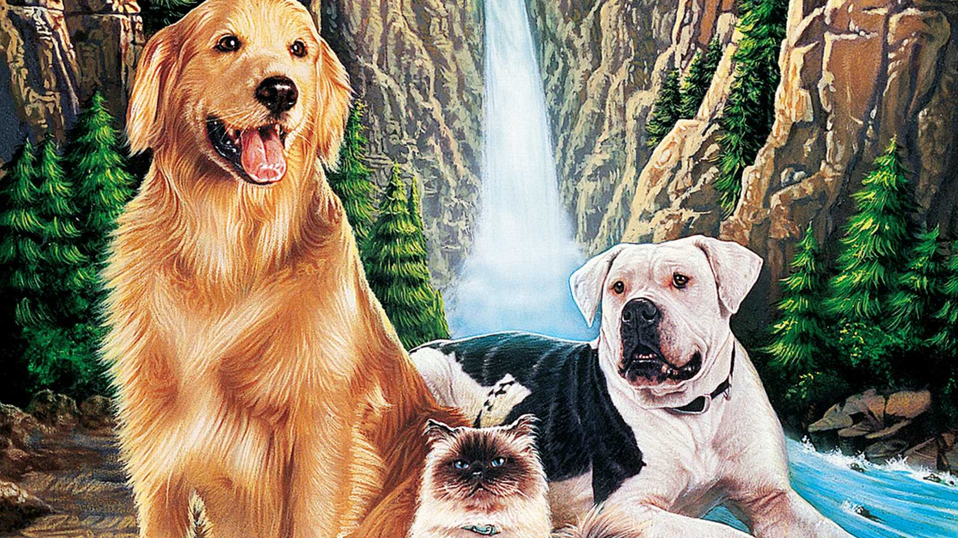
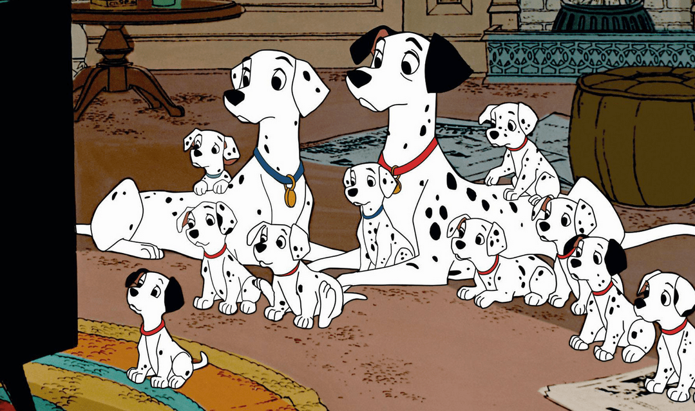
There are 69,952 black spots in this movie. Yes someone counted them all.
101 Dalmatians
OR
Homeward Bound

Slide 37
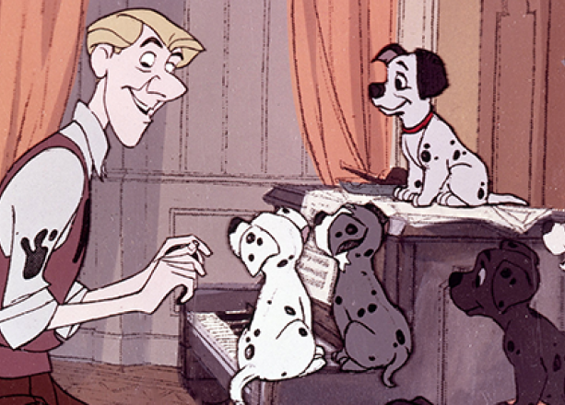
101 Dalmatians

Slide 38
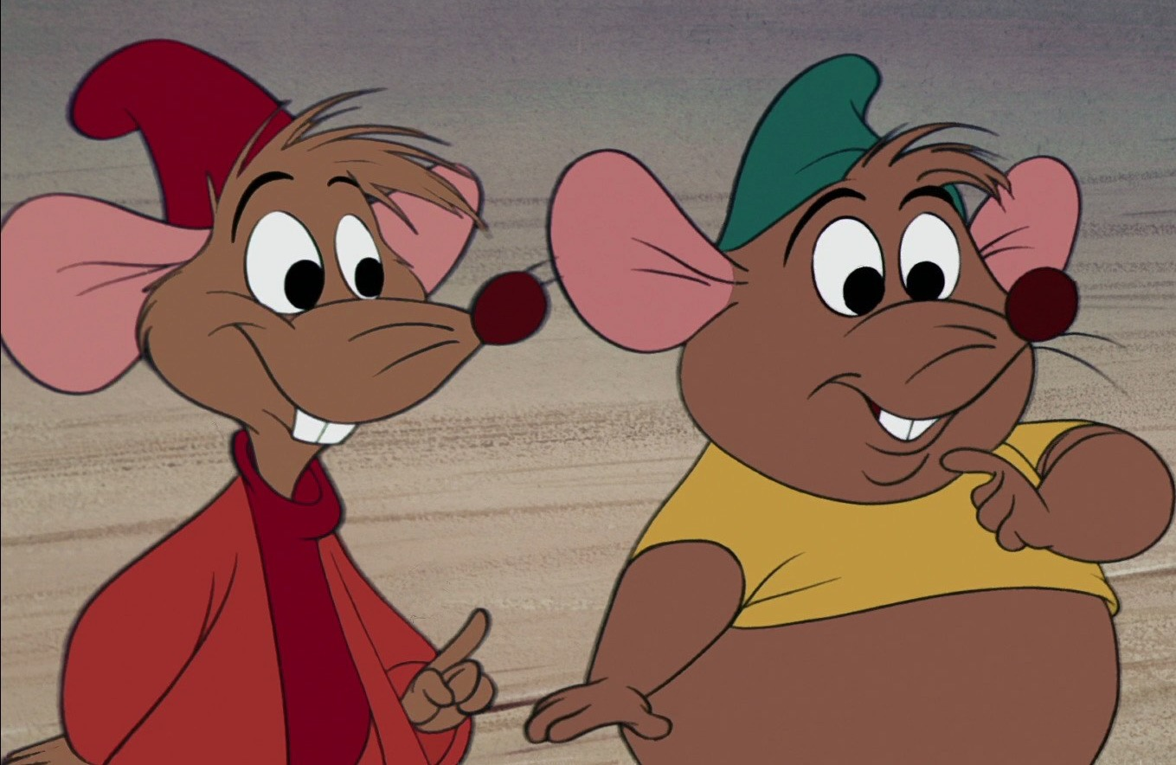
What Disney movie would you find the mischievous duo, Jack and Gus?
Cinderella
OR
The American Tail

Slide 39
Jack and Gus are in Cinderella

Slide 40
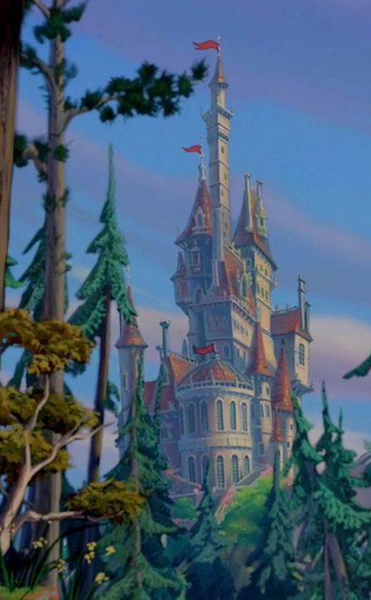
How long has the curse been over the castle in Beauty and the Beast?
10 years
OR
15 years

Slide 41
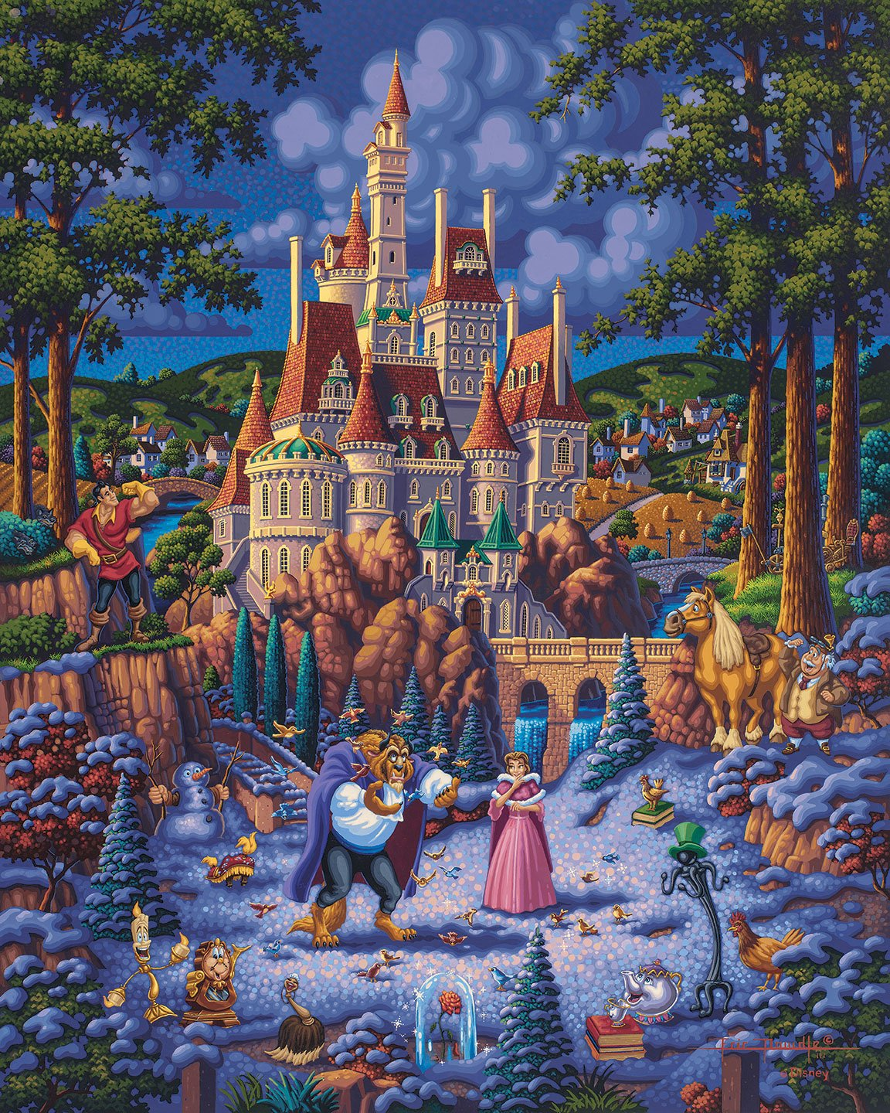
10 years since the house has been under curse

Slide 42
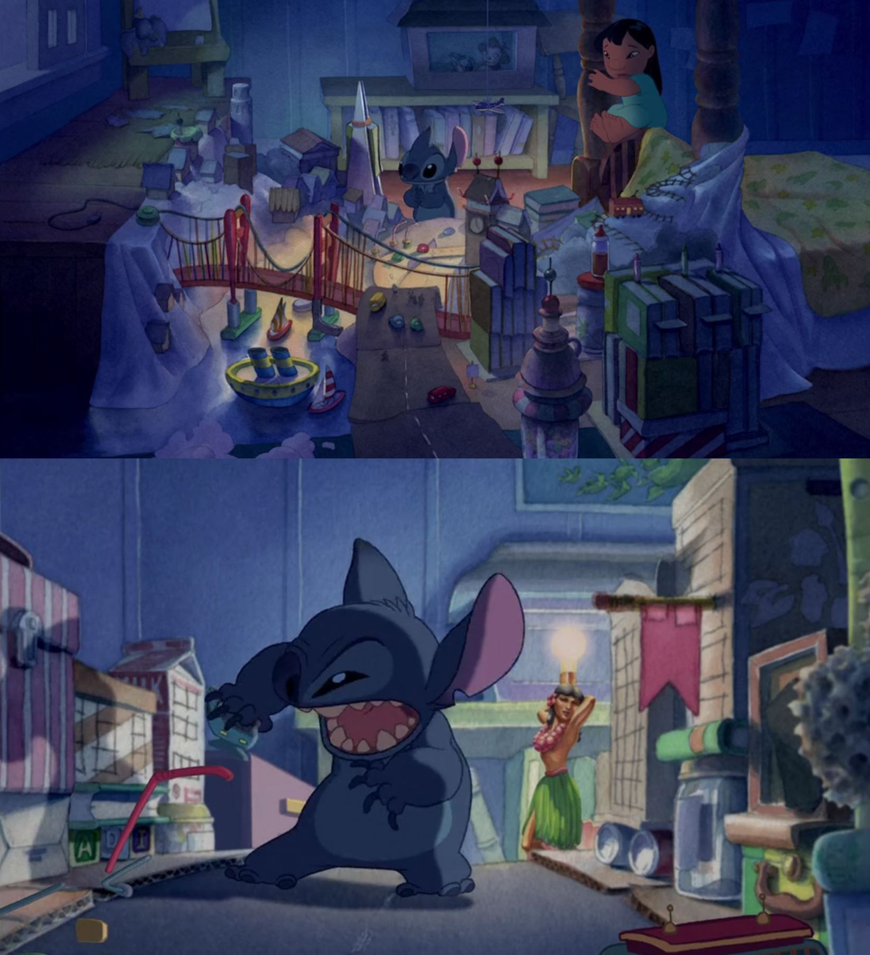
What city does Stitch build and then destroy in Lilo's room?
San Francisco
OR
New York City

Slide 43
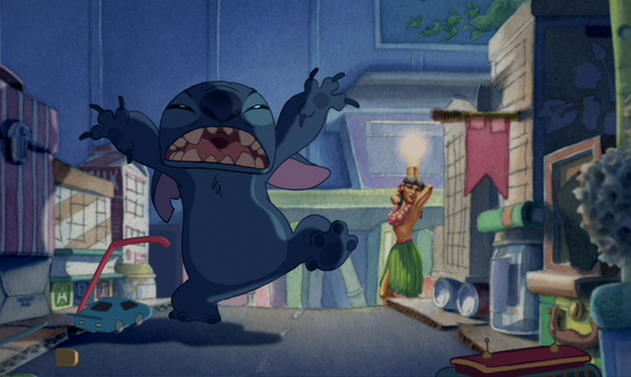
Stitch destroys San Francisco

Slide 44
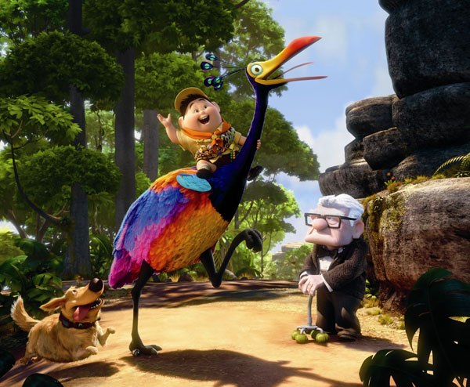
What type of bird does Russel think Kevin is?
Rainbow lory
OR
Snipe

Slide 45
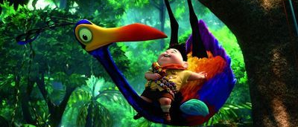
Russell thinks Kevin is a Snipe Bird

Slide 46
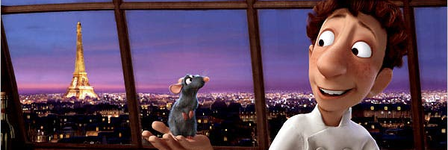
How does Remy control Linguini's actions?
By pulling Linguini's hair in the right direction
OR
By slapping Linguini head in the right direction

Slide 47
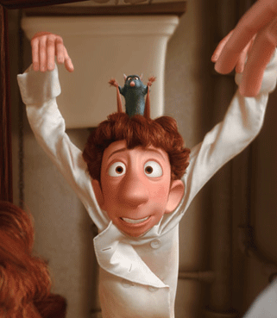
By pulling Linguini's hair in the right direction

Slide 48
What is the name of Peter Pan’s dog?
Nana
OR
Copper

Slide 49
Peter Pan dog name is Nana

Slide 50
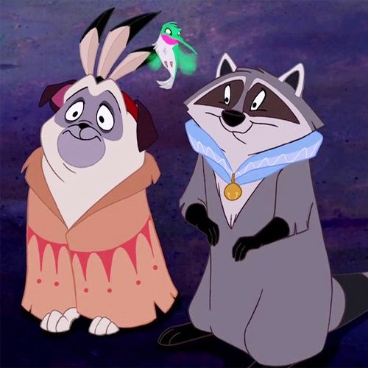
Who is the sidekick in Pocahontas?
Percy
OR
Meeko

Slide 51
Meeko is Pocahontas Sidekick

Slide 52
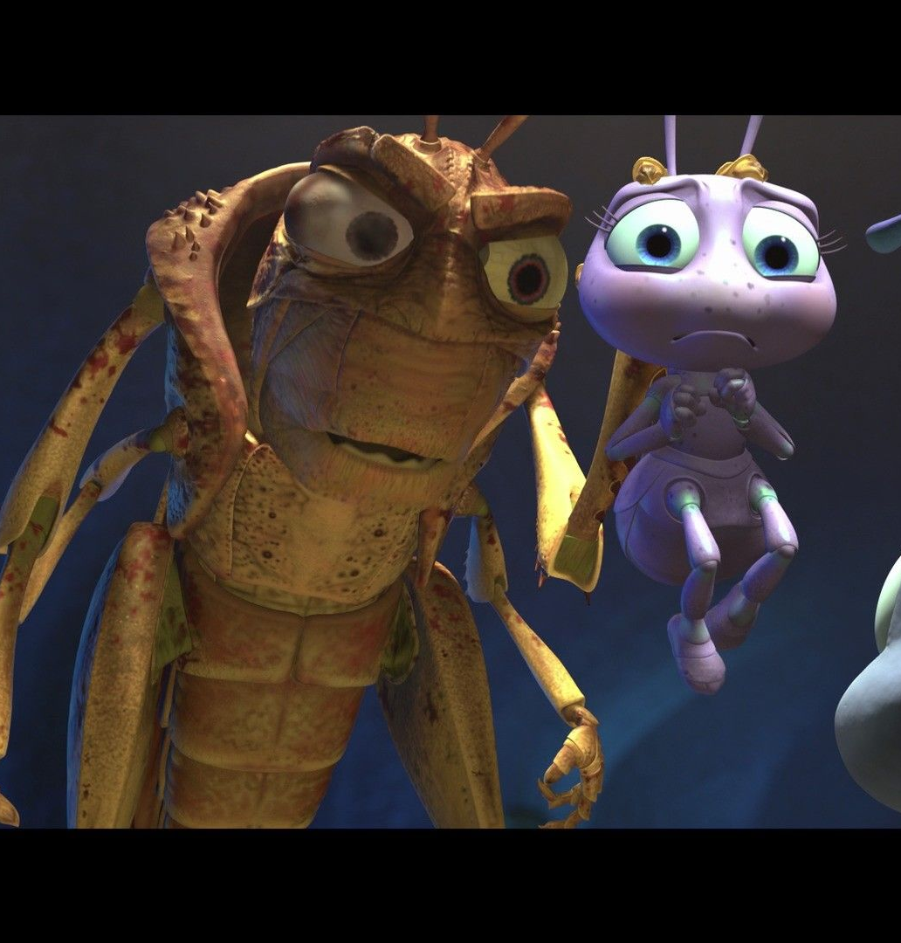
Who is the villain in A Bug’s Life?
Dot
OR
Hopper

Slide 53
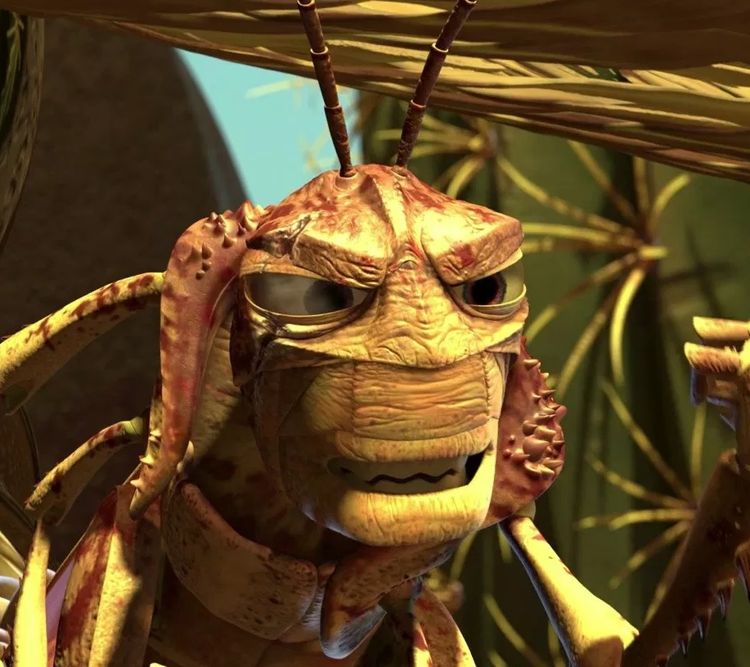
Hopper is the Villain from a Bug’s Life

