Slide 1
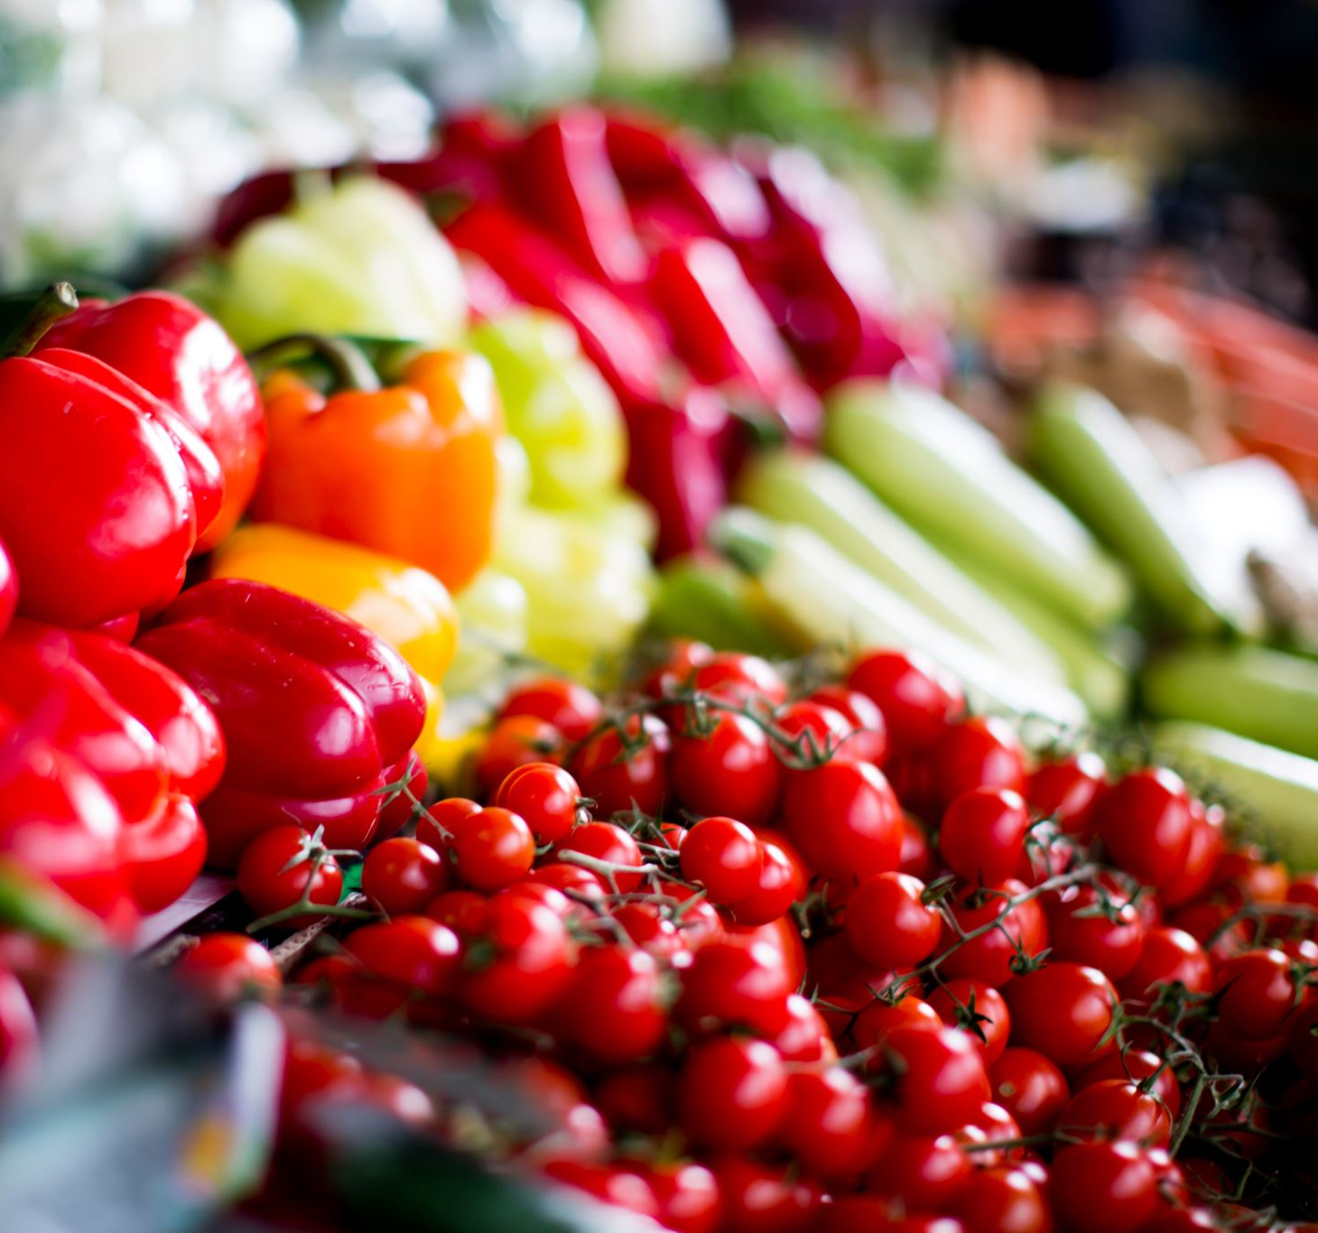

Nutrition Trivia

Slide 2
1. How many servings of fruits and vegetables should you have in a day?
7
3
12
5

Slide 3
2. What food has Vitamin C that helps our immune system?
Orange
Banana
Strawberry
Grape

Slide 4
3. Eating different proteins like meat/fish/nuts help you….
Sleep
Build muscle
See
Hear

Slide 5
4. What food is a great source of potassium?
Dragon Fruit
Cantaloupe
Banana
Steak

Slide 6
5. How many calories should be consumed in a day?
200
3000
1500
10000

Slide 7
6. What is a vegetable helps with your eyesight?
Celery
Broccoli
Carrot
Potato

Slide 8
7. Which one of these foods is considered a healthy fat?
A. Avocado
B. Chicken Skin
C. Butter
D. Red Meat

Slide 9
8. What are the food categories of Myplate?
Breakfast, Lunch, Snack, Dinner, Dessert
Fruits, Vegetables, Sweets, Meat, Milk
Water, Chicken, Corn, Mashed Potatoes, Cake
Protein, Fruits, Vegetables, Grains, Dairy

Slide 10
9. True of False: Fruit is better than fruit juice?

Slide 11
10. True or False: White Bread/Rice is better than Whole Wheat/Brown Rice?

