Slide 1



Backyard Collage

Slide 2
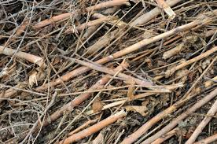
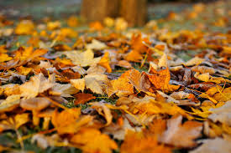
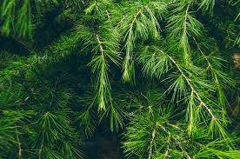
Step 1.
Walk all the way around your yard searching for different items to add to your collage
Leaves, sticks, flowers, etc.

Slide 3

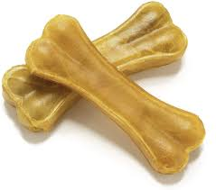
Step 2.
Make your collage personal!
What is something you could find in your yard but not your neighbors?
Get creative, anything goes!

Slide 4
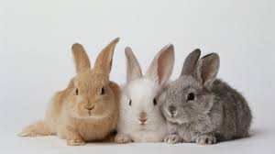
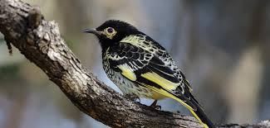
Step 3.
Add photos of things you can’t pick up to add to the collage

Slide 5
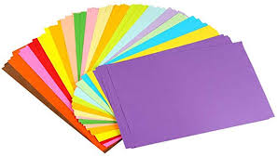
Step 4.
For color, put on colored paper or paint on a piece of paper then develop the collage on top of that!

Slide 6

Step 5.
Create the collage outside to avoid a mess in the house

Slide 7

Step 6.
Have fun! Be creative! Think outside the box!

