Slide 1
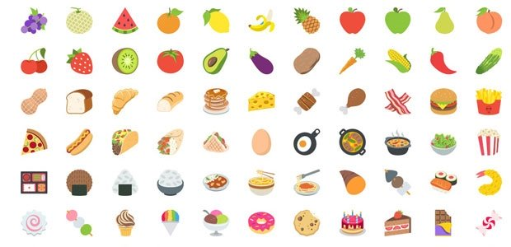
Guess the Food Answers

Slide 2
HOT DOG

Slide 3
CHERRY

Slide 4
PANCAKE

Slide 5
STRAWBERRY MILKSHAKE

Slide 6
GUMMY BEAR

Slide 7
WENDY’S

Slide 8
FRENCH FRIES

Slide 9
COTTON CANDY

Slide 10
ONINON RING

Slide 11
CORN DOG

Slide 12
WATERMELON

Slide 13
CHEESECAKE

Slide 14
GOLD FISH

Slide 15
FORTUNE COOKIE

Slide 16
MOON PIE

Slide 17
POPCORN

Slide 18
BANANA SPLIT

Slide 19
APPLE JACKS

Slide 20
CORN FLAKES

Slide 21
CHEESE STICKS

Slide 22
DARK CHOCOLATE

Slide 23
APPLE PIE

Slide 24
CANDY CORN

Slide 25
APPLE JUICE

Slide 26
CHOCOLATE MILK SHAKE

Slide 27
FRUIT SALAD

Slide 28
CUPCAKE

Slide 29
CHEESEBURGER

Slide 30
FRIED CHICKEN

Slide 31
SHERBET

Slide 32
PUMPKIN PIE

Slide 33
ICECREAM TRUCK

Slide 34
MEAT LOAF

Slide 35
WAFFLE CONE

Slide 36
RED BULL

Slide 37
TOMATO SOUP

Slide 38
BROCCOLI CHEDDAR SOUP

Slide 39
CHICKEN SANDWICH

Slide 40
CORN BREAD

Slide 41
EGG DROP SOUP

Slide 42
APPLE BEES

Slide 43
CHICKEN NOODLE SOUP

Slide 44
HARD BOILED EGG

Slide 45
BELGIAN WAFFLE

Slide 46
BLUE CHEESE

Slide 47
CHEESE FRIES

Slide 48
PORK CHOP

Slide 49
STRING CHEESE

Slide 50
CHICKEN FRIES

Slide 51
CHOCOLATE MILK

Slide 52
FISH AND CHIPS

Slide 53
GRILLED CHICKEN

Slide 54
BBQ RIBS

Slide 55
STRAWBERRY

Slide 56
CHICKEN WINGS

Slide 57
VANILLA

Slide 58
BLUEBERRY

Slide 59
S’MORES

Slide 60
MANGO

Slide 61
GRAPE

Slide 62
PEPPERMINT

Slide 63
CHOCOLATE CHIP

Slide 64
PIZZA HUT

Slide 65
KENTUCKY FRIED CHICKEN

Slide 66
STARBUCKS

Slide 67
SUBWAY

Slide 68
DUNKIN DOUGHNUTS

Slide 69
BURGER KING

Slide 70
DAIRY QUEEN

Slide 71
TACO BELL

Slide 72
DOMINO’S PIZZA

Slide 73
CHIPOTLE

Slide 74
TEXAS ROAD HOUSE

Slide 75
GRAPE FRUIT

Slide 76
BASKIN ROBBINS

Slide 77
POPEYES

Slide 78
ARBY’S

Slide 79
ORANGE JUICE

Slide 80
CHICKEN POT PIE

Slide 81
FISH STICKS

Slide 82
PANDA EXPRESS

Slide 83
OLIVE GARDEN

Slide 84
PINEAPPLE

Slide 85
COCONUT

Slide 86
FRUIT CAKE

Slide 87
KIWI

Slide 88
FISH FRY

Slide 89
FRENCH ONION SOUP

Slide 90
ITALIAN BEEF

Slide 91
RICE WATER/HORCHATA

Slide 92
GREEN TEA

Slide 93
GRILLED CHEESE

Slide 94
PIZZA ROLLS

Slide 95
ICEE

Slide 96
DR. PEPPER

Slide 97
SUNNY-D

Slide 98
BUTTER NOODLES

Slide 99
RED ROBIN

