Slide 1
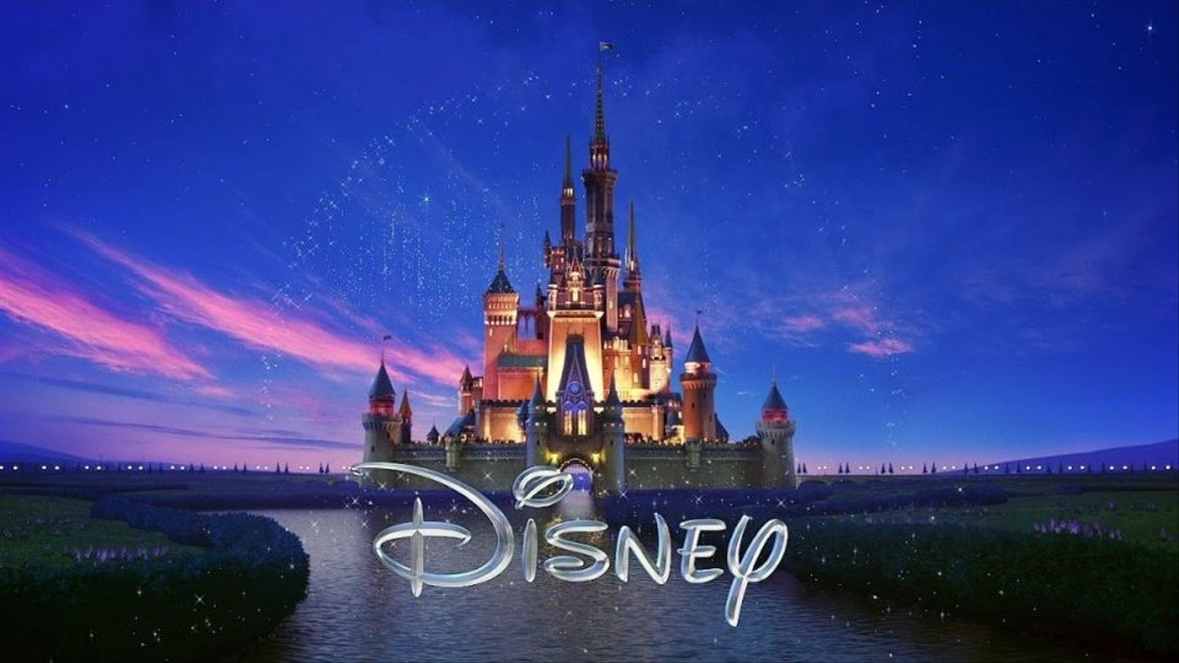
Guess the Disney Movie

Slide 2
See how many slides of pictures you can decode to reveal the Disney movie!
Answers are in separate PowerPoint titled “Guess the Disney Movie Answers”

Slide 4
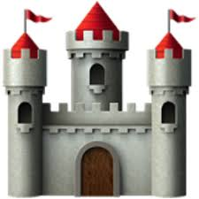

Slide 19
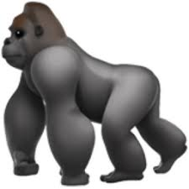

Slide 26
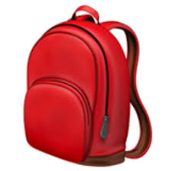

Slide 29
