Slide 1
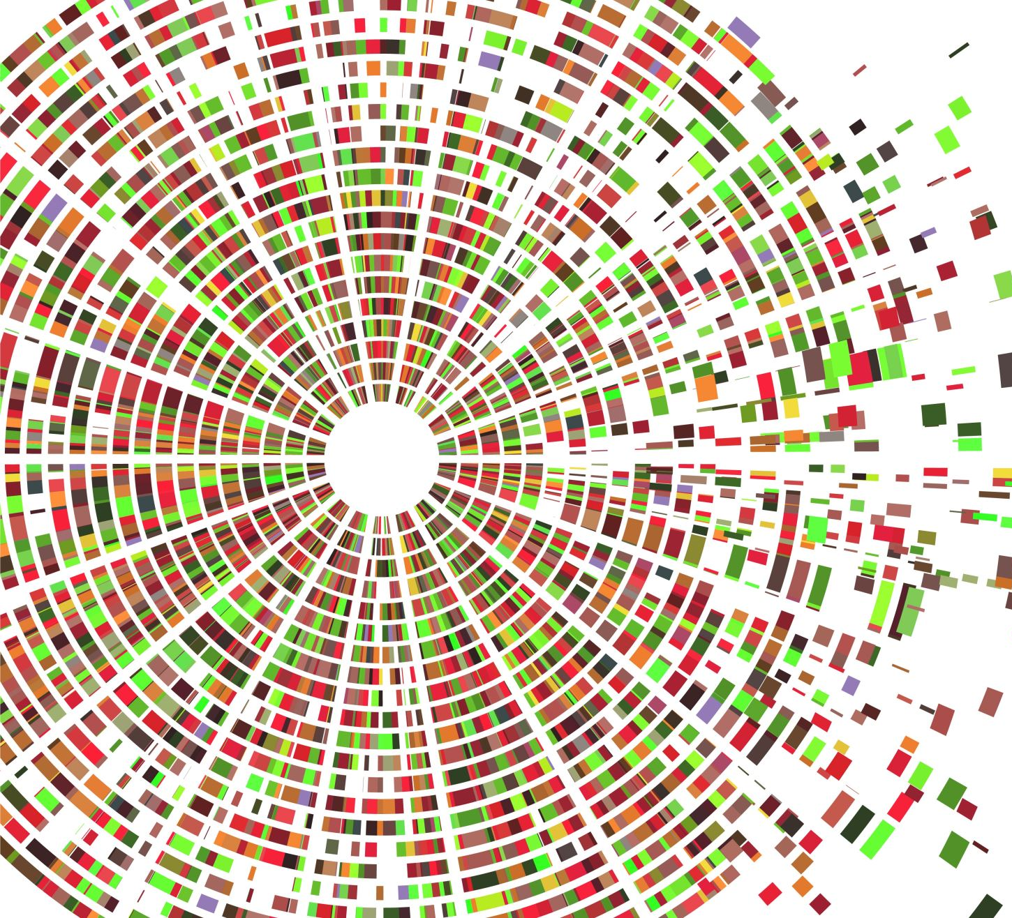


Say Cheese to the Leaves!
NATURE PHOTOGRAPHY

Slide 2
Get Inspired!
Be EXTRA observant
No limits for stunning photos!
Look high and low!

Slide 3
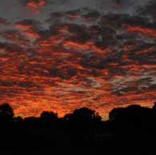
Find Your Golden Hour!
Take pictures at different times of the day, what do you like best?
Go outside more during the time you like best for some quality snapshots!

Slide 4
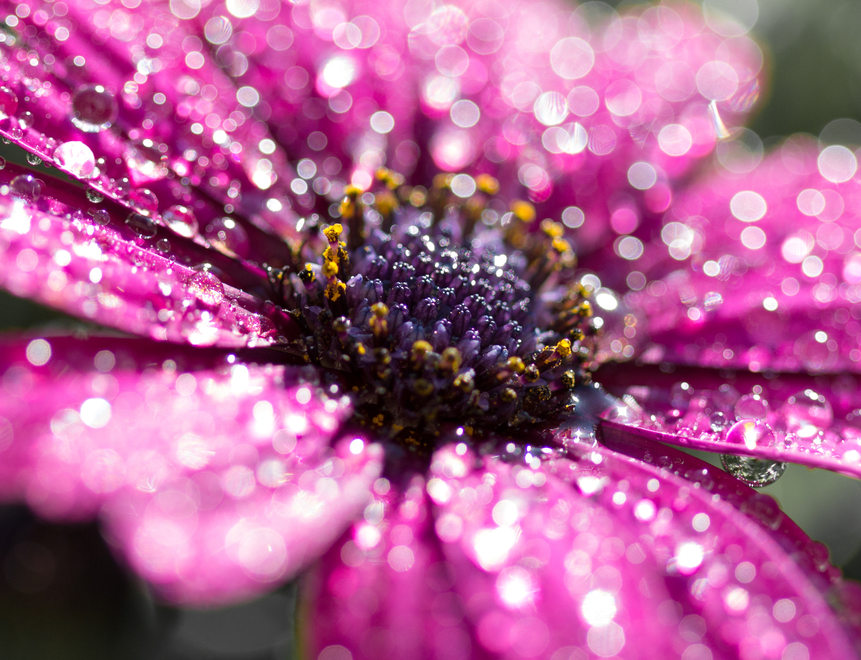
Get Closer!
Get close and zoom in!
Different colors, textures, and insects can be hiding from a distance

Slide 5
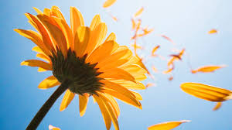
Use the Sky!
Angle the camera to use the sky for a perfect background
Try at different times of the day for different results

Slide 6
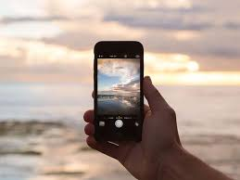
Burst it!
Use the burst option on iPhone
OR click the “capture” button as fast as you can
Reducing blurriness on pictures of moving animals

Slide 7
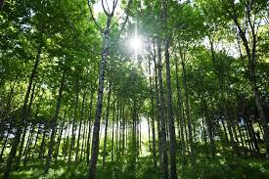
Be Patient!
Photos won’t always come out the way we want, that’s OK!
Have fun with it, keep trying

Slide 8
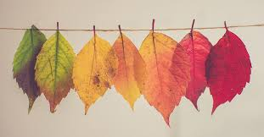
Edit!
Find some photo editor apps/websites, play around until you like what you see!
Share with friends/family or keep a collection of your best photos to yourself

