Slide 1

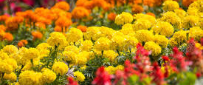

GET YOUR GARDEN ON

Slide 2
Location, Location, Location
Out of sight, out of mind.

Slide 3

Sunshine!
Pay attention to how the sun moves through your yard.
Most plants that you would eat (herbs, vegetables, fruits, etc.) need at least 6 hours of sun.

Slide 4
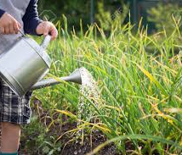
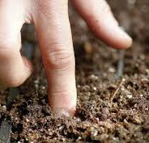
Water
Garden close to water.
Push your finger about an inch in the soil (about one knuckle deep) of dry, your plant is thirsty!

Slide 5
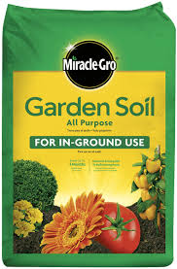
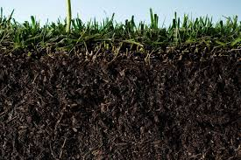
Soil
A nutrient rich soil is important!
Example: Miracle Gro All Purpose Garden Soil

Slide 6
Think about Containers
Growing plants in pots or other containers can help prevent over or under watering plants.
Use a potting mix soil for this option!

Slide 7
Research
Learn the types of plants that will be successful in your climate!

Slide 8
Get out and Garden!
https://www.youtube.com/watch?v=5ef59CDwrn0

