Slide 1
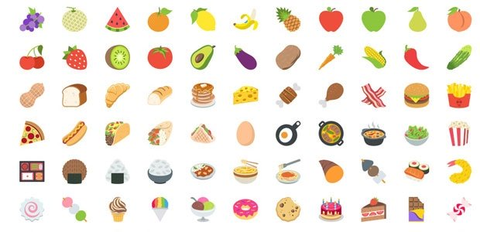
Guess the Food

Slide 2
See how many slides of pictures you can decode to reveal the food item, drink, or restaurant it is!
Answers are in separate PowerPoint titled “Guess the Food Answers”

Slide 3



Slide 4



Slide 5
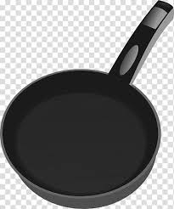


Slide 6




Slide 7
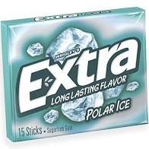


Slide 8

‘s

Slide 9



Slide 10
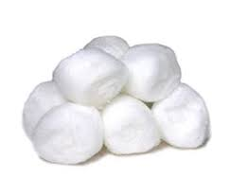


Slide 11



Slide 12



Slide 13
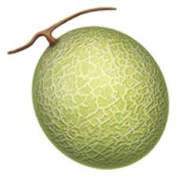


Slide 14


Slide 15
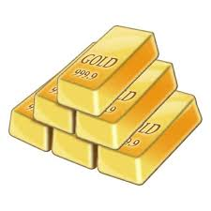


Slide 16
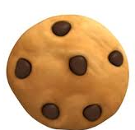


Slide 17



Slide 18


Slide 19



Slide 20

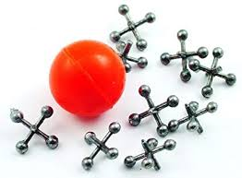

Slide 21


Slide 22
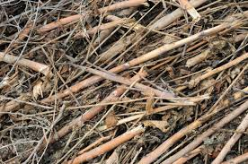

Slide 23

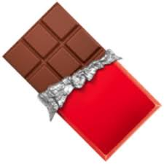

Slide 26


Slide 28



Slide 29


Slide 30


Slide 31


Slide 32



Slide 33


Slide 34


Slide 35
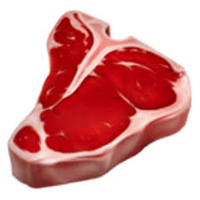


Slide 36



Slide 37



Slide 38

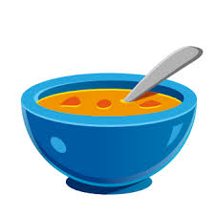

Slide 39


Slide 40
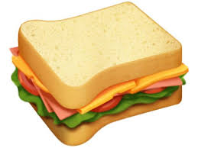

Slide 42


Slide 43



Slide 44


Slide 45


Slide 46


Slide 47


Slide 49



Slide 50


Slide 53


Slide 54


Slide 55
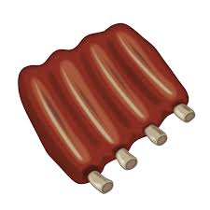

Slide 56


Slide 57


Slide 58




Slide 59


Slide 60
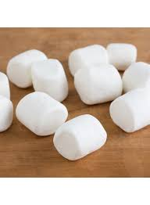
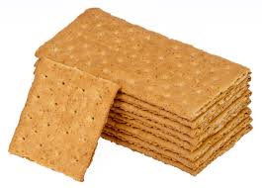

Slide 61



Slide 62



Slide 63



Slide 65

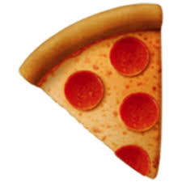

Slide 66
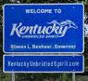

Slide 67
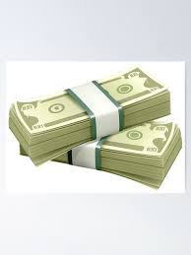


Slide 68
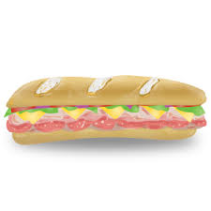


Slide 69
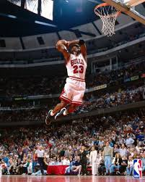


Slide 70


Slide 72



Slide 73
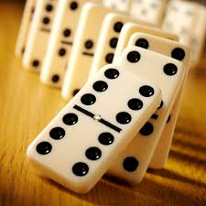

Slide 74



Slide 75




Slide 76


Slide 77


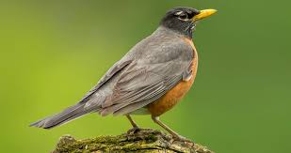

Slide 78



Slide 79


Slide 80


Slide 83

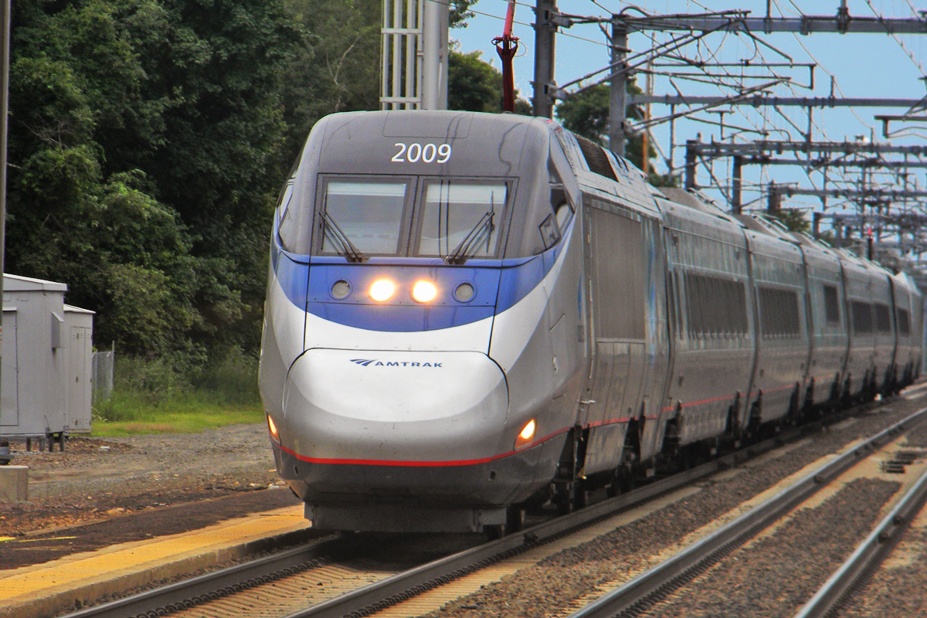

Slide 84

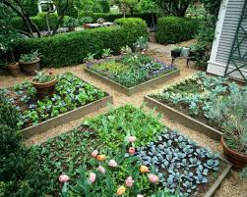

Slide 85


Slide 86
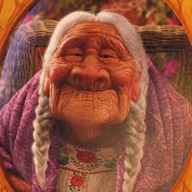


Slide 88



Slide 91



Slide 92
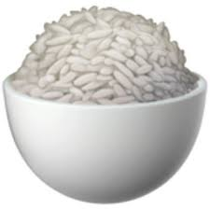

Slide 93



Slide 95
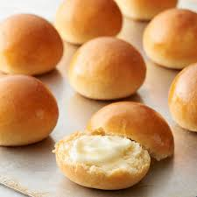

Slide 96



Slide 97



Slide 98



Slide 99
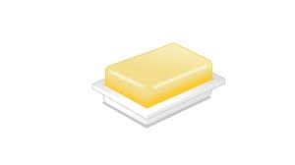


Slide 100


