Slide 1


Don’t forget the lyric

Slide 2


1. Perfect- Ed Sheeran
Now I know I have met an angel in person
And she looks perfect
No, I don’t deserve this
____ _____ _______ _______

Slide 3
1. Perfect- Ed Sheeran
Now I know I have met an angel in person
And she looks perfect
No, I don’t deserve this
____ _____ _______ _______
I found a love
Your heart is all I own
You look perfect tonight

Slide 4
1. Perfect- Ed Sheeran
Now I know I have met an angel in person
And she looks perfect
No, I don’t deserve this
Answer: C.
You Look Perfect Tonight

Slide 5
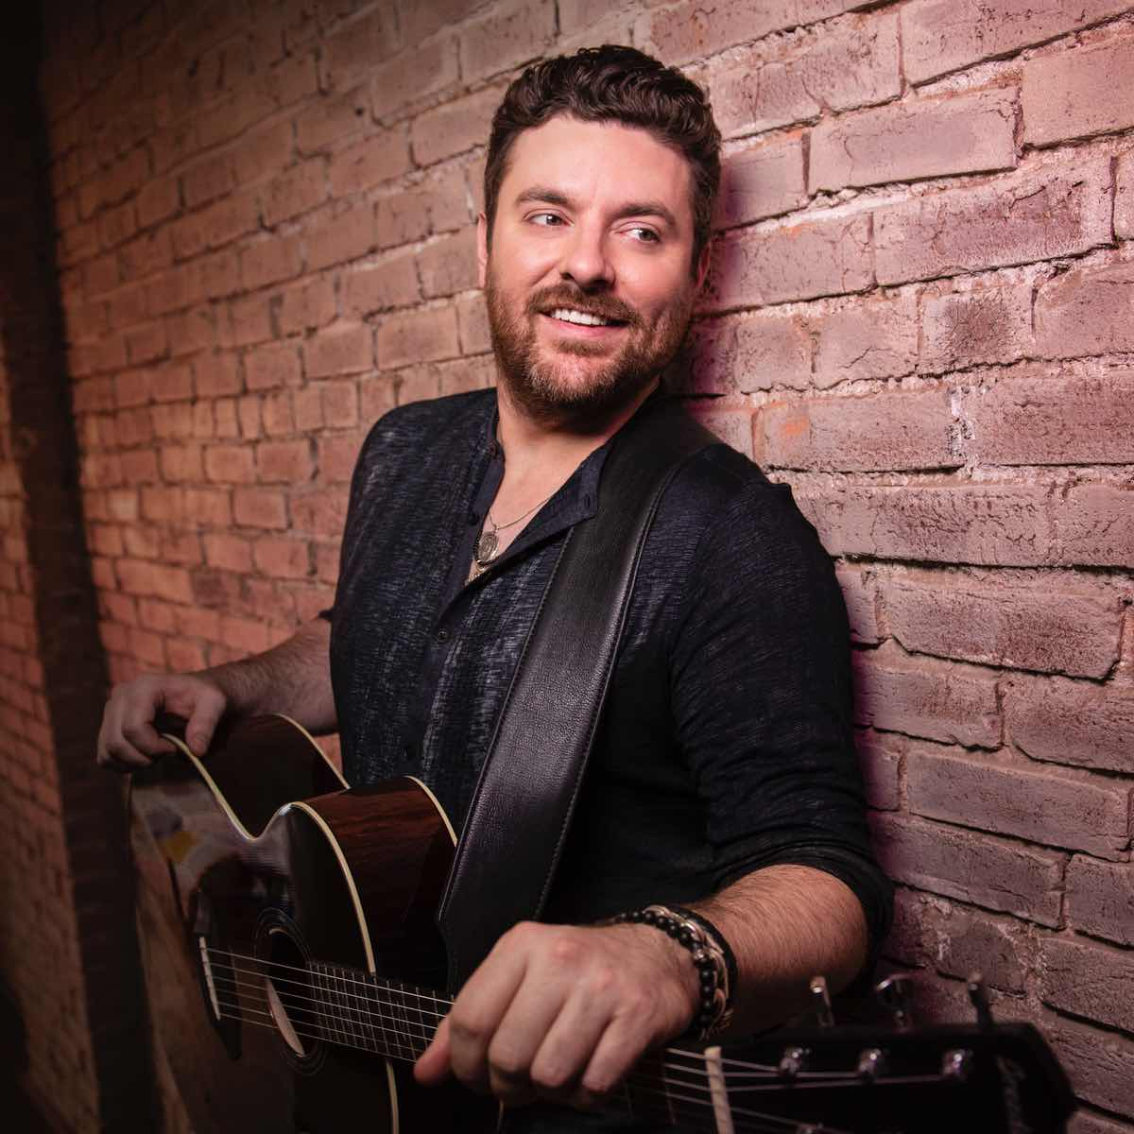
2. Voices- Chris Young
And grandma sayin’: “if you find the one
you better treat her right”
__ , ____ ___ ___ ___ ___ ___

Slide 6
2. Voices- Chris Young
And grandma sayin’: “if you find the one
you better treat her right”
__ , ____ ___ ___ ___ ___ ___
Yeah, I hear voices all the time
Man, I can’t avoid it at all
Walkin’ round with all these whispers

Slide 7
2. Voices- Chris Young
And grandma sayin’: “if you find the one
you better treat her right”
Answer: A.
**Yeah, I hear voices all the time

Slide 8
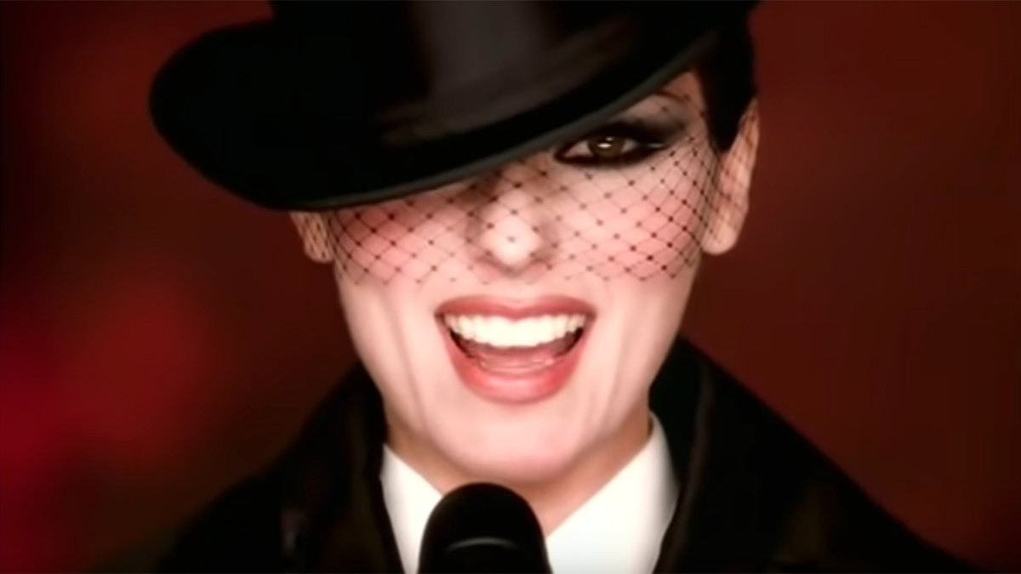
3. Man I feel like a women- Shania twain
I get totally crazy
Can you feel it
Come, come, come, on baby
__ ___ ___ ___ ___

Slide 9
3. Man I feel like a women- Shania twain
I get totally crazy
Can you feel it
Come, come, come, on baby
__ ___ ___ ___ ___
Get a little outta line
Man I feel like a women
I’m going out tonight

Slide 10
3. Man I feel like a women- Shania twain
I get totally crazy
Can you feel it
Come, come, come, on baby
Answer: B
_Man_ _I_ _Feel _Like_ _A_ Women

Slide 11
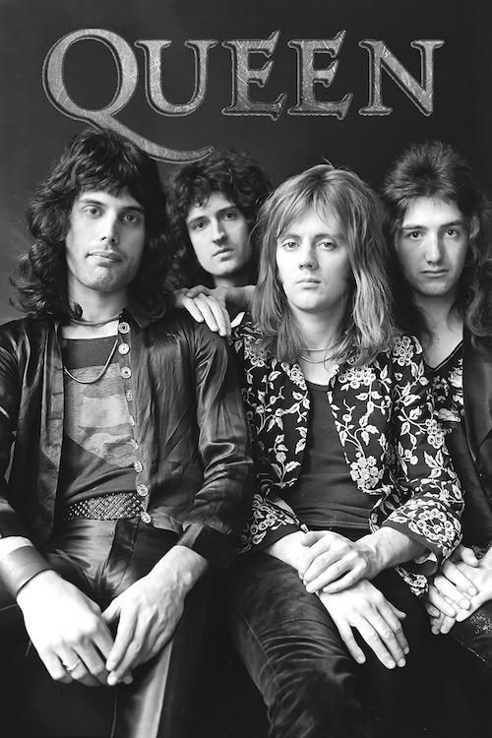
4. Somebody to love- queen
Till the tears run down from my eyes
Lord, somebody (somebody)
Ooh Somebody (please)
Can anybody find me
______ ____ _____

Slide 12
4. Somebody to love- queen
Till the tears run down from my eyes
Lord, somebody (somebody)
Ooh Somebody (please)
Can anybody find me
______ ____ _____
Take a look in the mirror?
What you are doing to me?
Somebody to love?

Slide 13
4. Somebody to love- queen
Till the tears run down from my eyes
Lord, somebody (somebody)
Ooh Somebody (please)
Can anybody find me
Answer: C
Somebody to love?

Slide 14
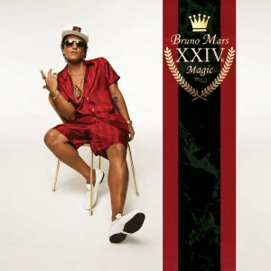
5. Just the way you are- Bruno mars
And when you smile
The whole world stops and stares for a while
‘cause girl, you’re amazing
____ ____ _____ _____

Slide 15
5. Just the way you are- Bruno mars
And when you smile
The whole world stops and stares for a while
‘cause girl, you’re amazing
____ ____ _____ _____ _____
When I see your face
Just the way you are
She’s so beautiful and I tell her everyday

Slide 16
5. Just the way you are- Bruno mars
And when you smile
The whole world stops and stares for a while
‘cause girl, you’re amazing
Answer: B
Just the way you are

Slide 17
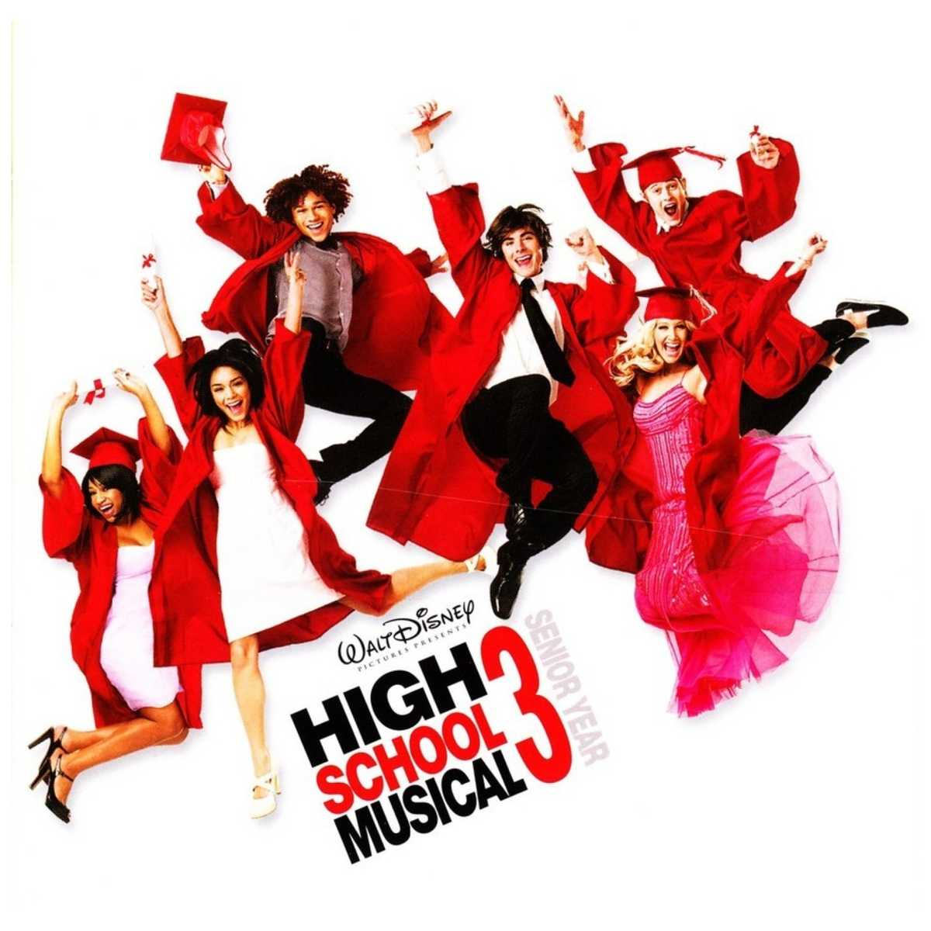
6. Just wanna be with you- high school musical
No matter where life takes us
Nothing can break us apart
You know its true
__ ____ ____ ___ ____ ____

Slide 18
6. Just wanna be with you- high school musical
No matter where life takes us
Nothing can break us apart
You know its true
__ ____ ____ ___ ____ ____
I JUST WANNA BE WITH YOU
THERE’S NOTHING WE CAN’T DO
YOU KNOW HOW LIFE CAN BE

Slide 19
6. Just wanna be with you- high school musical
No matter where life takes us
Nothing can break us apart
You know its true
Answer: A
I just wanna be with you

Slide 20
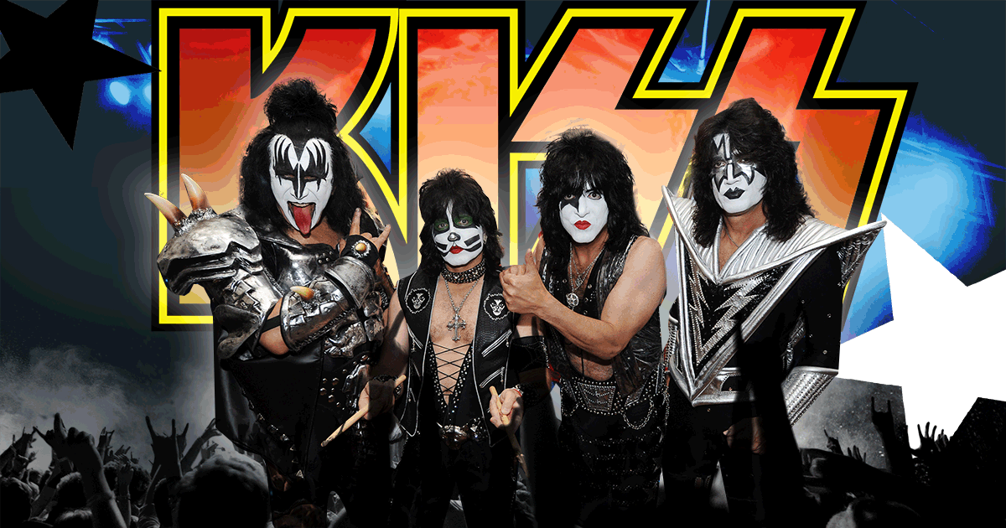
7. Rock and Roll all nite- kiss
The party’s just begun, we’ll let you in
You drive us wild, we’ll drive you crazy
You keep on shoutin’, you keep on shoutin’
__ ___ ___ ___ ___ __ ___

Slide 21
7. Rock and Roll all nite- kiss
The party’s just begun, we’ll let you in
You drive us wild, we’ll drive you crazy
You keep on shoutin’, you keep on shoutin’
You’re lookin’ fancy and I like your style
You say you wanna go for a spin
I wanna rock and roll all nite

Slide 22
7. Rock and Roll all nite- kiss
The party’s just begun, we’ll let you in
You drive us wild, we’ll drive you crazy
You keep on shoutin’, you keep on shoutin’
Answer: C
I wanna rock and roll all nite

Slide 23
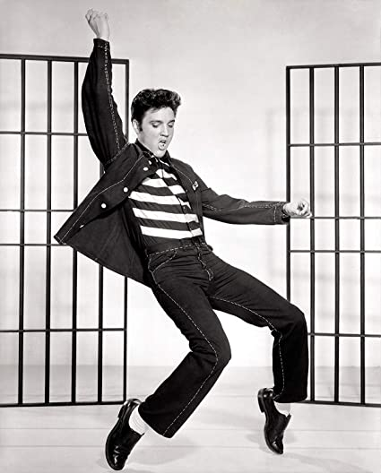
8. Jailhouse rock- Elvis Presley
The whole rhythm section was the purple gang
Let’s rock, everybody, let’s rock
Everybody in the whole cell block
___ ____ ___ ___ _______ _____

Slide 24
8. Jailhouse rock- Elvis Presley
The whole rhythm section was the purple gang
Let’s rock, everybody, let’s rock
Everybody in the whole cell block
___ ____ ___ ___ _______ _____
I wanna stick around for a while
Was dancing to the jailhouse rock
Sad sack was sitting on a block

Slide 25
8. Jailhouse rock- Elvis Presley
The whole rhythm section was the purple gang
Let’s rock, everybody, let’s rock
Everybody in the whole cell block
Answer: B
Was dancing to the jailhouse rock

Slide 26
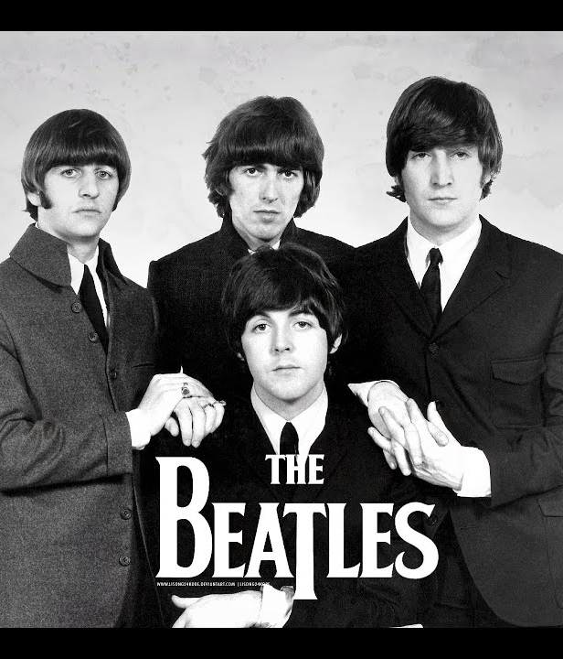
9. HElp- the Beatles
And I do appreciate you being ‘round
Help me get my feet back on the ground
Won’t you please, please help me?
___ ___, ____ ____

Slide 27
9. HElp- the Beatles
And I do appreciate you being ‘round
Help me get my feet back on the ground
Won’t you please, please help me?
___ ___, ____ ____
Feed me, feed me
Help me, help me
Save me, save me

Slide 28
9. HElp- the Beatles
And I do appreciate you being ‘round
Help me get my feet back on the ground
Won’t you please, please help me?
Answer: B
Help me, help me

Slide 29
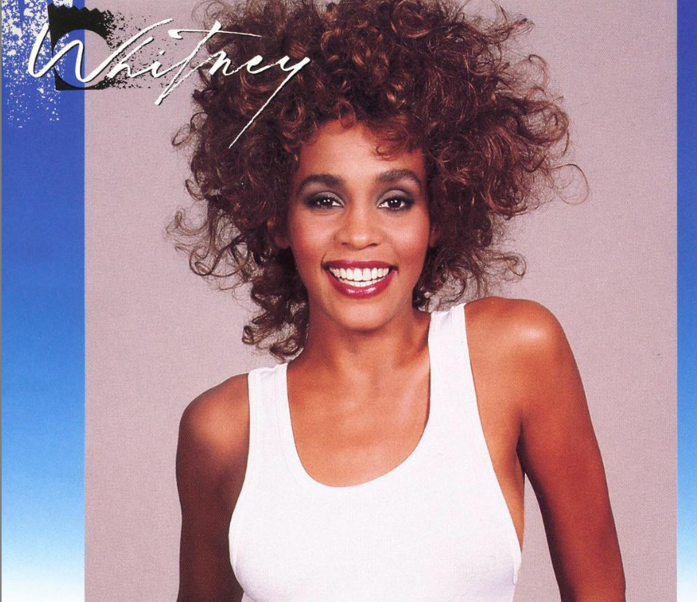
10. I wanna dance with somebody- Whitney Houston
Oh, I wanna dance with somebody
I wanna feel the heat
Yeah, I wanna dance with somebody
___ _____ ____ ____ ____

Slide 30
10. I wanna dance with somebody- Whitney Houston
Oh, I wanna dance with somebody
I wanna feel the heat
Yeah, I wanna dance with somebody
__ ____ ____ ____ ____
And I wind up feeling down
With somebody who loves me
Clock strikes upon the hour

Slide 31
10. I wanna dance with somebody- Whitney Houston
Oh, I wanna dance with somebody
I wanna feel the heat
Yeah, I wanna dance with somebody
Answer: b
With somebody who loves me <3

Slide 32
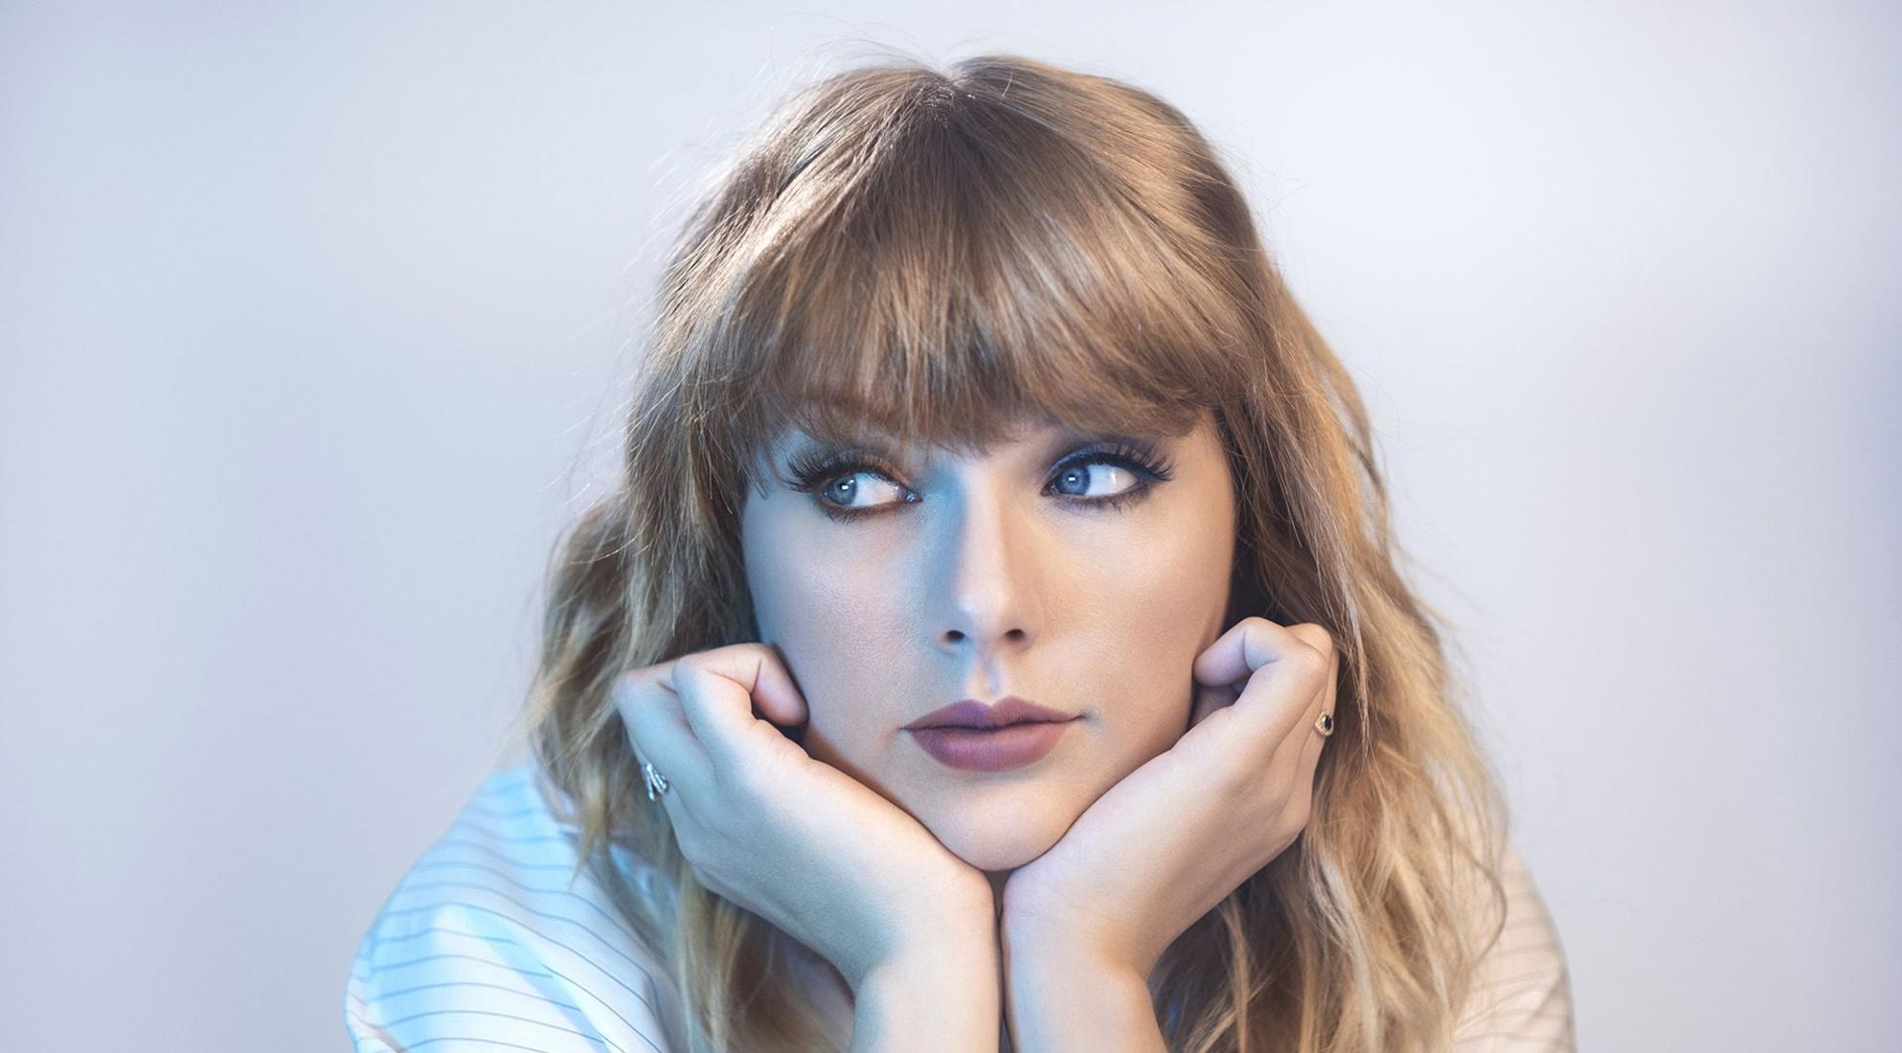
11. Love story- Taylor swift
Romeo save me, they’re trying to tell me how to feel
This love is difficult, but its real
Don’t be afraid, we’ll make it out of this mess
__ __ ___ ____, ___, ___ ___ ___

Slide 33
11. Love story- Taylor swift
Romeo save me, they’re trying to tell me how to feel
This love is difficult, but its real
Don’t be afraid, we’ll make it out of this mess
It’s a love story, baby, just say yes
Wondering if you were, ever coming around
I keep waiting for you but you never come

Slide 34
11. Love story- Taylor swift
Romeo save me, they’re trying to tell me how to feel
This love is difficult, but its real
Don’t be afraid, we’ll make it out of this mess
Answer: A
It’s a love story, baby, just say yes

Slide 35
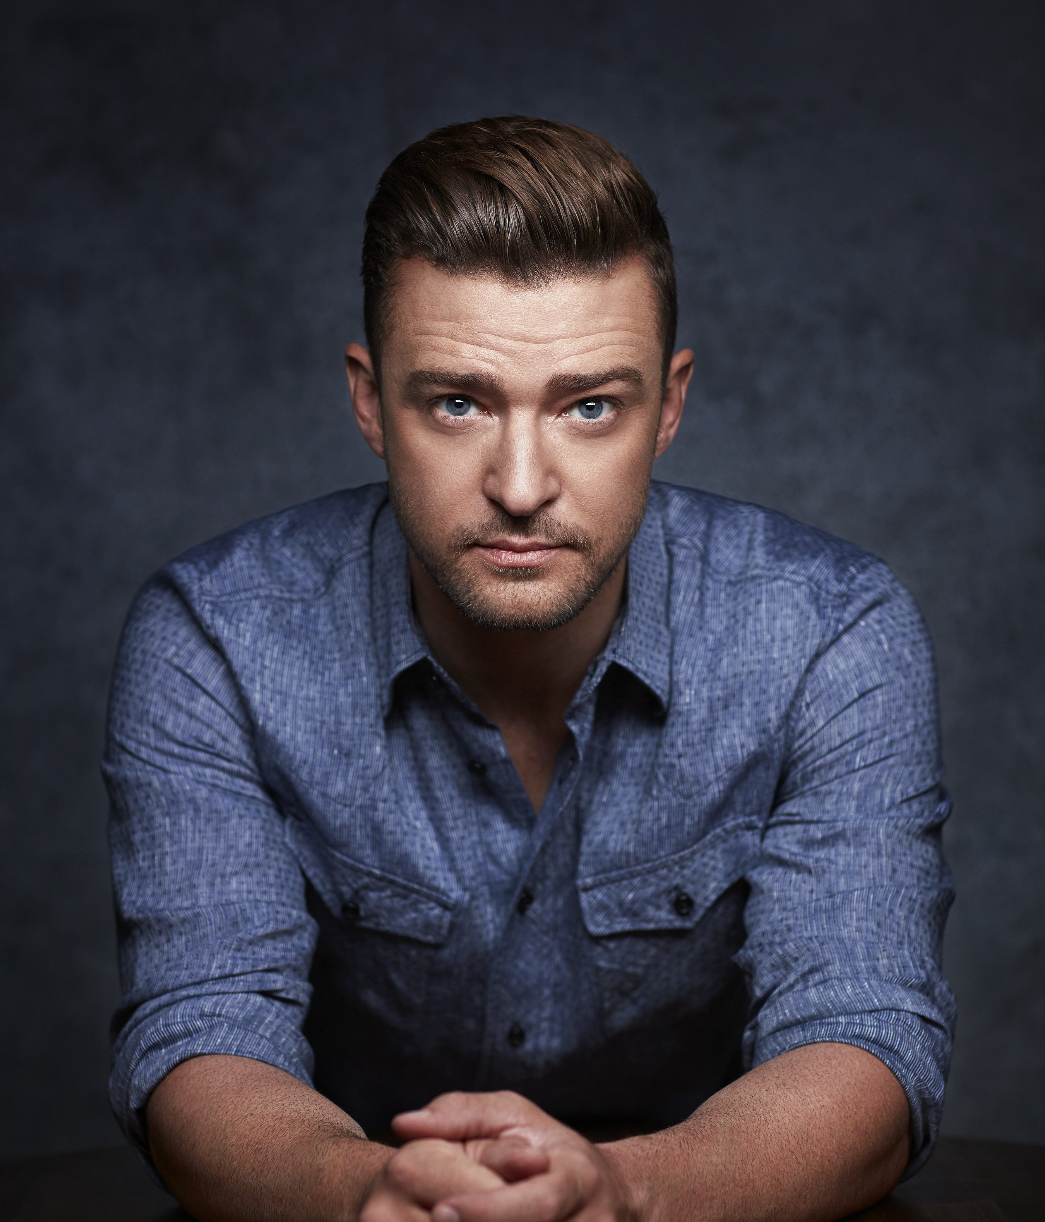
12. can’t stop the feeling- Justin Timberlake
And under the lights
When everything goes
Nowhere to hide when i’m getting you close
___ ____ ____ ____ ___ ____ ____
So just imagine
Just imagine

Slide 36
12. can’t stop the feeling- Justin Timberlake
And under the lights
When everything goes
Nowhere to hide when i’m getting you close
___ ____ ____ ____ ___ ____ ____
So just imagine
Just imagine
I can see you but when you dance
When we move well you already know
I got that sunshine in my pocket

Slide 37
12. can’t stop the feeling- Justin Timberlake
And under the lights
When everything goes
Nowhere to hide when I'm getting you close
___ ____ ____ ____ ___ ____ ____
So just imagine
Just imagine
Answer: B
When we move well you already know

Slide 38
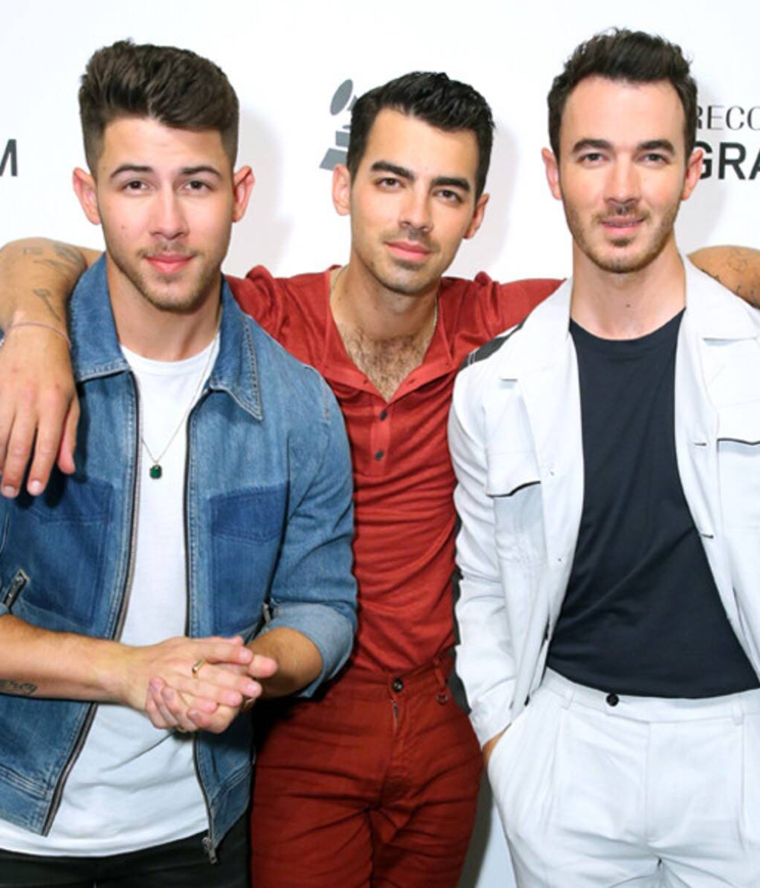
13. sucker- Jonas brothers
You’re the medicine and the pain
The tattoo inside my brain
And baby, you know its obvious
___ ___ ____ ____ ____

Slide 39
13. sucker- Jonas brothers
You’re the medicine and the pain
The tattoo inside my brain
And baby, you know its obvious
___ ___ ____ ____ ____
I’ve been dancing on top of cars
I’m a sucker for you
Break my typical rules its true

Slide 40
13. sucker- Jonas brothers
You’re the medicine and the pain
The tattoo inside my brain
And baby, you know its obvious
___ ___ ____ ____ ____
Answer: B
I’m a sucker for you

Slide 41
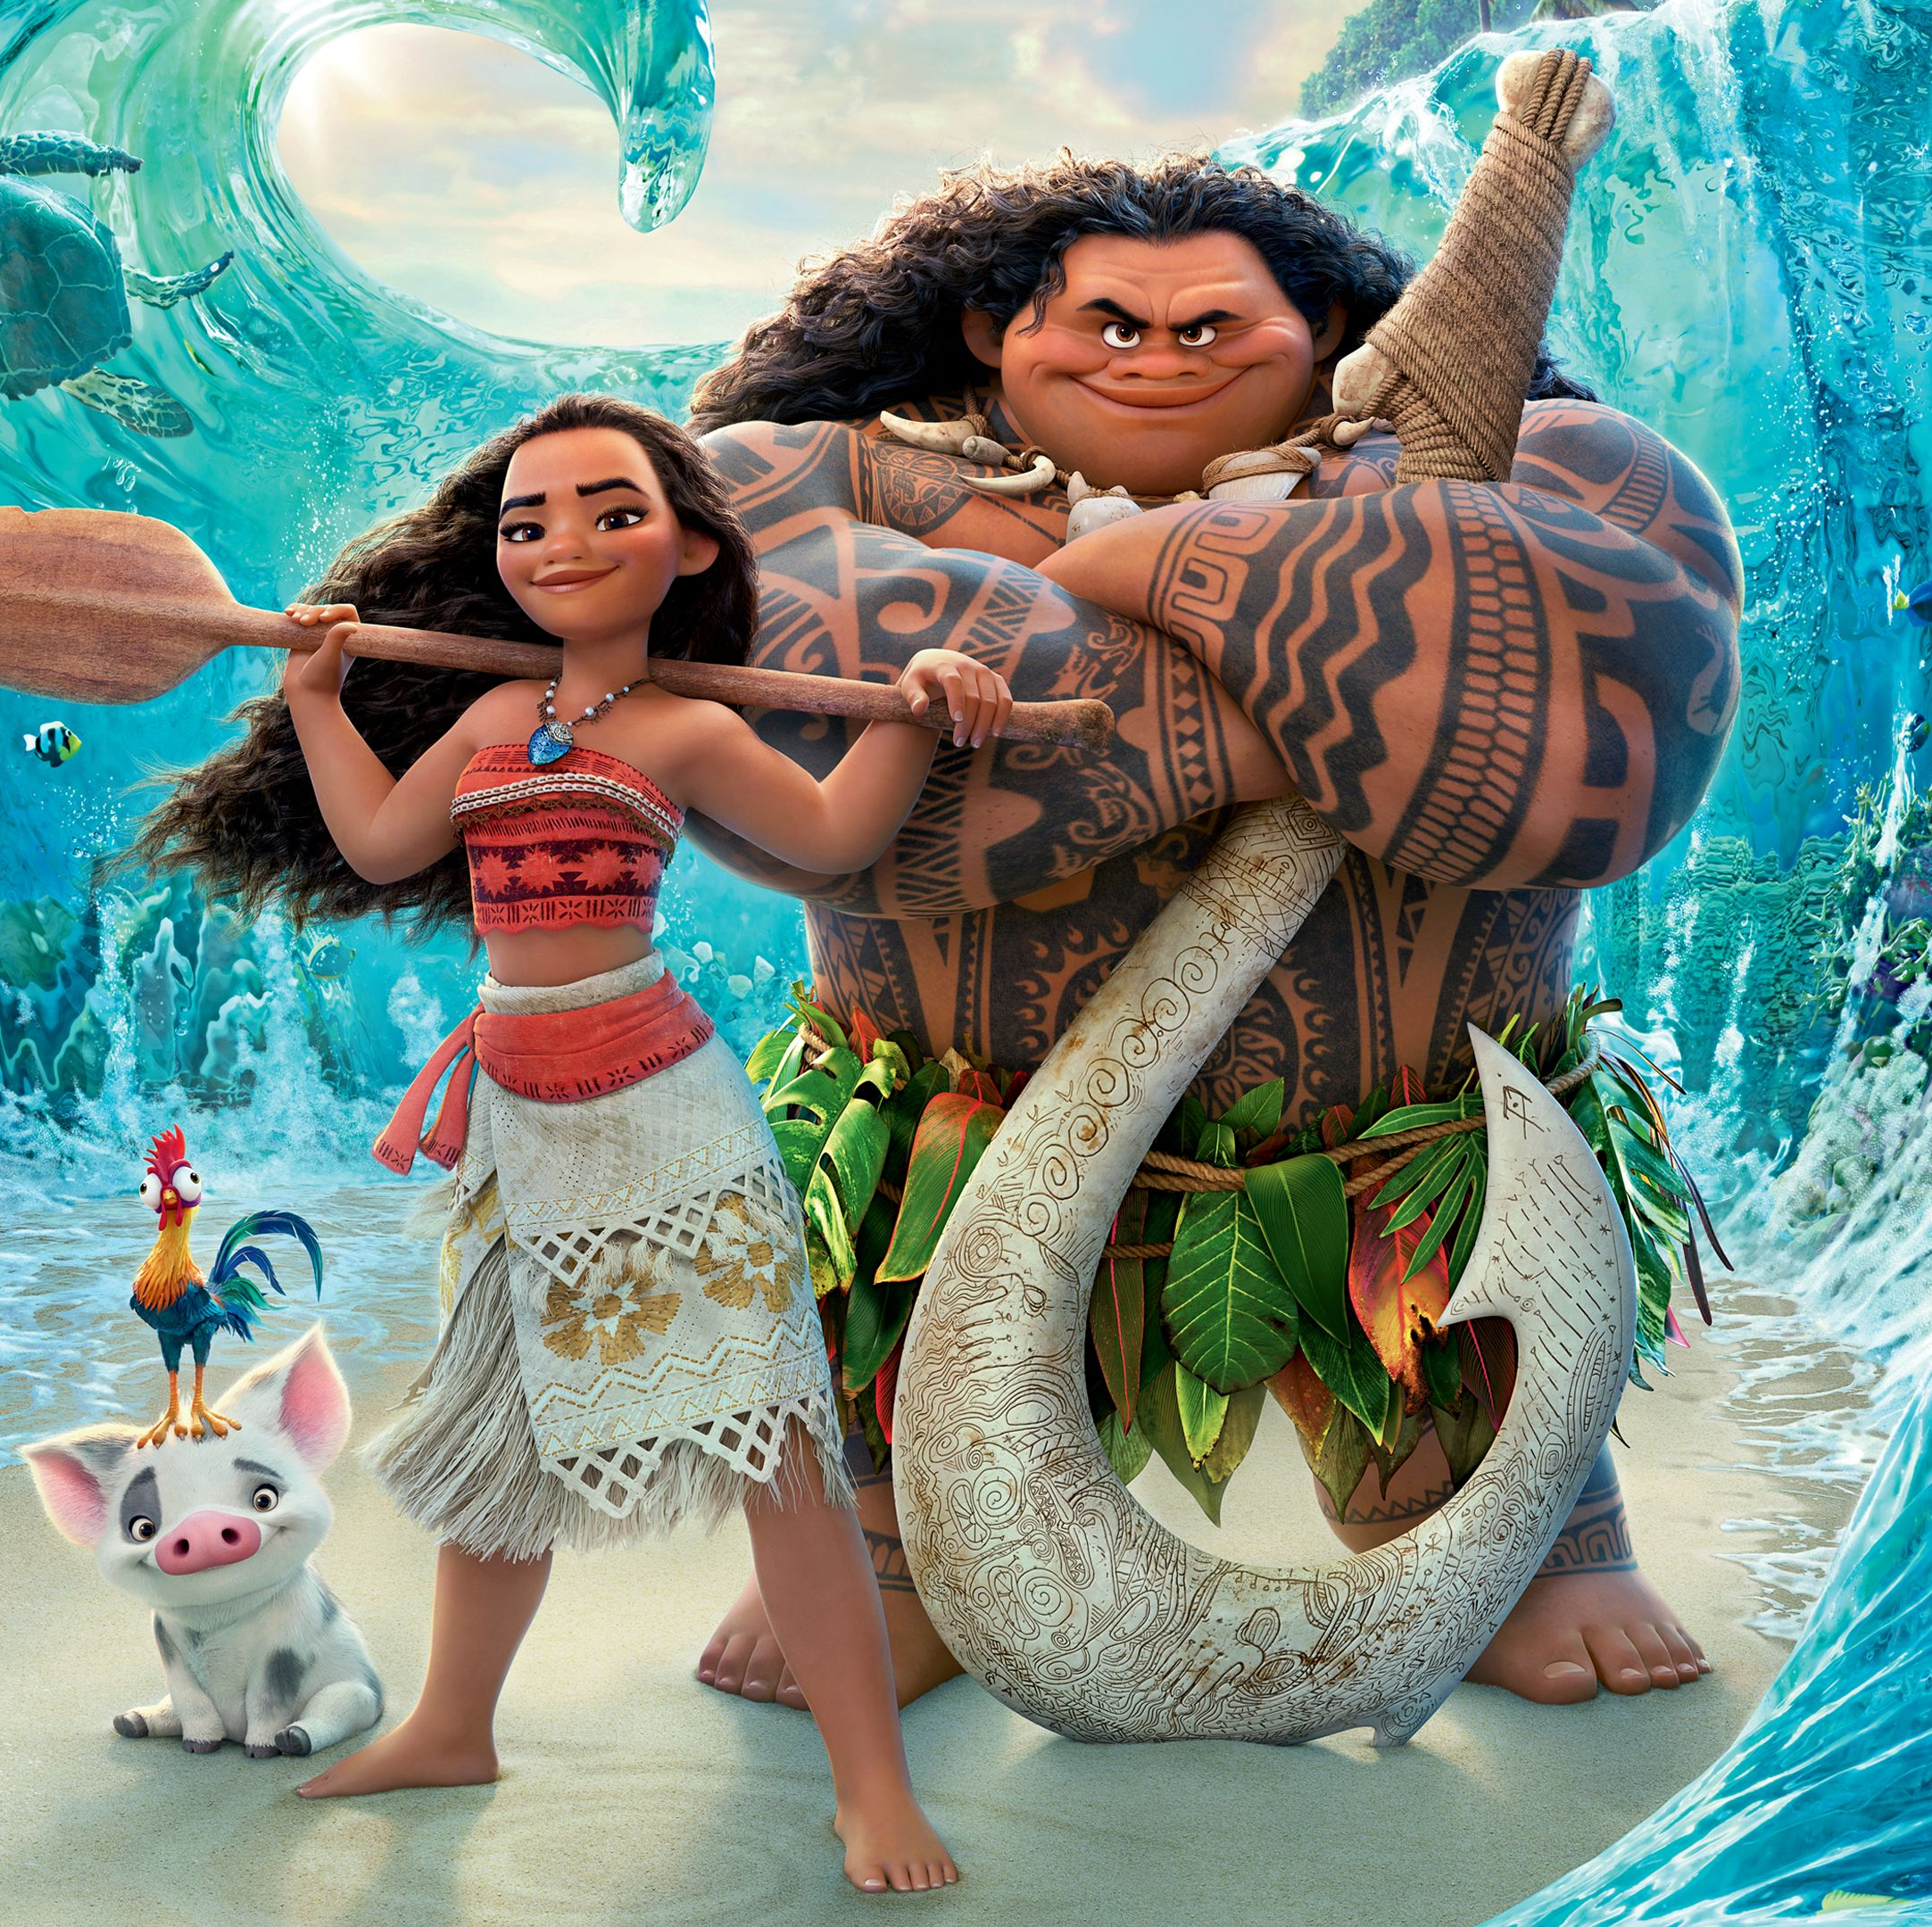
14. How far I’ll go- moana
The line where the sky meets the sea? It calls me
And no one knows, how far it goes
If the wind in my sail on the sea stays behind me
___ ___ ____ ____, ____ ____ ___ ____

Slide 42
14. How far I’ll go- moana
The line where the sky meets the sea? It calls me
And no one knows, how far it goes
If the wind in my sail on the sea stays behind me
___ ___ ____ ____, ____ ____ ___ ____
One day I’ll know, how far I’ll go
One day no one knows, how far it goes
I’ll be satisfied if I play along

Slide 43
14. How far I’ll go- moana
The line where the sky meets the sea? It calls me
And no one knows, how far it goes
If the wind in my sail on the sea stays behind me
Answer: A
One day I’ll know, how far I’ll go

Slide 44
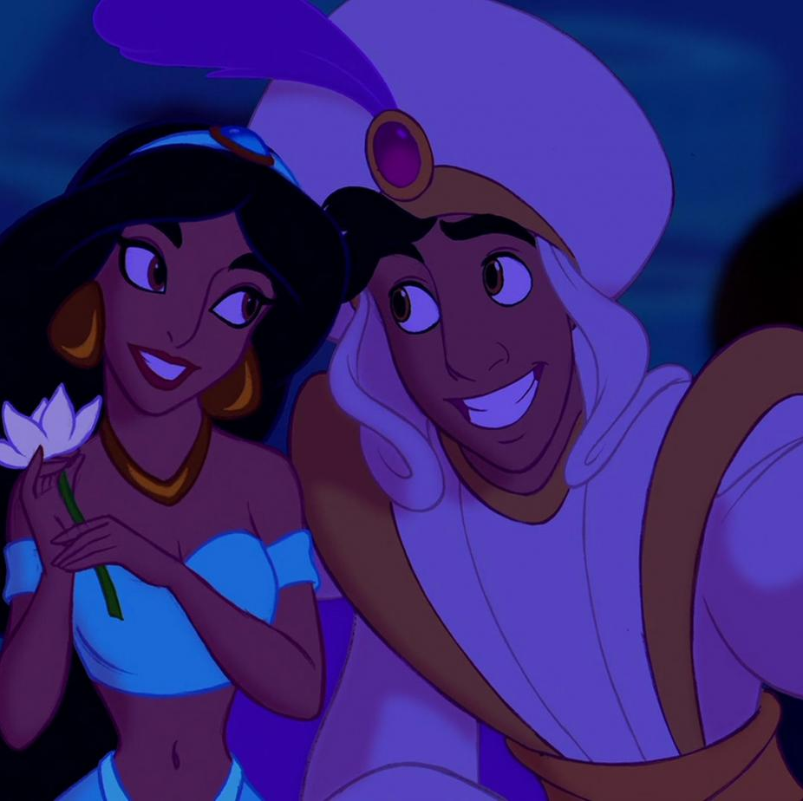
15. A whole new world- aladdin
I’ll chase them anywhere, there’s time to spare
And then we’re home (there’s time to spare)
Let me share this ___ ____ ___ ___ ___.

Slide 45
15. A whole new world- aladdin
I’ll chase them anywhere, there’s time to spare
And then we’re home (there’s time to spare)
Let me share this ___ ____ ___ ___ ___.
Shooting stars with you
Thrilling chase and wondrous place
Whole new world with you
A.

Slide 46
15. A whole new world- aladdin
I’ll chase them anywhere, there’s time to spare
And then we’re home (there’s time to spare)
Let me share this ___ ____ ___ ___ ___.
Answer: C
Whole new world with you

Slide 47
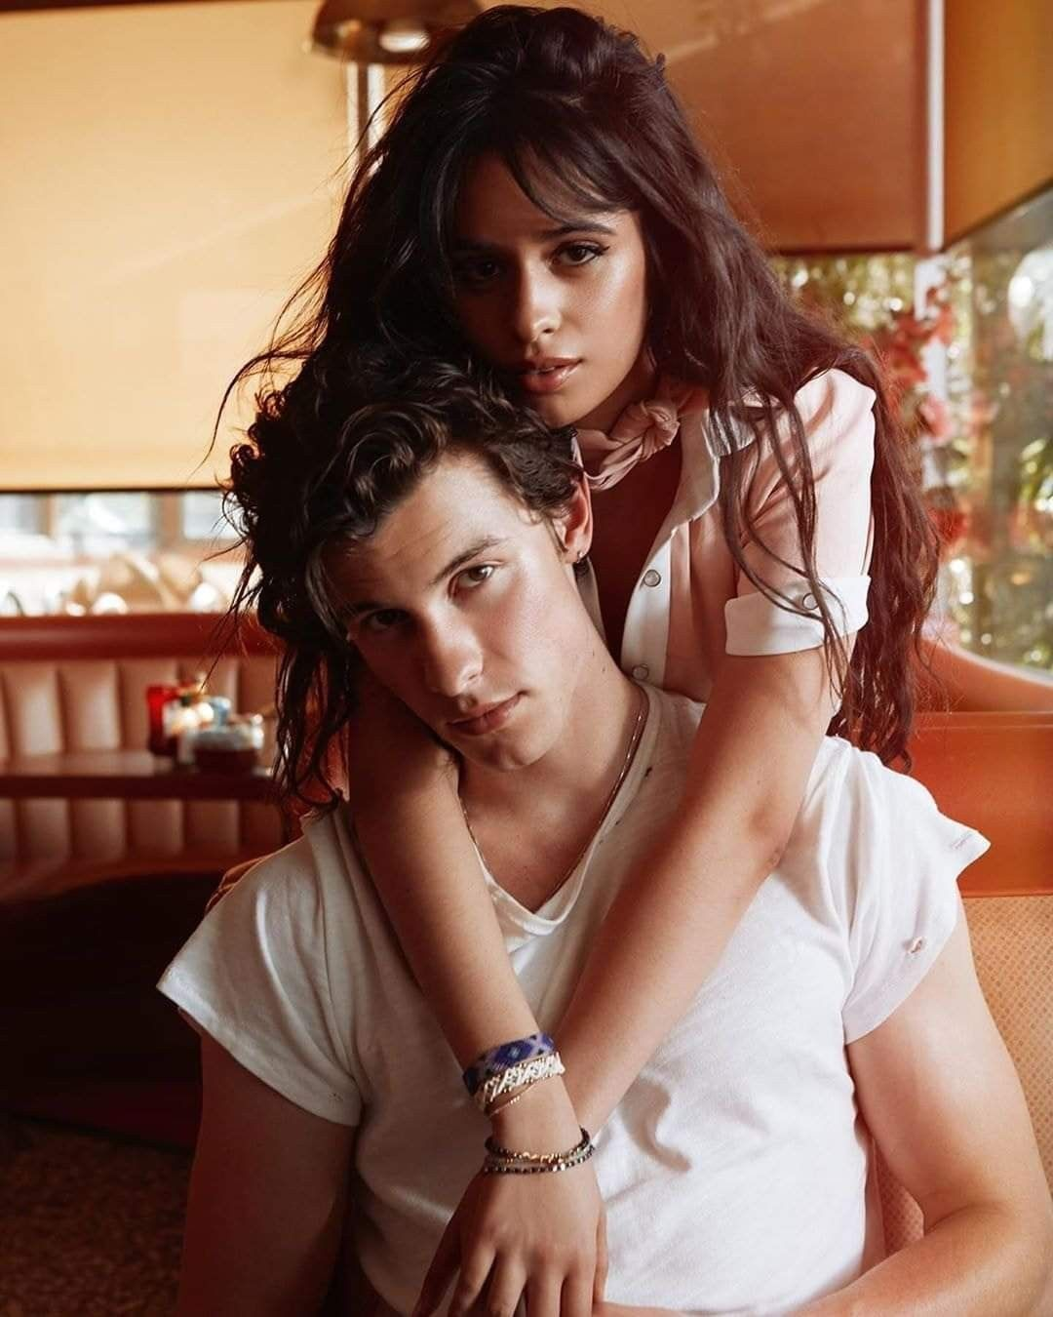
16. Camila Cabello Ft. Shawn mendes
I love it when you call me Senorita
I wish I could pretend I didn’t need ya
But every touch is ooh-la-la-la, it’s true-la-la-la
Ooh, I should be running, ooh __ ___ __ ____ ___ ___

Slide 48
16. Camila Cabello Ft. Shawn mendes
I love it when you call me Senorita
I wish I could pretend I didn’t need ya
But every touch is ooh-la-la-la, it’s true-la-la-la
Ooh, I should be running, ooh __ ___ __ ____ ___ ___
We danced for hours in the sand
You keep me coming for ya
We’re just friends la-la-la

Slide 49
16. Camila Cabello Ft. Shawn mendes
I love it when you call me Senorita
I wish I could pretend I didn’t need ya
But every touch is ooh-la-la-la, it’s true-la-la-la
Ooh, I should be running, ooh
Answer: B
You keep me coming for ya

Slide 50
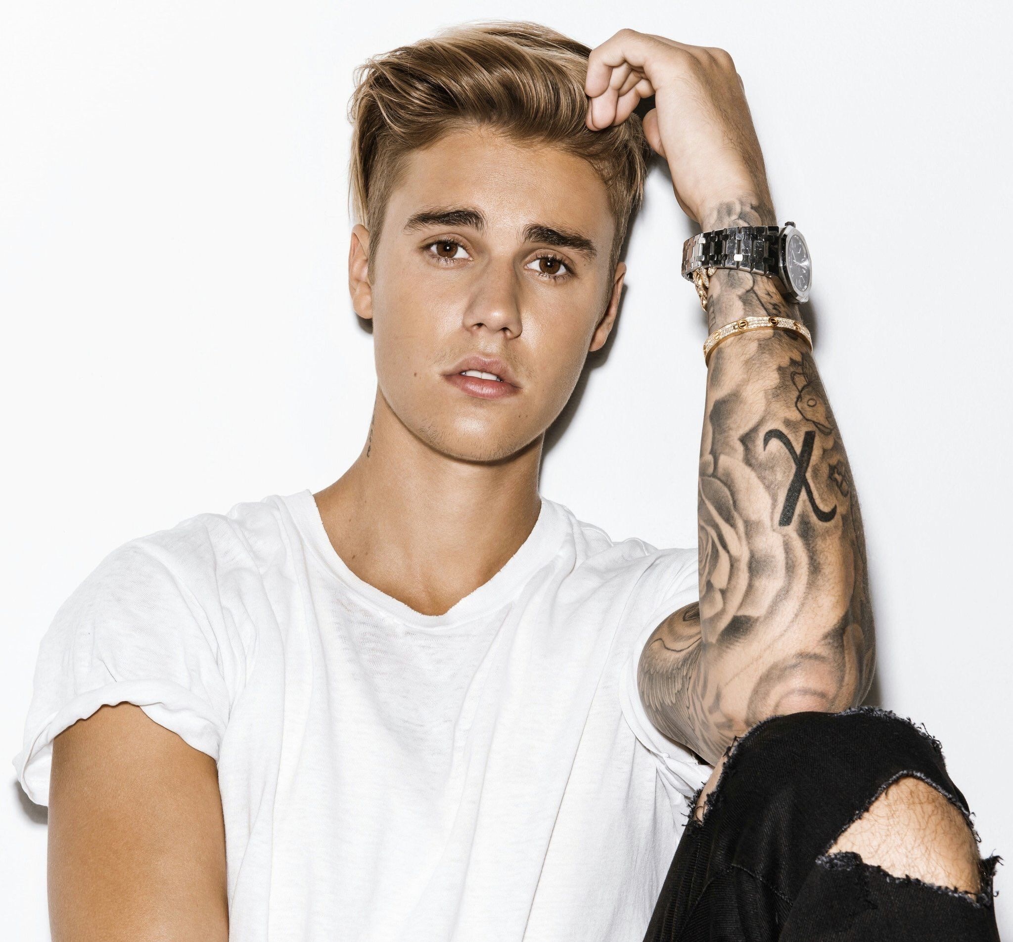
17. Sorry- justin beiber
I’m not just tryna get you back on me
‘cause I’m missin’ more than just your body
Oh, is it too late now to say sorry?
Yeah, __ __ ___ __ ___ ___ ___
Is it too late to say sorry now?

Slide 51
17. Sorry- justin beiber
I’m not just tryna get you back on me
‘cause I’m missin’ more than just your body
Oh, is it too late now to say sorry?
Yeah, __ __ ___ __ ___ ___ ___
Is it too late to say sorry now?
I know that I let you down
I’ll take every single piece of the blame
I made those mistakes maybe once or twice

Slide 52
17. Sorry- justin beiber
I’m not just tryna get you back on me
‘cause I’m missin’ more than just your body
Oh, is it too late now to say sorry?
Yeah, __ __ ___ __ ___ ___ ___
Is it too late to say sorry now?
Answer: A
I know that I let you down

Slide 53
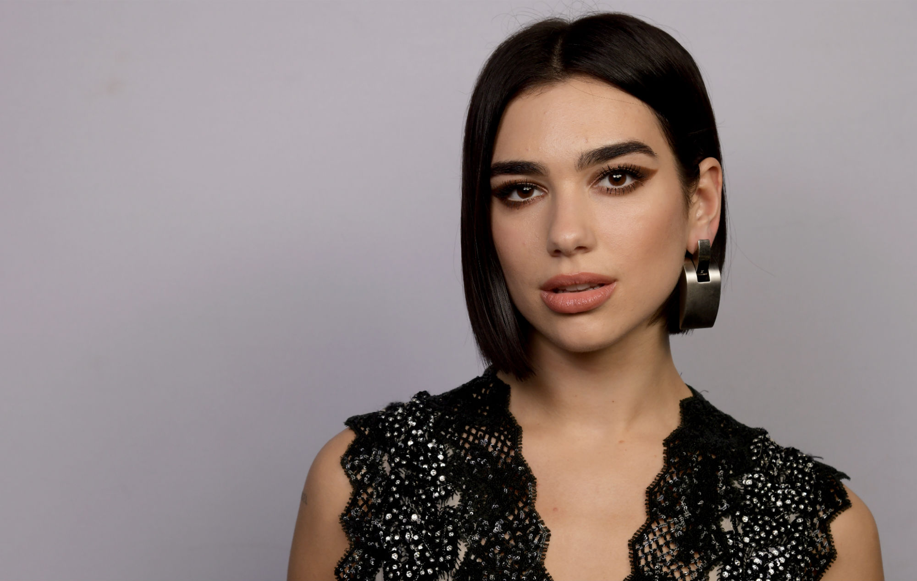
18. Don’t start now- dua lipa
Don’t show up, don’t come out
Don’t start caring about me now
Walk away, you know how
____ _____ ____ ____ ___ ___.

Slide 54
18. Don’t start now- dua lipa
Don’t show up, don’t come out
Don’t start caring about me now
Walk away, you know how
____ _____ ____ ____ ___ ___.
I’m all good already so move
Don’t start caring about me now
You wanna believe that anything could stop me

Slide 55
18. Don’t start now- dua lipa
Don’t show up, don’t come out
Don’t start caring about me now
Walk away, you know how
____ _____ ____ ____ ___ ___.
Answer: B
don’t start caring about me now

Slide 56
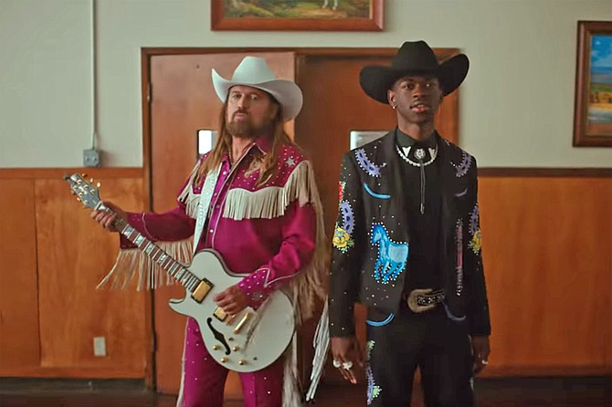
19. Old Town Road- Lil Nas X
Yeah, I’m gonna take my horse to the old town road
I’m gonna ride ‘til I can’t no more
I’m gonna take my horse to the old town road
I’m gonna ride ___ ___ ____ ___ ____.

Slide 57
19. Old Town Road- Lil Nas X
Yeah, I’m gonna take my horse to the old town road
I’m gonna ride ‘til I can’t no more
I’m gonna take my horse to the old town road
I’m gonna ride ___ ___ ____ ___ ____.
‘Til I can’t no more
Through all that
Roll back to that old town

Slide 58
19. Old Town Road- Lil Nas X
Yeah, I’m gonna take my horse to the old town road
I’m gonna ride ‘til I can’t no more
I’m gonna take my horse to the old town road
I’m gonna ride ___ ___ ____ ___ ____.
Answer: A
‘til I can’t no more

Slide 59
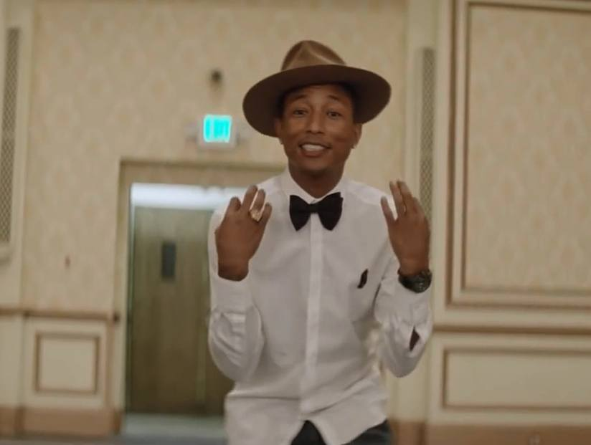
20. Happy- Pharrell Williams
Because I’m happy
Clap along if you feel like a room without a roof
Because i’m happy
Clap along if you feel happiness is the truth
Because I’m happy
Clap along if you know ___ _____ ___ ____ ___

Slide 60
20. Happy- Pharrell Williams
Because I’m happy
Clap along if you feel like a room without a roof
Because i’m happy
Clap along if you feel happiness is the truth
Because I’m happy
Clap along if you know ___ _____ ___ ____ ___
What happiness is the truth
Feel like that’s what you wanna do
Sunshine she’s here, you can take a break

Slide 61
20. Happy- Pharrell Williams
Because I’m happy
Clap along if you feel like a room without a roof
Because i’m happy
Clap along if you feel happiness is the truth
Because I’m happy
Clap along if you know ___ _____ ___ ____ ___
Answer: A
What happiness is to you

Slide 62
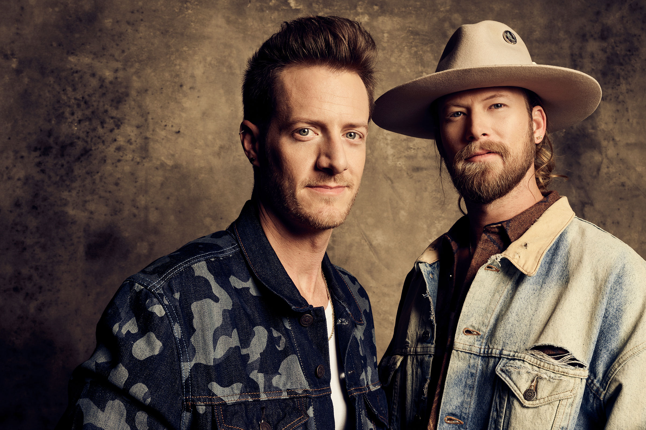
21. Cruise- Florida Georgia Line
Baby you a song
You make me wanna roll my windows down and cruise
Down a back road blowin’ stop signs through the middle
Every little farm town with you
In this brand new Chevy with a lift kit
It’d ___ __ ___ ____ ____ ____ ____ ___ ___ ___

Slide 63
21. Cruise- Florida Georgia Line
Baby you a song
You make me wanna roll my windows down and cruise
Down a back road blowin’ stop signs through the middle
Every little farm town with you
In this brand new Chevy with a lift kit
It’d ___ __ ___ ____ ____ ____ ____ ___ ___ ___
Look a hell lot better with you up in it
Wont change a thing, no way
Whippin’ cross the border Florida into Georgia

Slide 64
21. Cruise- Florida Georgia Line
Baby you a song
You make me wanna roll my windows down and cruise
Down a back road blowin’ stop signs through the middle
Every little farm town with you
In this brand new Chevy with a lift kit
It’d ___ __ ___ ____ ____ ____ ____ ___ ___ ___
Answer: A
Look a hell lot better with you up in it

Slide 65
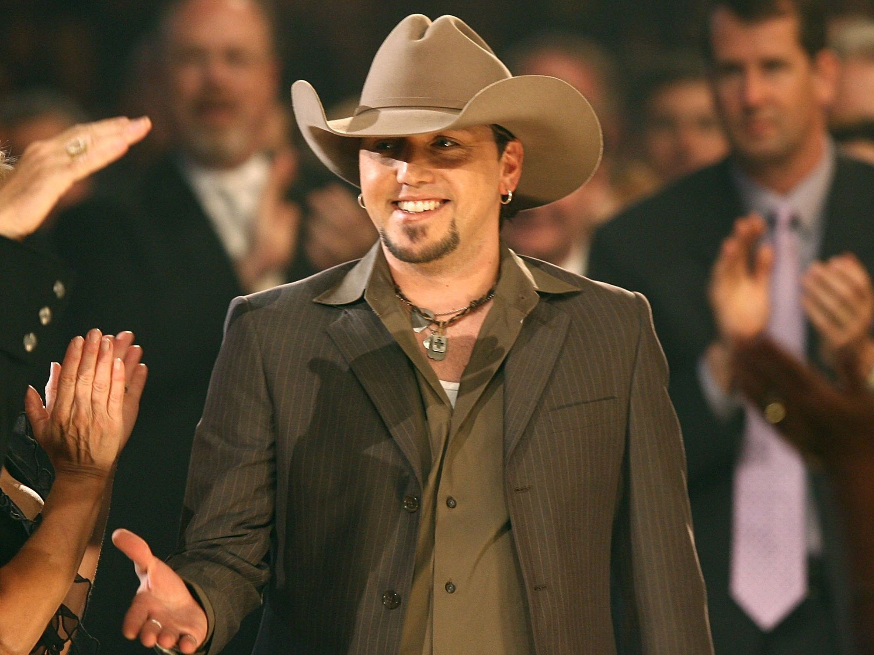
22. Big green tractor- Jason Aldean
You can climb up in my lap and drive if you want too
Girl, you know you got me to hold on to
___ ___ ___ ___ ___, if you’d rather
I’ll take you for a ride on my big green tractor

Slide 66
22. Big green tractor- Jason Aldean
You can climb up in my lap and drive if you want too
Girl, you know you got me to hold on to
___ ___ ___ ___ ___, if you’d rather
I’ll take you for a ride on my big green tractor
Ya’ll get in to drive
We can go to town
We can take another ride

Slide 67
22. Big green tractor- Jason Aldean
You can climb up in my lap and drive if you want too
Girl, you know you got me to hold on to
___ ___ ___ ___ ___, if you’d rather
I’ll take you for a ride on my big green tractor
Answer: B
We can go to town

Slide 68
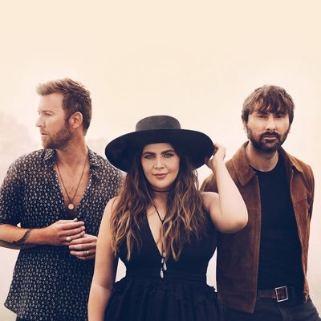
23. Just a kiss- lady antebellum
Just a shot in the dark that you just might
Be the one I’ve been waiting for my whole life
So baby I’m alright, oh, let’s do this right
___ ___ ___ ____ ______

Slide 69
23. Just a kiss- lady antebellum
Just a shot in the dark that you just might
Be the one I’ve been waiting for my whole life
So baby I’m alright, oh, let’s do this right
___ ___ ___ ____ ______
I don’t want to push too far
With just a kiss goodnight
But you’ll be in my dreams

Slide 70
23. Just a kiss- lady antebellum
Just a shot in the dark that you just might
Be the one I’ve been waiting for my whole life
So baby I’m alright, oh, let’s do this right
___ ___ ___ ____ ______
Answer: b
With just a kiss goodnight

Slide 71
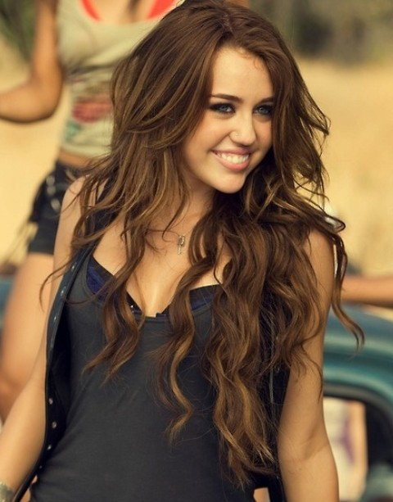
24. Party in the USA- miley Cyrus
So I put my hands up
They’re playing my song,
And the butterflies fly away
Noddin’ my head like, yeah
____ ___ ____ ___, ___
I got my hands up,
They’re playin’ my song

Slide 72
24. Party in the USA- miley Cyrus
So I put my hands up
They’re playing my song,
And the butterflies fly away
Noddin’ my head like, yeah
____ ___ ____ ___, ___
I got my hands up,
They’re playin’ my song
Movin’ my belly like, yeah
Movin’ my body like, yeah
Movin’ my hips like, yeah

Slide 73
24. Party in the USA- miley Cyrus
So I put my hands up
They’re playing my song,
And the butterflies fly away
Noddin’ my head like, yeah
____ ___ ____ ___, ___
I got my hands up,
They’re playin’ my song
Answer: C
Movin’ my hips like, yeah

Slide 74
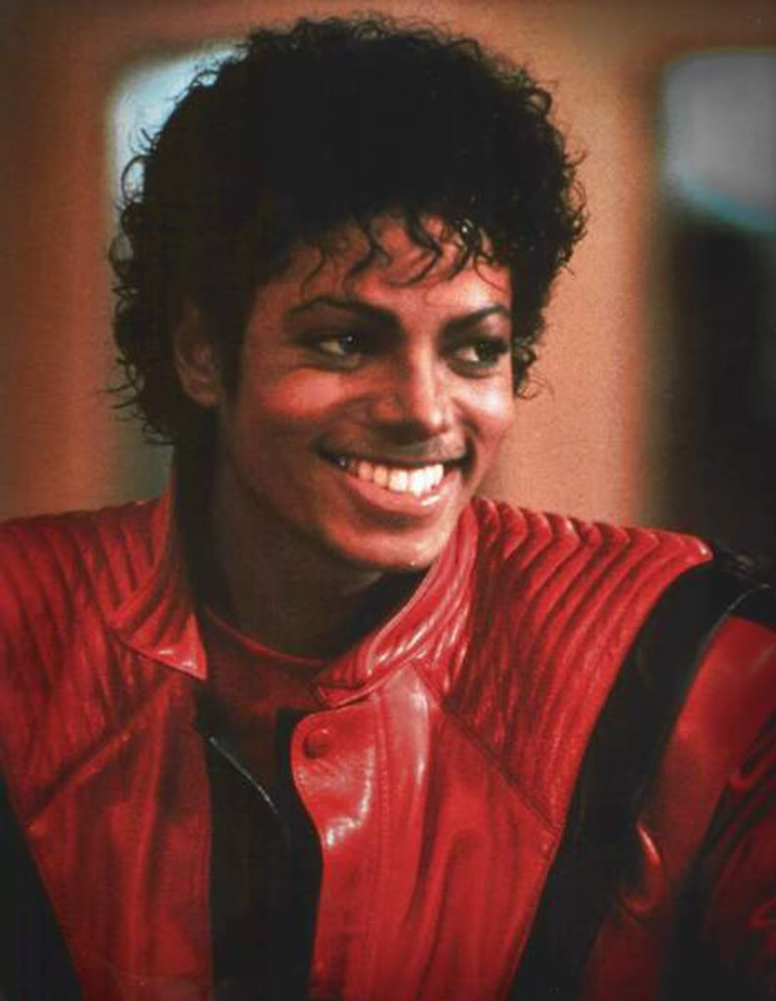
25. Thriller- Michael Jackson
It’s close to midnight
And something evil’s lurking in the dark
Under the moonlight, you see a sight that almost stops your heart
You try to scream, but terror ____ ___ ____ ____ ___ ___ ___

Slide 75
25. Thriller- Michael Jackson
It’s close to midnight
And something evil’s lurking in the dark
Under the moonlight, you see a sight that almost stops your heart
You try to scream, but terror ____ ___ ____ ____ ___ ___ ___
Takes the sound before you make it
Horror looks you right between your eyes
Gonna save you from the beast about to strike

Slide 76
25. Thriller- Michael Jackson
It’s close to midnight
And something evil’s lurking in the dark
Under the moonlight, you see a sight that almost stops your heart
You try to scream, but terror ____ ___ ____ ____ ___ ___ ___
Answer: A
Takes the sound before you make it

Slide 77
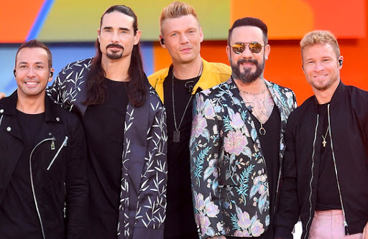
26. Everybody- back street boys
Everybody, yeah
Rock you body, yeah
Everybody
Rock you body right
______ ______ ____ ____
Alright

Slide 78
26. Everybody- back street boys
Everybody, yeah
Rock you body, yeah
Everybody
Rock you body right
______ ______ ____
Alright
Am I the only one? Yeah
Nsync back alright
Backstreet back alright

Slide 79
26. Everybody- back street boys
Everybody, yeah
Rock you body, yeah
Everybody
Rock you body right
______ ______ ____ ____
Alright
Answer: C
Backstreet back alright

Slide 80
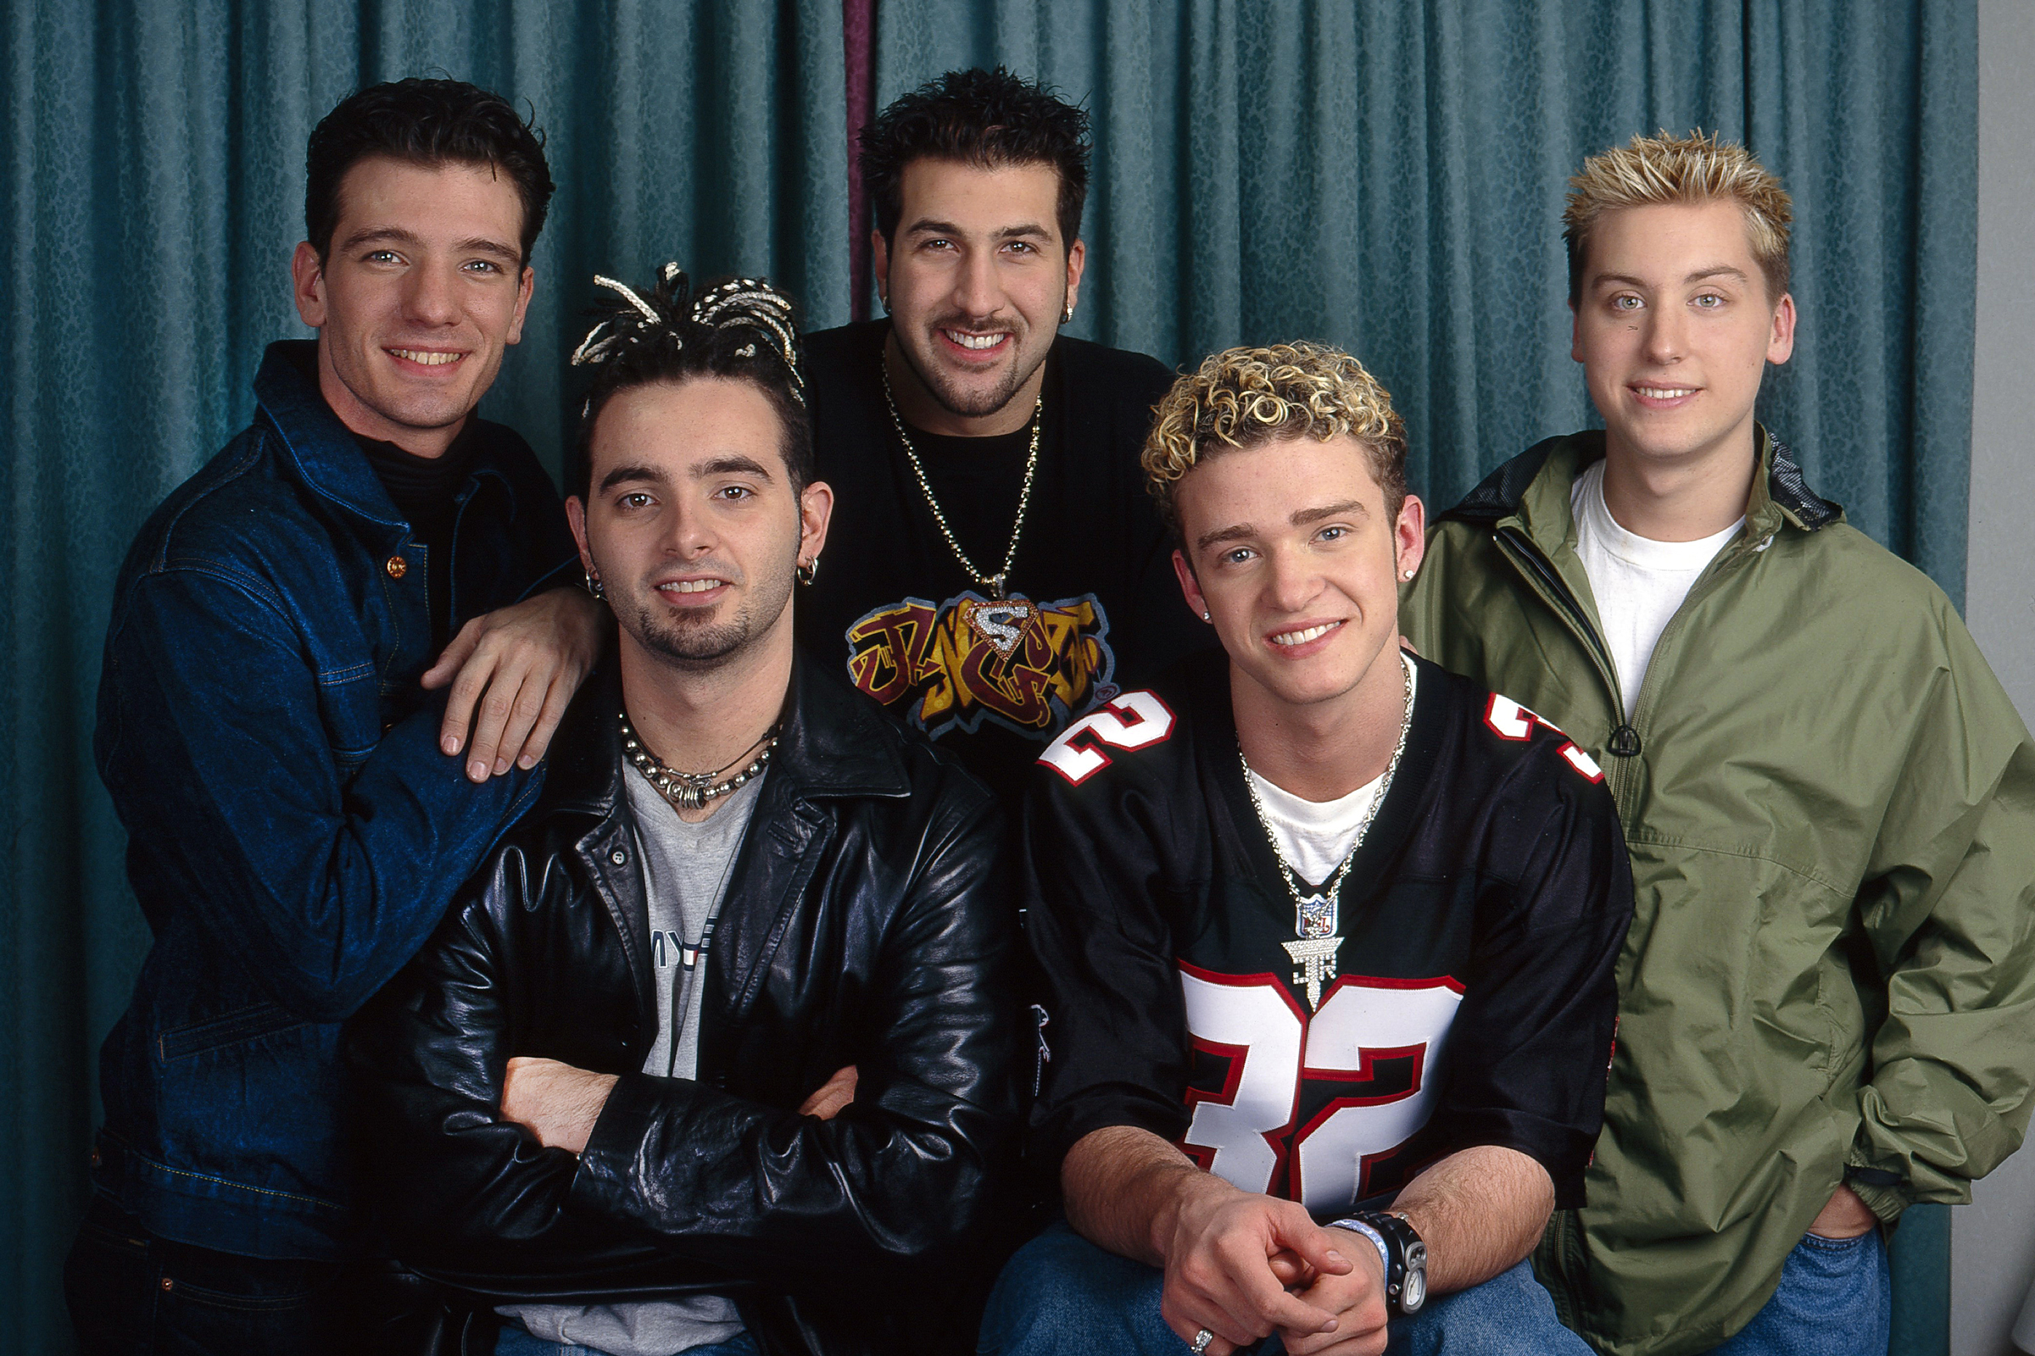
27. It’s gonna be me- nsync
Every little thing I do
Never seems enough for you
You don’t lose it again
But I’m not like them
Baby, ___ ___ ___ ___ ___ _____
Guess what? It’s gonna be me

Slide 81
27. It’s gonna be me- nsync
Every little thing I do
Never seems enough for you
You don’t lose it again
But I’m not like them
Baby, ___ ___ ___ ___ ___ _____ ___
Guess what? It’s gonna be me
When you finally get to love somebody
There comes a day when I’ll be the one you see
You know there ain’t no time to waste

Slide 82
27. It’s gonna be me- nsync
Every little thing I do
Never seems enough for you
You don’t lose it again
But I’m not like them
Baby, ___ ___ ___ ___ ___ _____
Guess what? It’s gonna be me
Answer: A
Baby, when you finally get to love somebody

