Slide 1
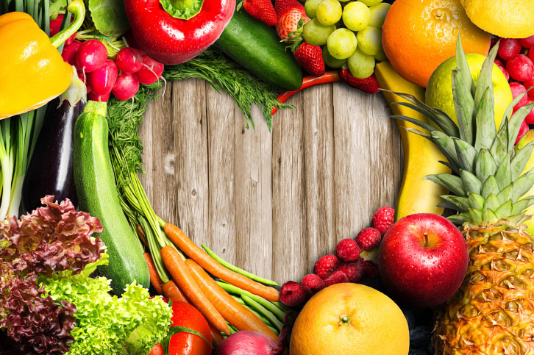
Nutrition 101

Slide 2
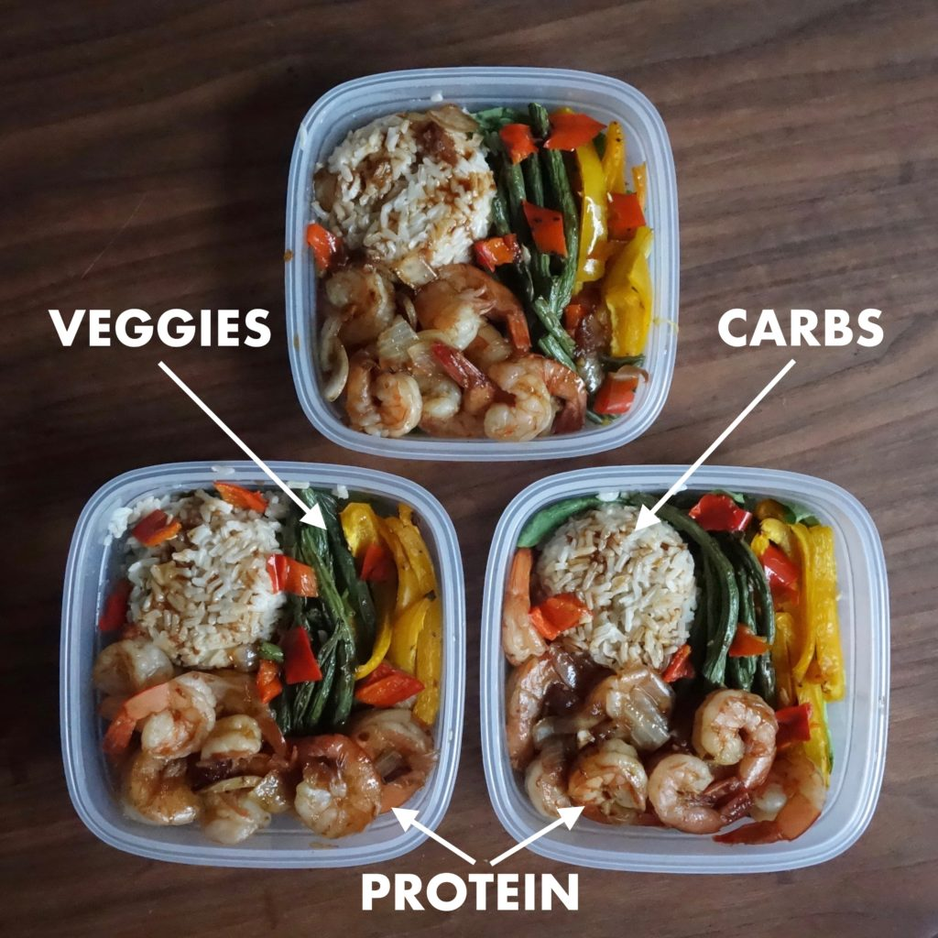
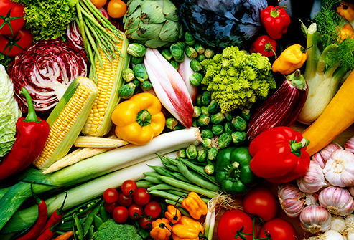
Healthy Eating Reminders
Make Half (or all) your whole grains
Focus on Fruits
Choose a variety of fruits, including a variety of colors. They can be canned, frozen or dried.
Vary your Veggies
Choose a wide variety of vegetable, including a variety of colors. They can be canned, frozen or dried.
Know YOUR limits” Fats, sugar, and Salt
Limit sugar, fats and salt (sodium)
Go Lean with Protein
Choose lean meats, poultry, beans and eggs
Dairy
If you have dairy food, choose low fat or non-fat dairy items

Slide 3
Choose My Plate
“Choose my plate” is to promote eating healthy and having a fine balance of fruits, vegetable, protein, grains and dairy.
Here is something to look at when balancing out meals for breakfast, lunch and dinner.

Slide 4
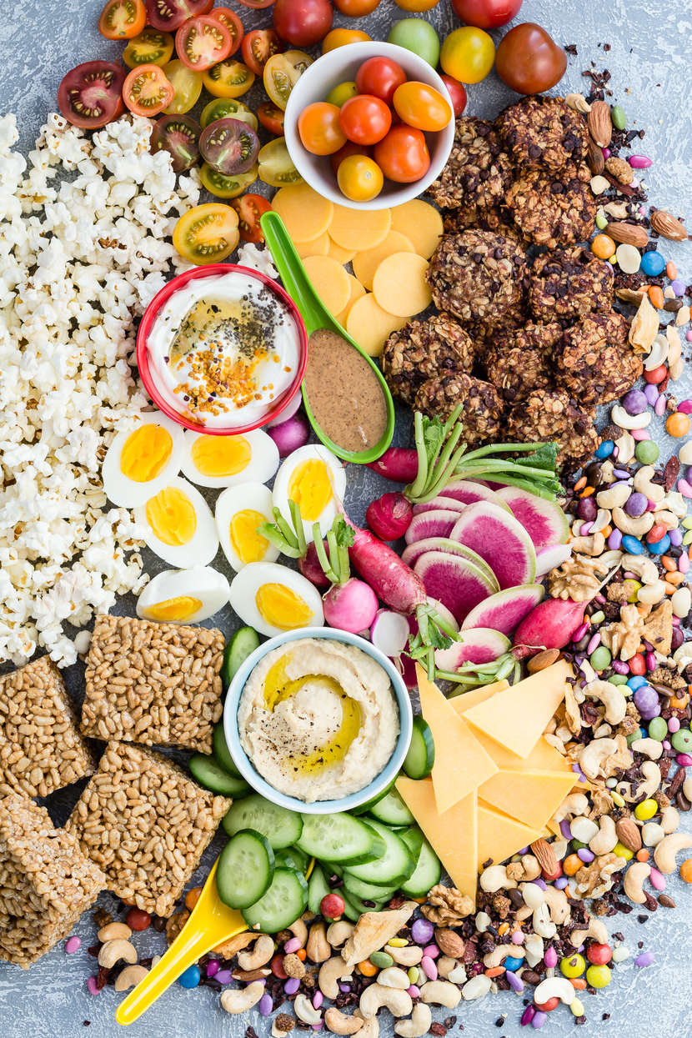
Snack Ideas
Apple slices with cinnamon
Oatmeal (1/4 cup dry, prepared) with frozen mixed berries
½ turkey sandwich on whole grain bread
Hard boiled egg and cucumber slices
Celery or other veggies with (hummus, ranch)
Fruits- blueberries, strawberries, oranges, grapes etc.
Oatmeal
Rice cakes
Cheese (cubes or sticks)
Skinny popcorn with dark chocolate chips
Applesauce
Whole grain toast with peanut butter with a banana (if allergic to peanut butter eat the bread only)

Slide 5
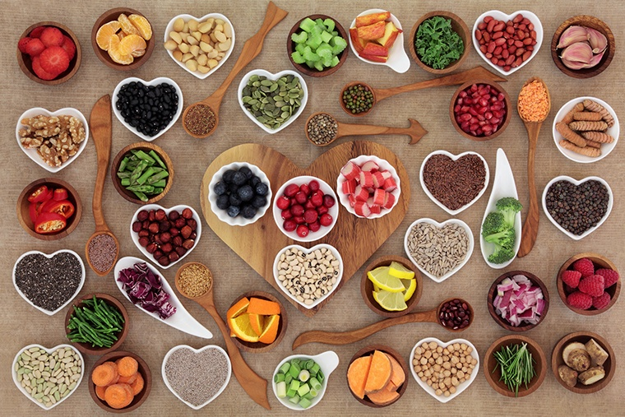
Make tiny changes
Focus on making small changes at each meal, by making healthier choices will help you improve your eating habits in a way that isn’t difficult.

Slide 6
Breakfast
Instead of: | Try:
Fruit flavored yogurt and store bought muffin | Plain yogurt topped with berries, granola
Bowl or surgery cereal with whole milk | Whole grain cereal with fruit and low-fat milk
Biscuits and gravy | Egg, whole wheat toast, orange
A large muffin or pastry from the bakery | Share with a friend

Slide 7
Lunch
Instead of: | Try:
1 slice of pizza | Whole grain English muffin pizza with a small amount of cheese and a small salad
1 carton of fruit yogurt and a cookie | 1 carton of plain yogurt with fresh fruit added, and a few whole grain crackers

Slide 8
Dinner
Instead of: | Try:
Fish sticks and French fries | Grilled fish and roasted potatoes with vegetables
Fettucine alfredo with sausage | Whole grain pasta with marinara and a green salad
Chili in a bread bowl with cheese and sour cream | A bowl of chili with a whole grain roll
Fried Chicken and mashed potatoes | Baked chicken with roasted potatoes and vegetables

Slide 9
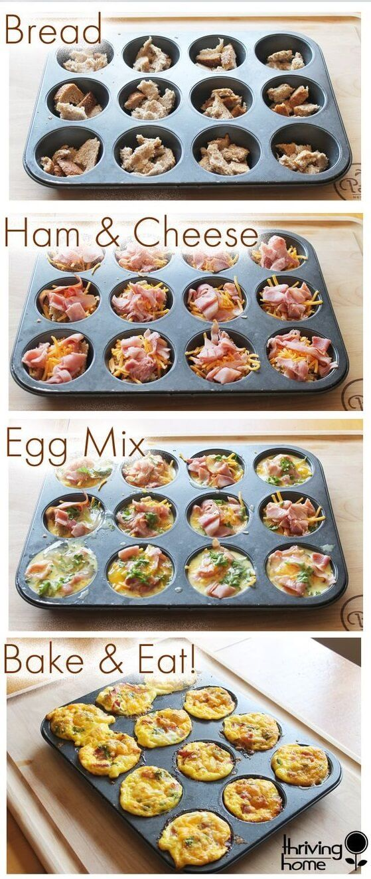
Breakfast Recipe
Ingredients
Instructions
Bread
Ham or Turkey
Cheese
Egg
Add anything you would want if your muffin.
Preheat oven to 350°F | 180°C. Lightly spray a 12-cup capacity muffin tin with nonstick oil spray.
In a large bowl, whisk eggs. Season with salt and pepper, to taste.
Add egg mixture halfway up into each tin of a greased muffin tin.
Bake for 20 minutes.
Serve OR store in an airtight container in the refrigerator for up to 4 days and reheat when ready to serve.

Slide 10
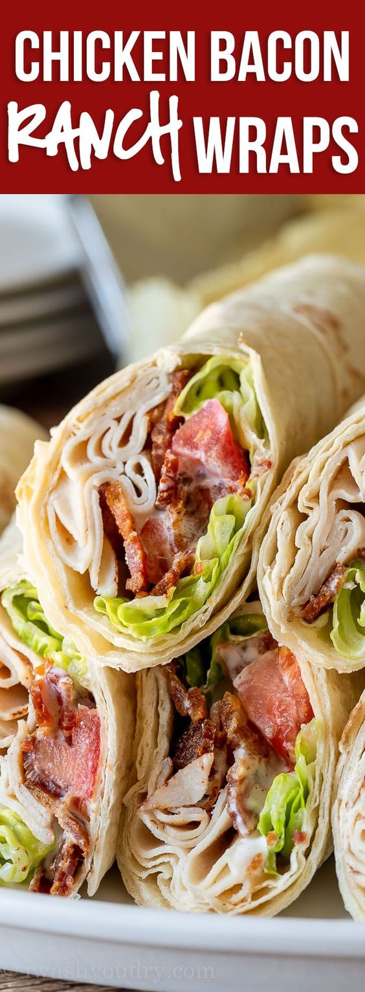
Lunch Recipe
Ingredients
Instructions
Bread & Baking Goods
Tortillas
Condiments
Ranch Dressing
Any dressing you like
Produce
Lettuce
Tomatoes
Meats
Bacon strips
Turkey slices
Lay tortilla out on plate, top with 1/2 cup lettuce leaves in center of tortilla. Top with 2 tbsp. diced tomatoes, 1 tbsp. ranch dressing, 2 strips cooked bacon and 2 oz. chicken breast.
Roll up tortilla tightly and cut in half. Enjoy!

Slide 11
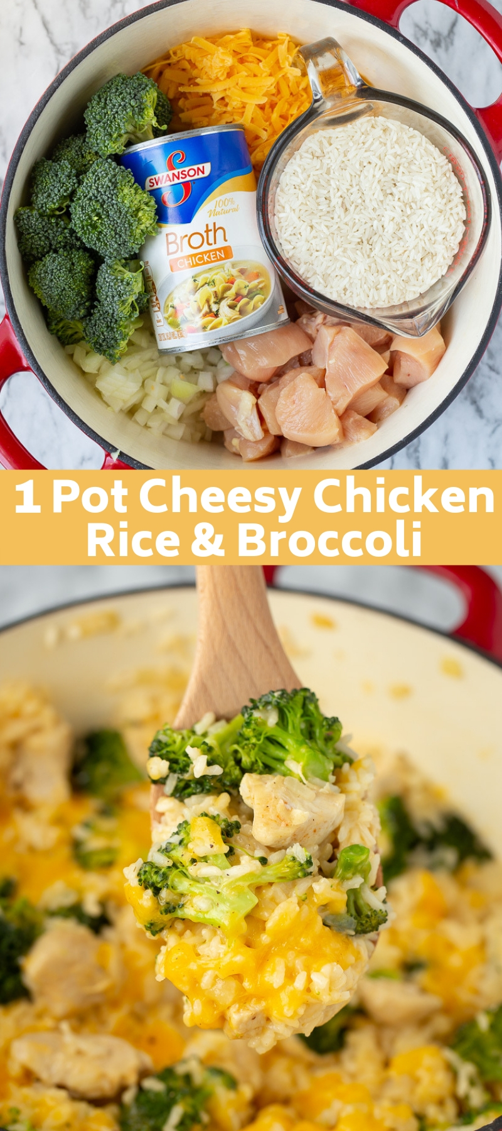
Dinner Recipe
Ingredients
Instructions
1 1/2 pound chicken breast cut into one-inch pieces
3 tbsp. extra virgin olive oil
½ medium yellow onion diced
2 tbsp. minced garlic
2 cups broccoli cut into bite-sized pieces
2 1/2 cups chicken broth
1/2 cup water
2 cups uncooked extra long grain white rice
2 cups shredded extra sharp cheddar cheese
salt and pepper to taste
a large pot, over medium-high heat, add the olive oil. Once shimmering, add the onions and sauté for 2-3 minutes.
Season chicken with the salt and pepper and add to the pot. Cook for 4-5 minutes or until there is no more pink visible.
Add the garlic and cook for one minute.
Add the rice, chicken broth, and water. Cover with a lid and turn the heat down to low.
Cook for 15 minutes stirring halfway through.
After 15 minutes remove the lid, stir the broccoli in, cover again and cook for 7-8 more minutes until the rice is cooked and tender.
Remove from heat and stir in 1 cup of cheese. Once stirred in, sprinkle the remaining cheese on top and cover for a few minutes to allow the cheese to melt. Serve while warm.

Slide 12
