Slide 1
Do you Know your Restaurants?

Slide 2
1 Point for each
Food Item
Restaurant
Price (Within .50 range)
*NO LOOKING UP ANSWERS ON PHONES/COMPUTERS/TABLETS

Slide 3
READY??????

Slide 4
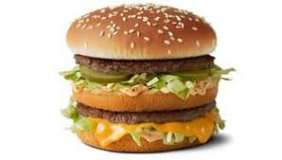
1.

Slide 5
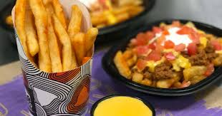
2.

Slide 6
3.

Slide 7
4.

Slide 8
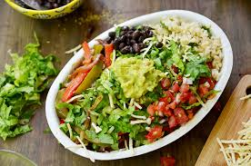
5.

Slide 9
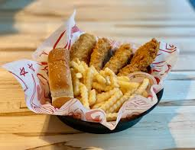
6.

Slide 10
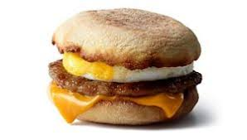
7.

Slide 11
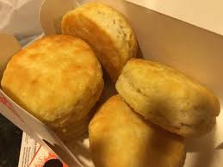
8.

Slide 12
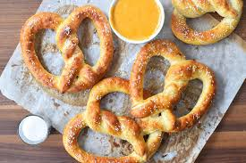
9.

Slide 13
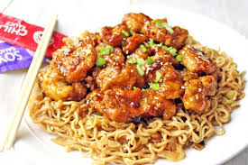
10.

Slide 14
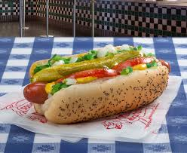
11.

Slide 15
12.

Slide 16
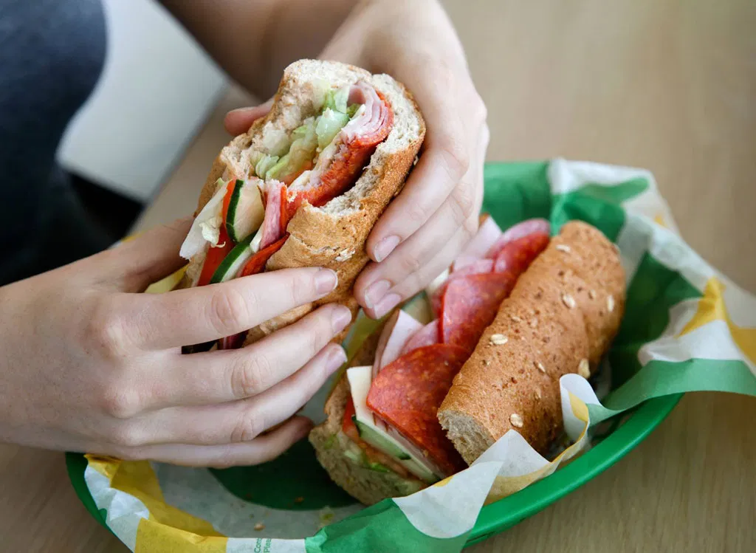
13.

Slide 17
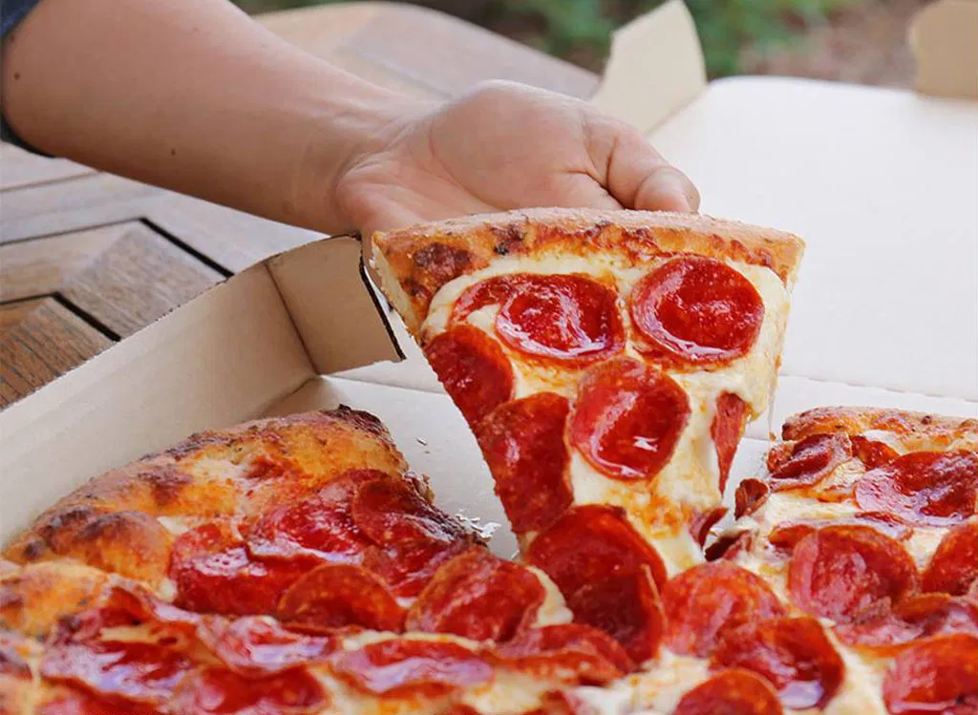
14.

Slide 18
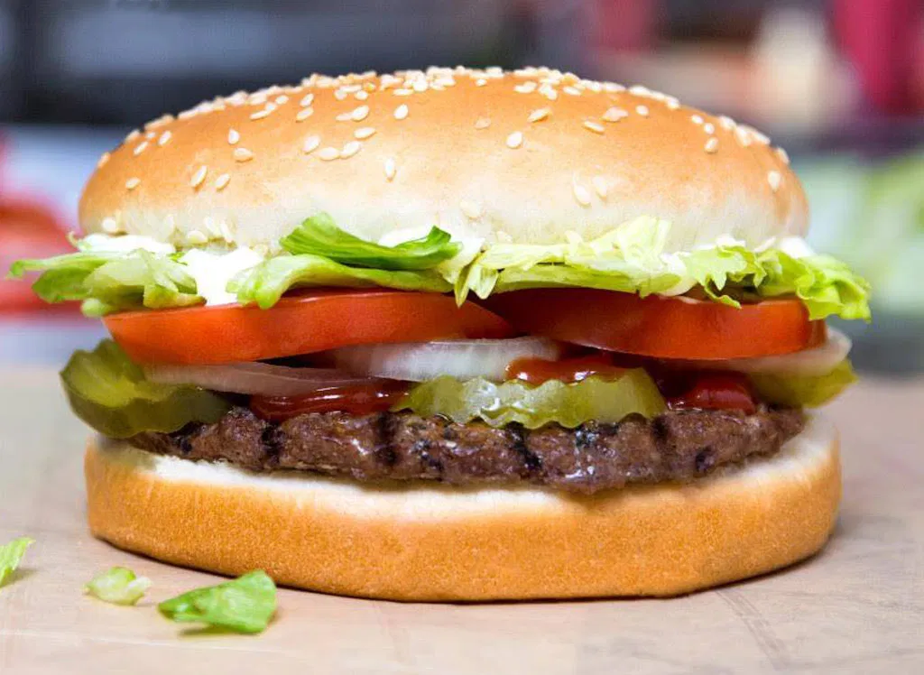
15.

Slide 19
16.

Slide 20
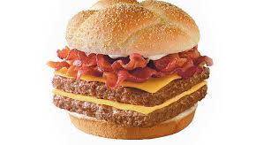
17.

Slide 21
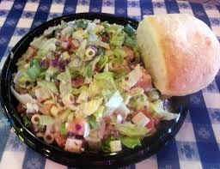
18.

Slide 22
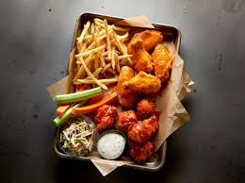
19.

Slide 23
20.

Slide 24
21.

Slide 25
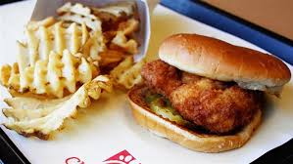
22.

Slide 26
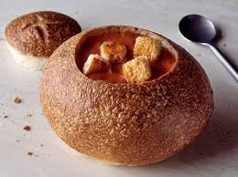
23.

Slide 27
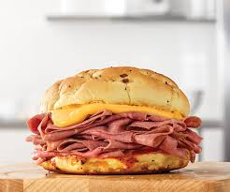
24.

Slide 28
25.

Slide 29
26.

