Slide 1

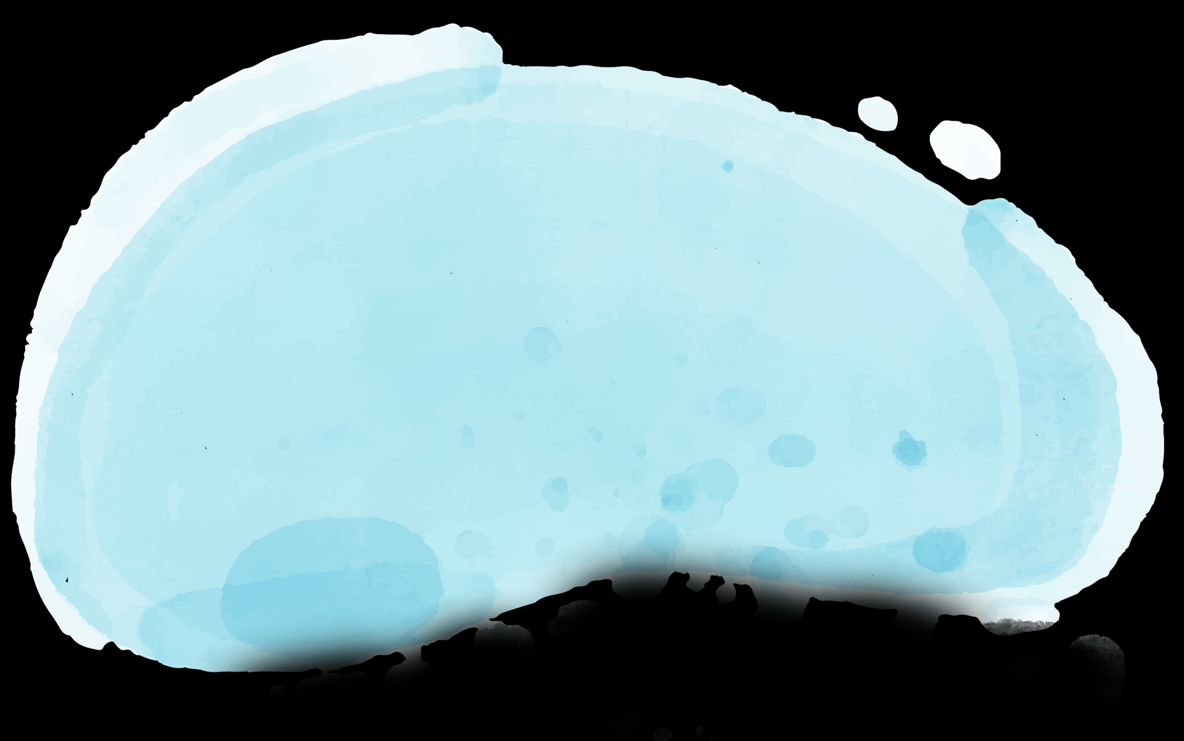
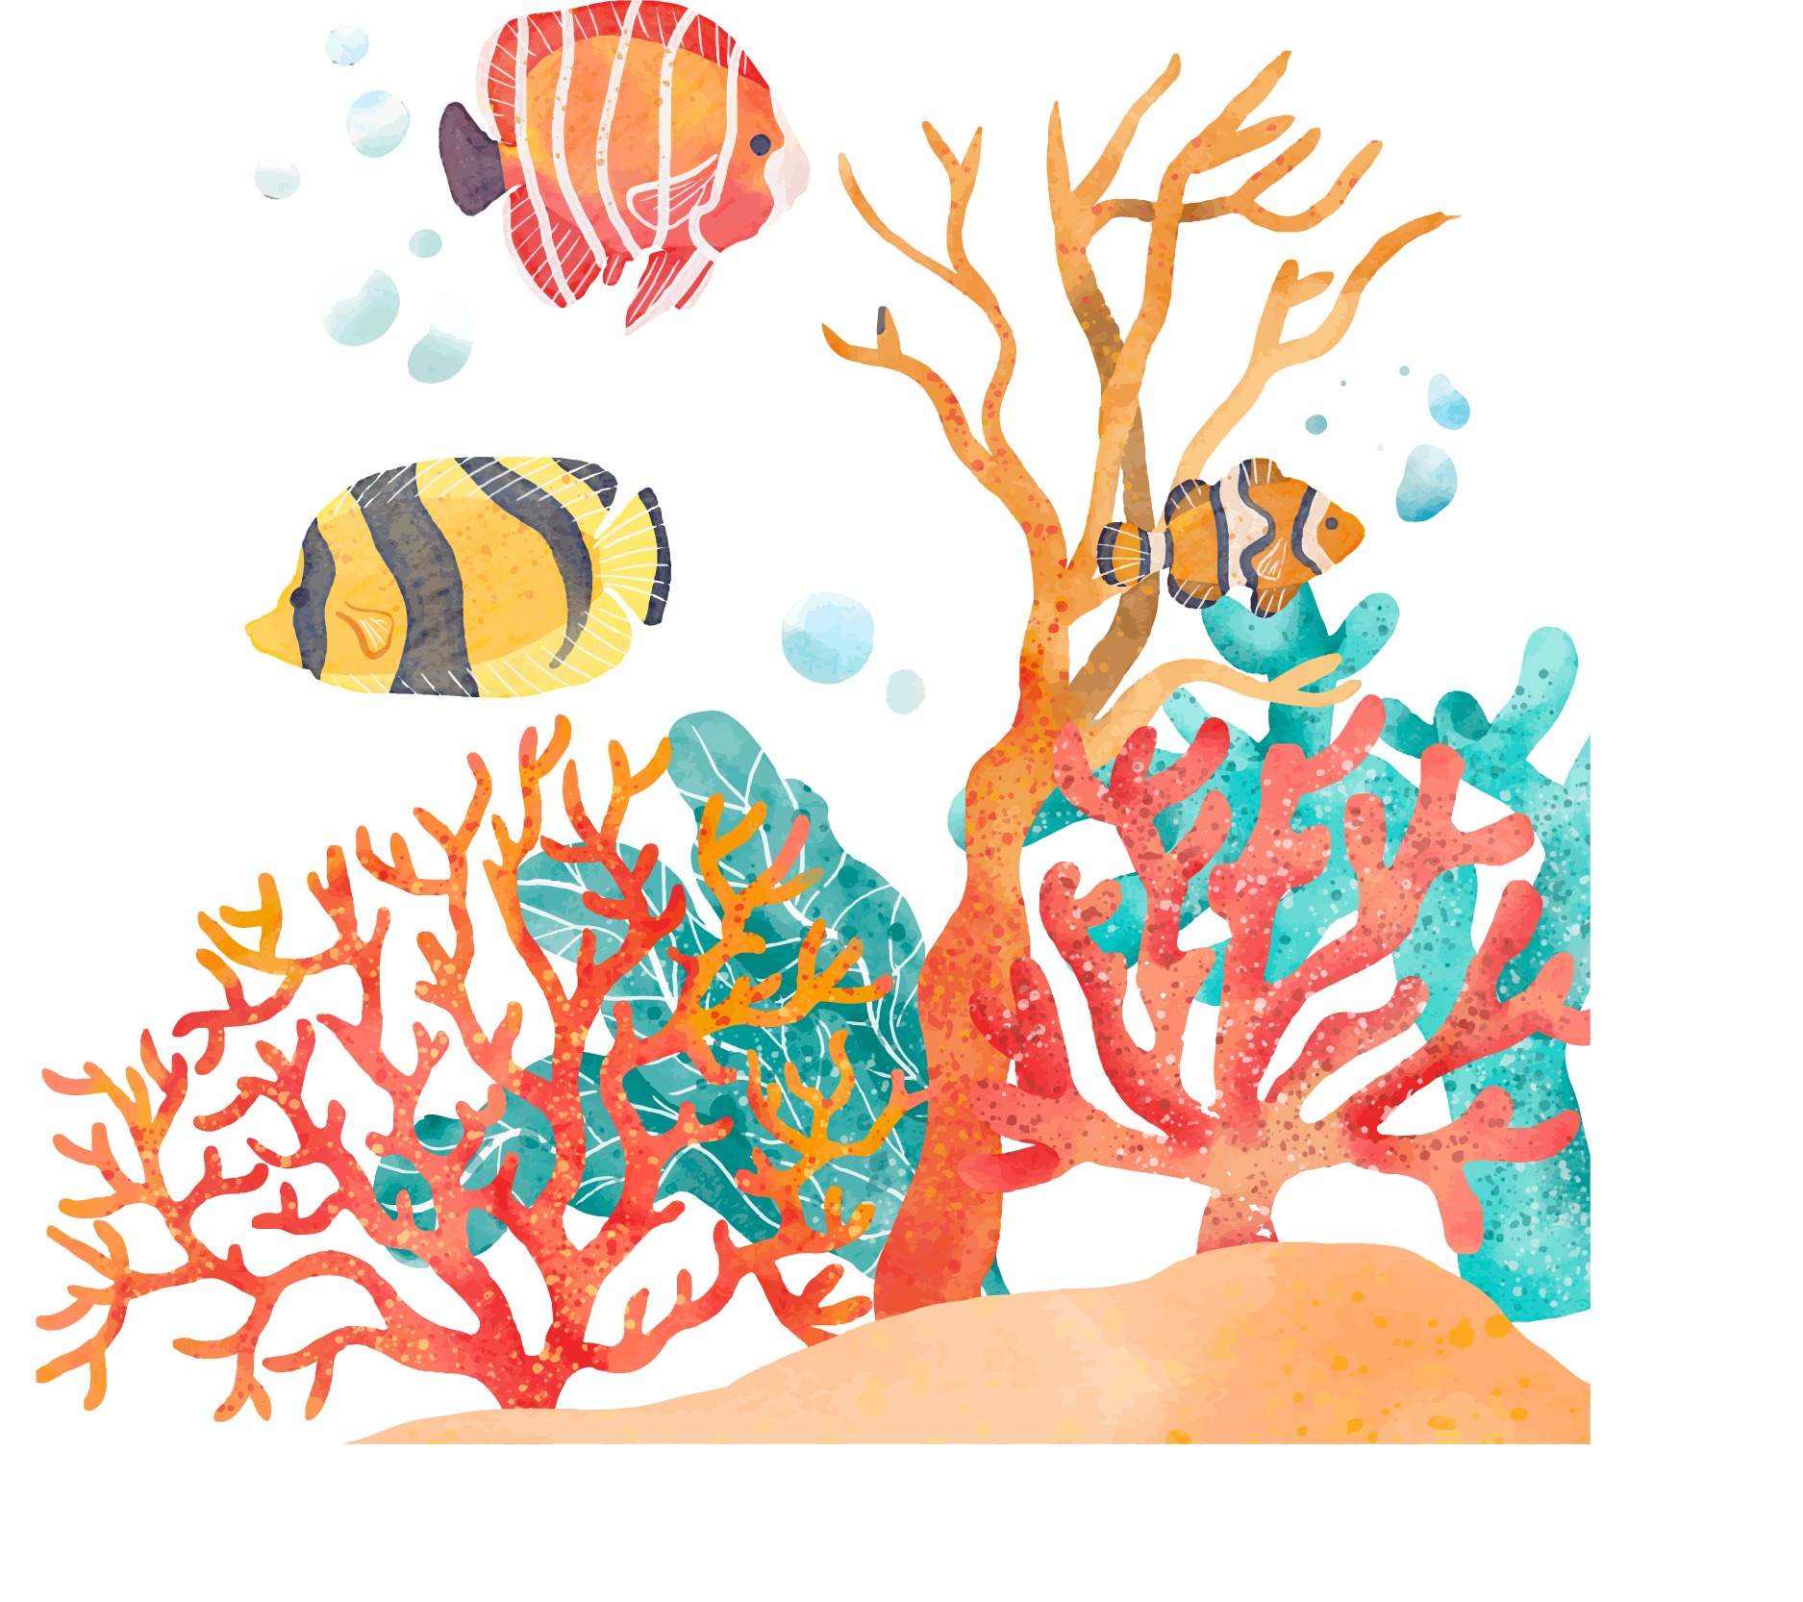


SeaQuest Virtual Field Trip

Slide 2
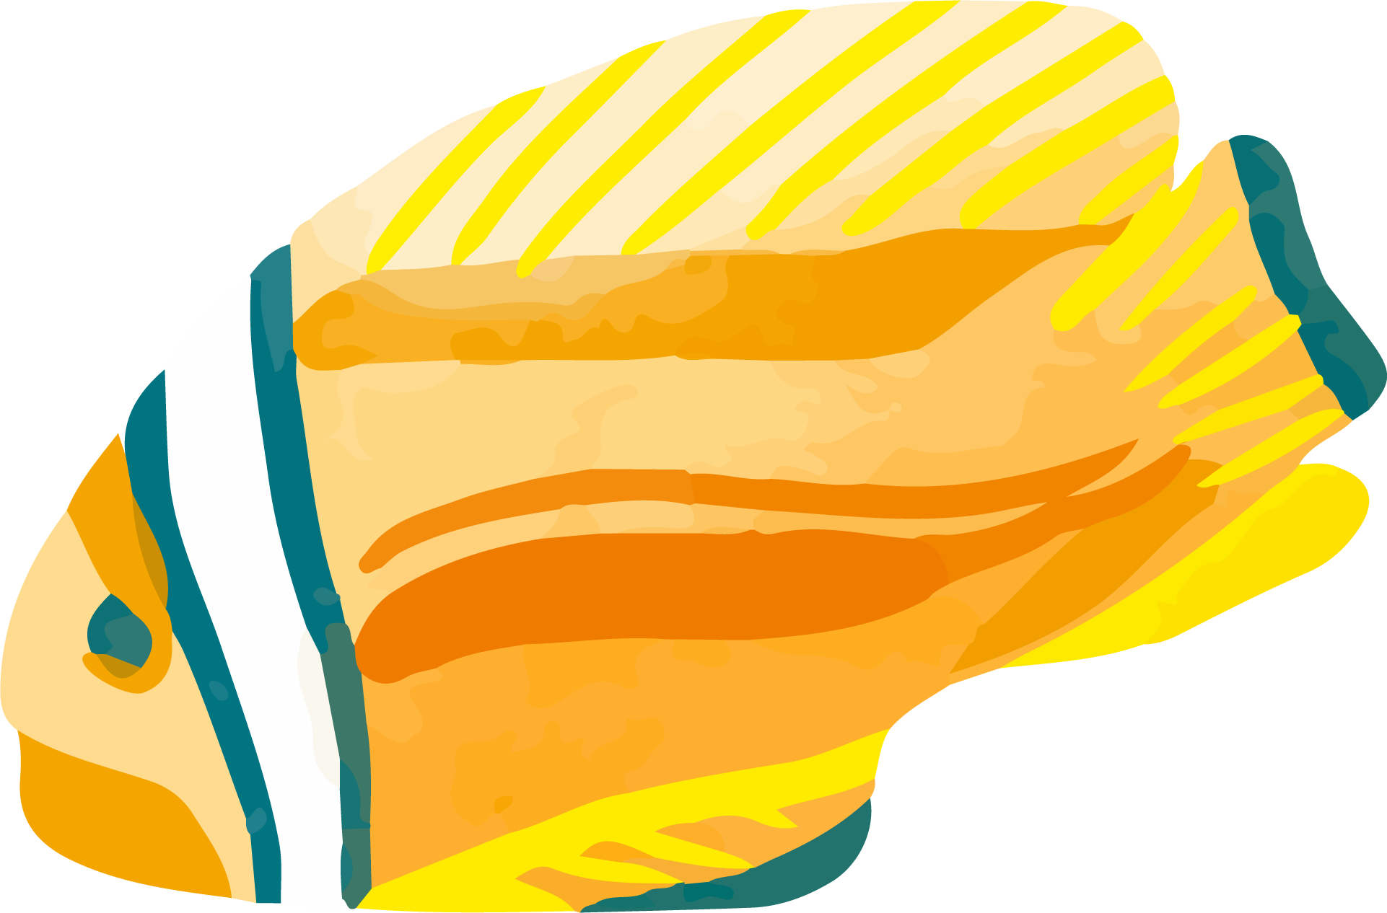

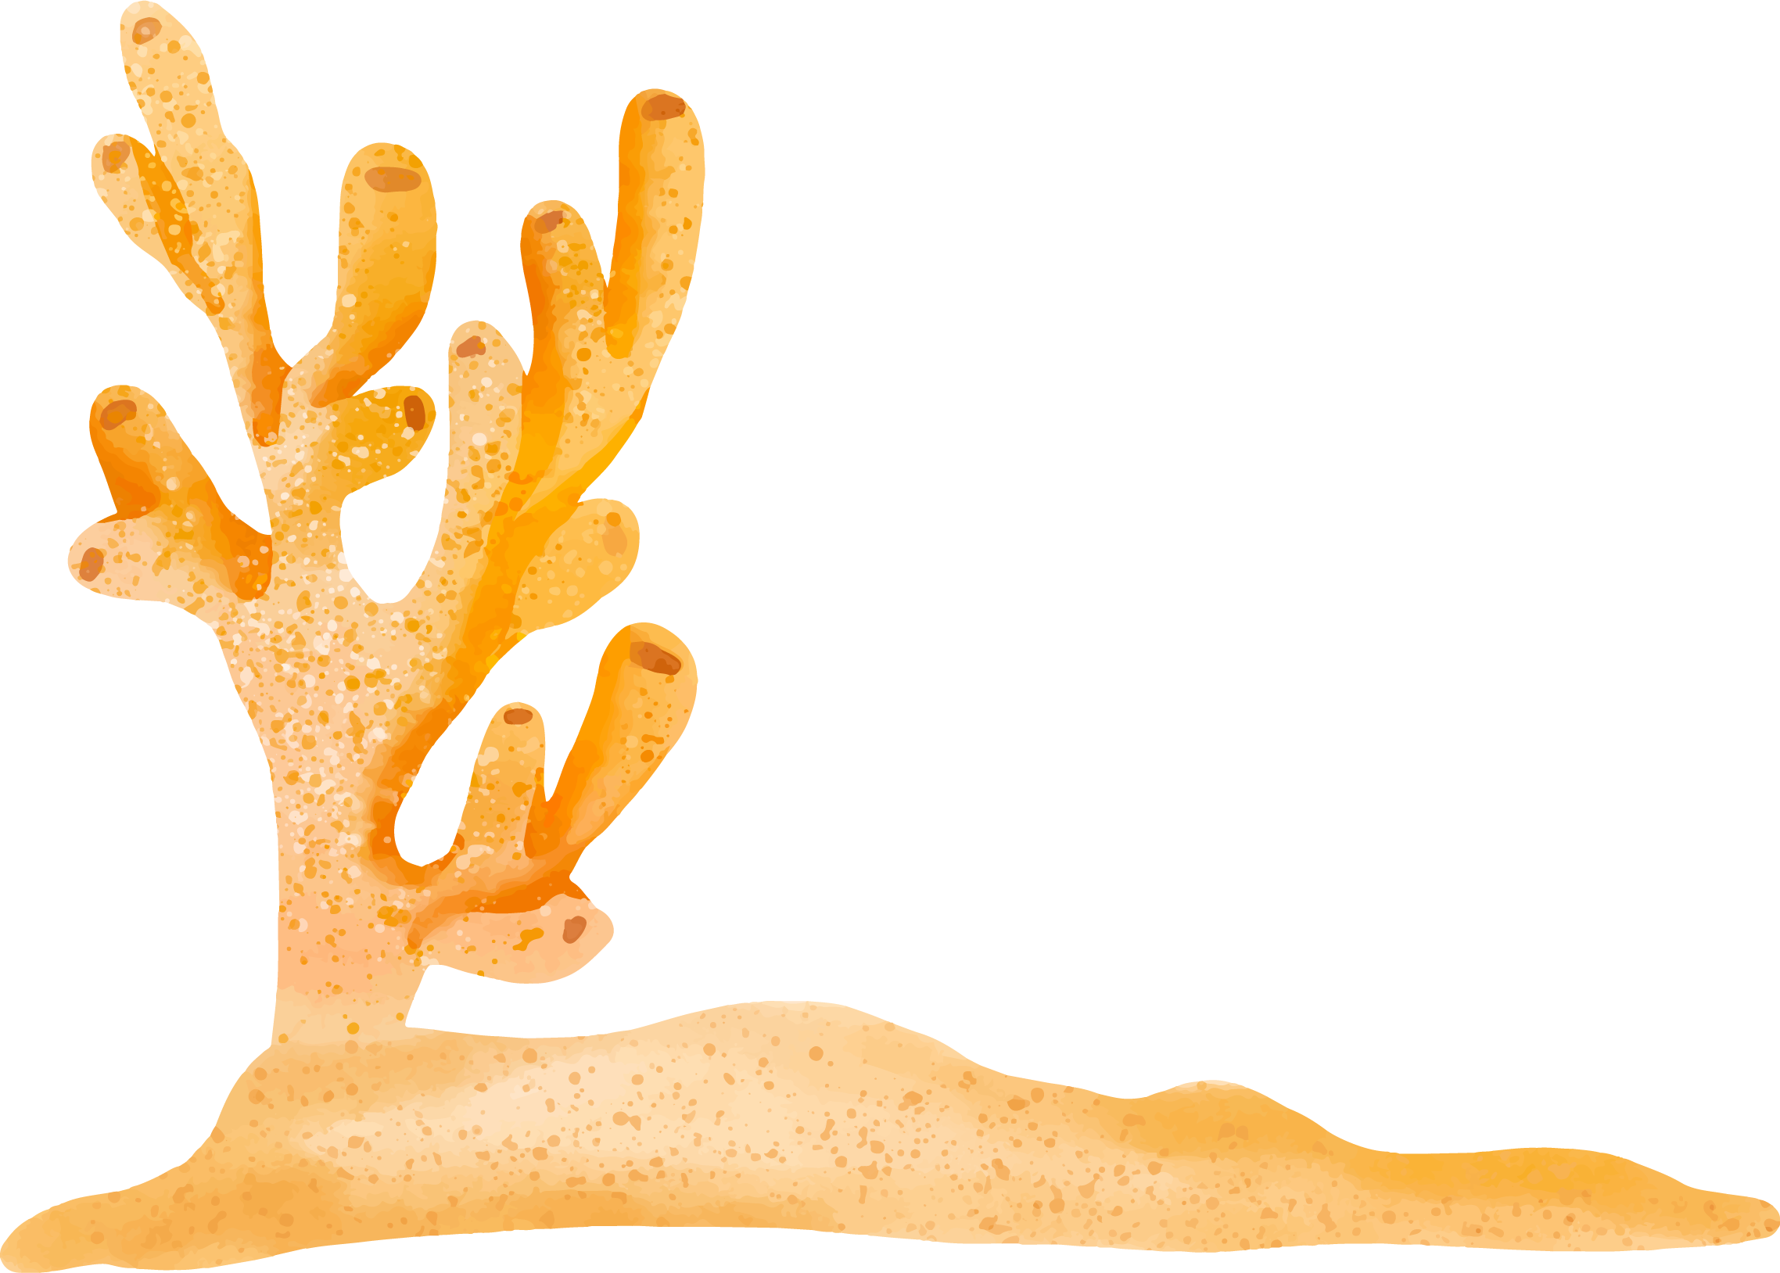
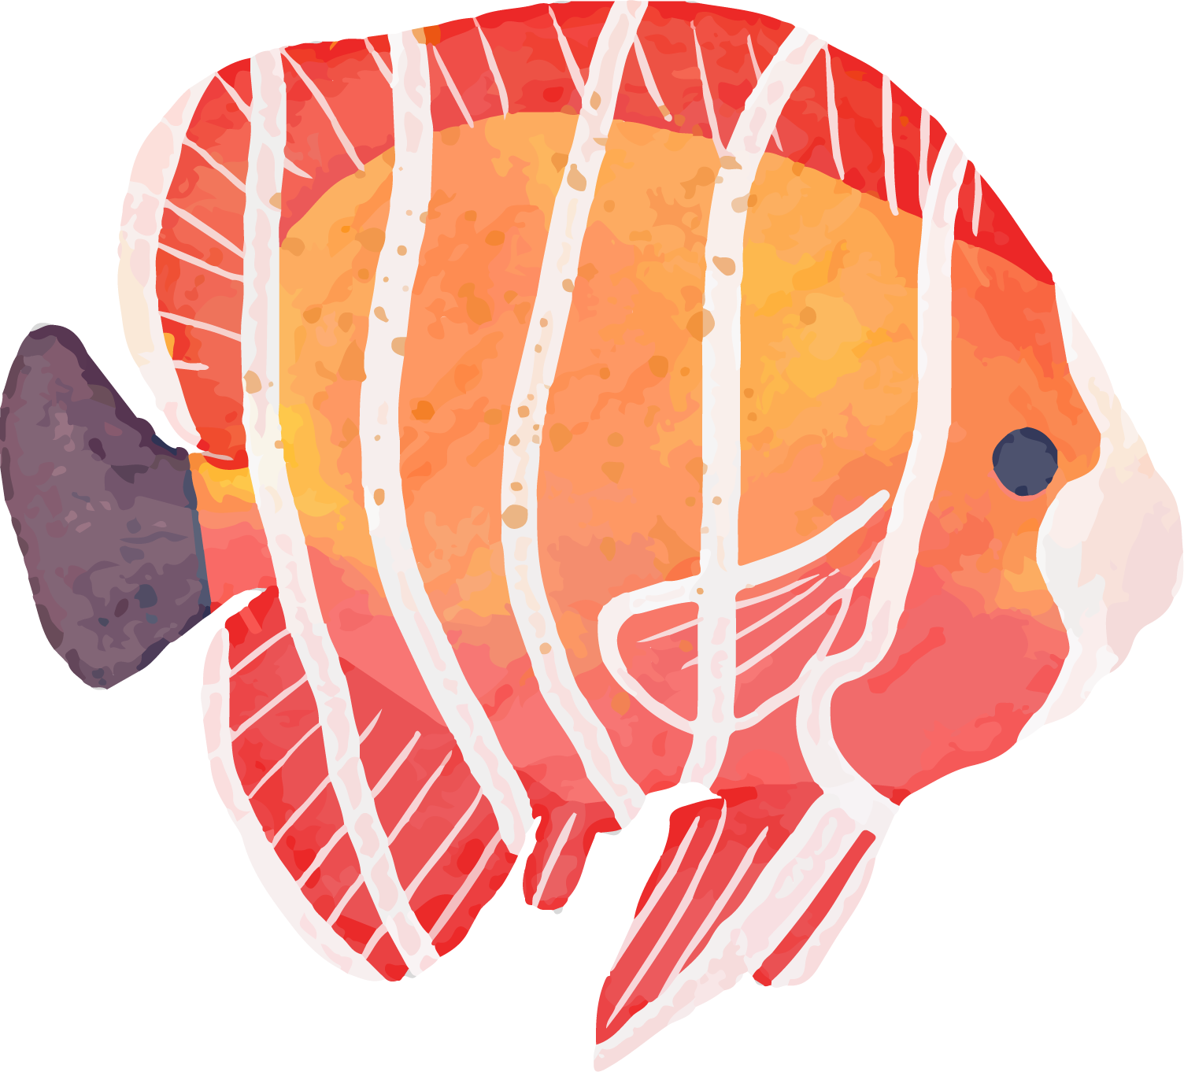


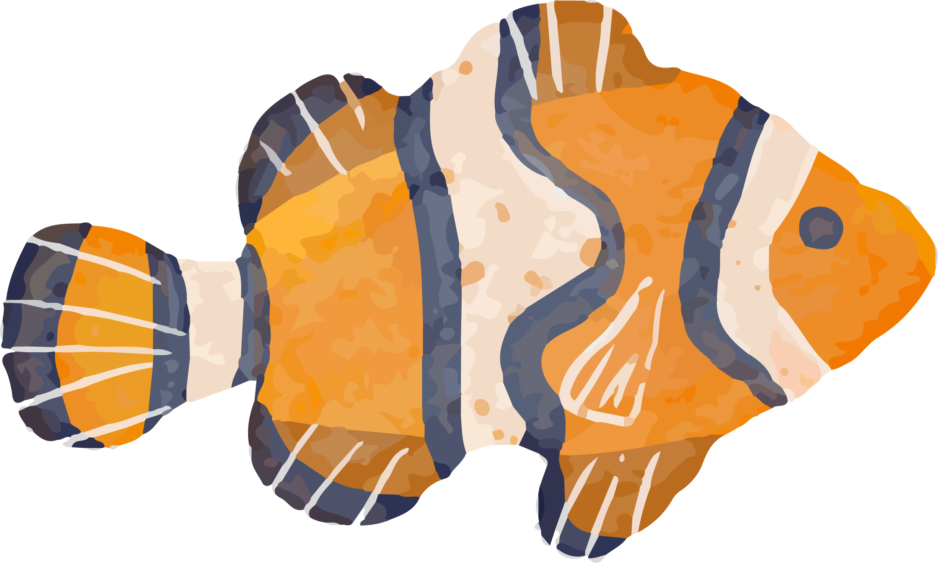
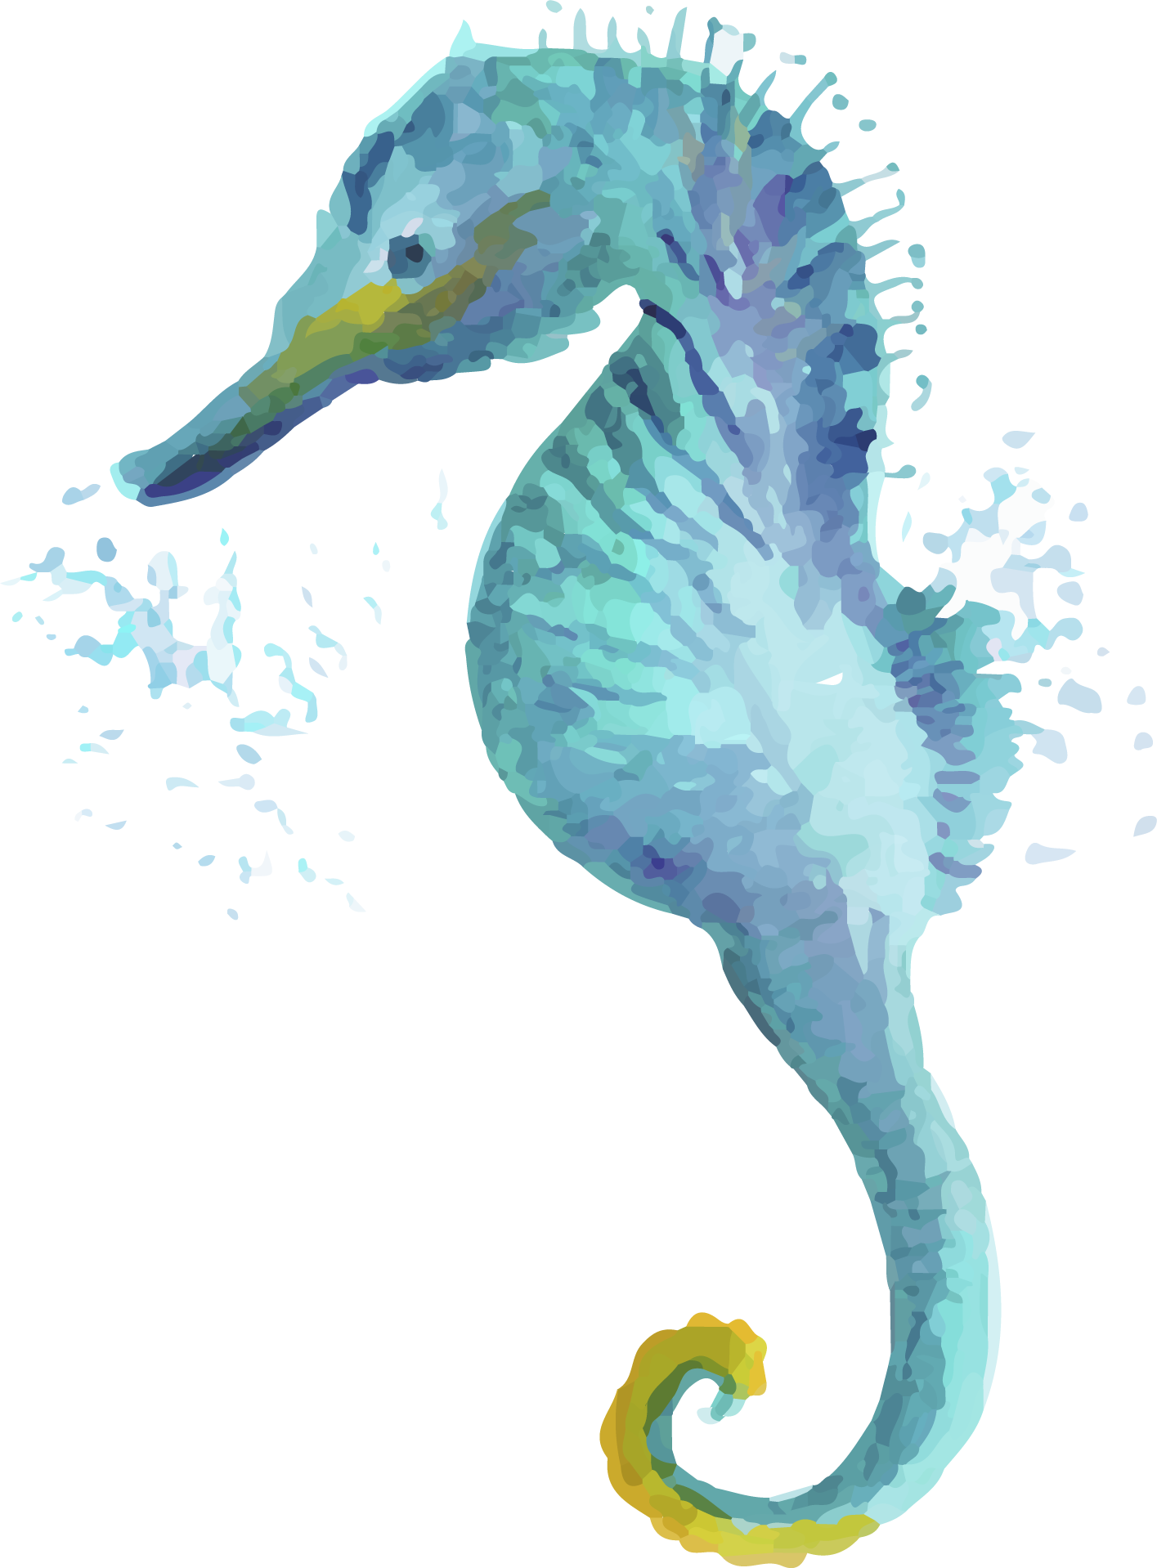
What is SeaQuest?

Slide 3
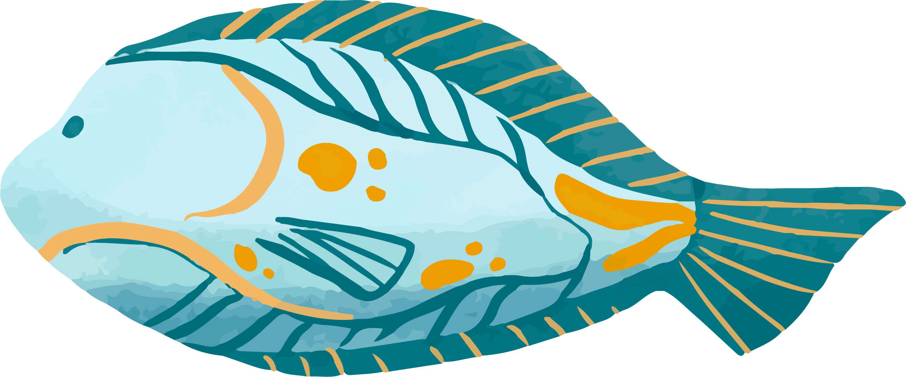
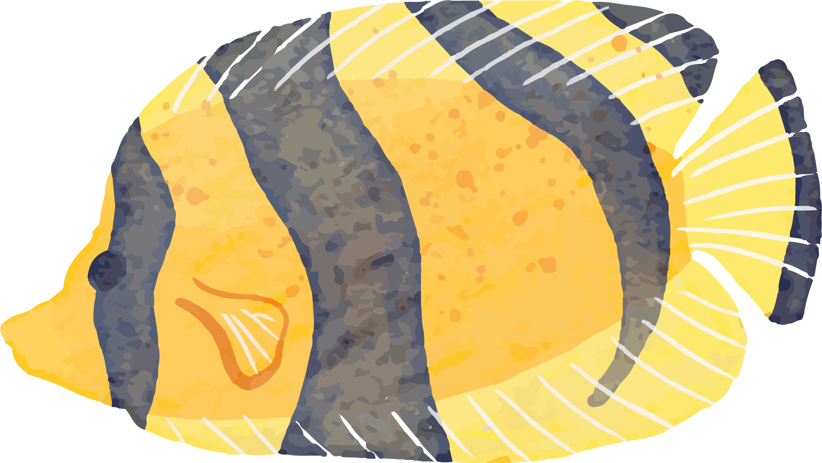

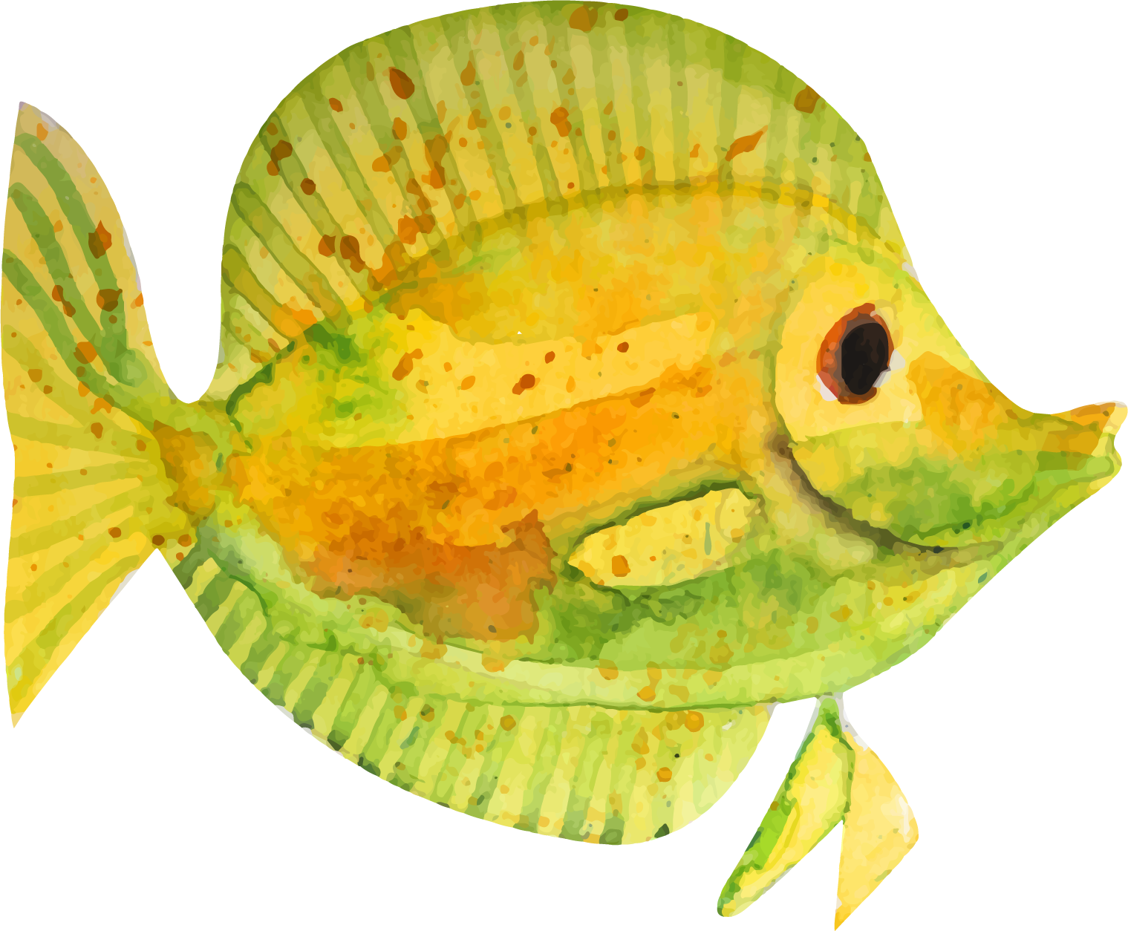
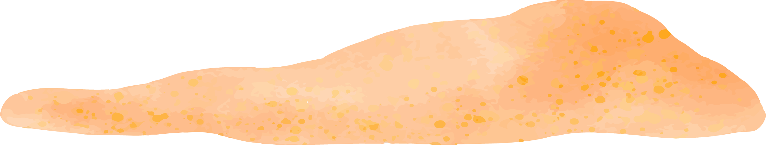
9 locations in US
Feeding & Petting Programs for Guests
Helping vulnerable & endangered species

Slide 4
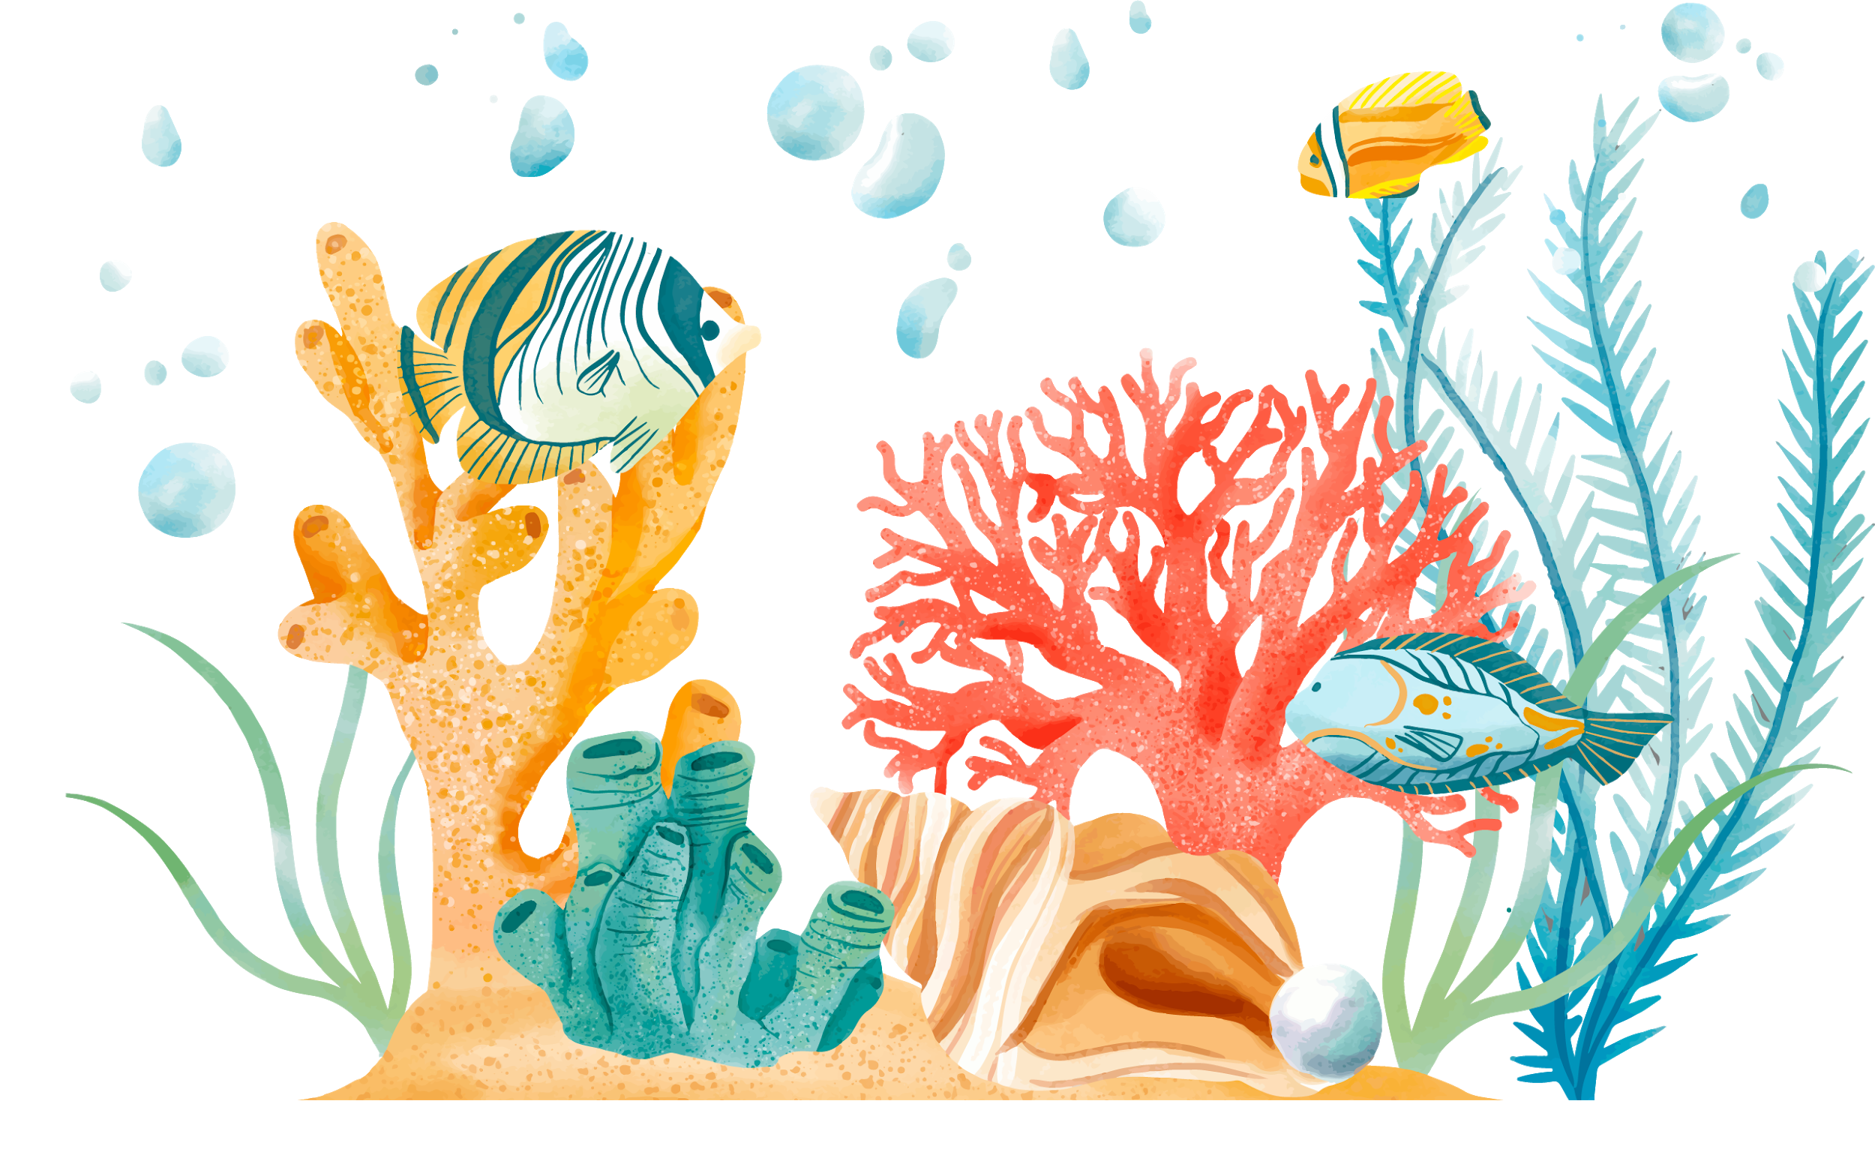
Sulcata Tortoise

Slide 5
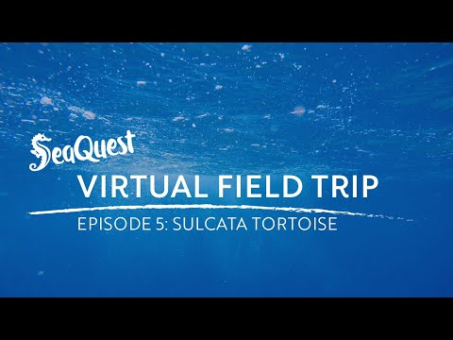

Slide 6
Where do Sulcata Tortoises live?
Asia
Africa

Slide 7

Africa!

Slide 8
What is Norman’s favorite food?

Slide 9
Yellow Squash!

Slide 10
What kind of mouth does Norman have?
Lips
Beak

Slide 11
Beak!

Slide 12
How old can Sulcata Tortoises get?

Slide 13

Over 100 years old!

Slide 14
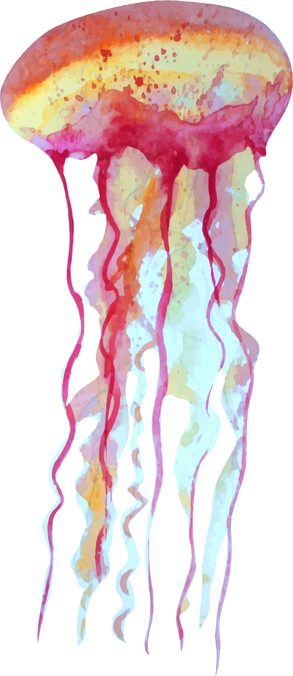
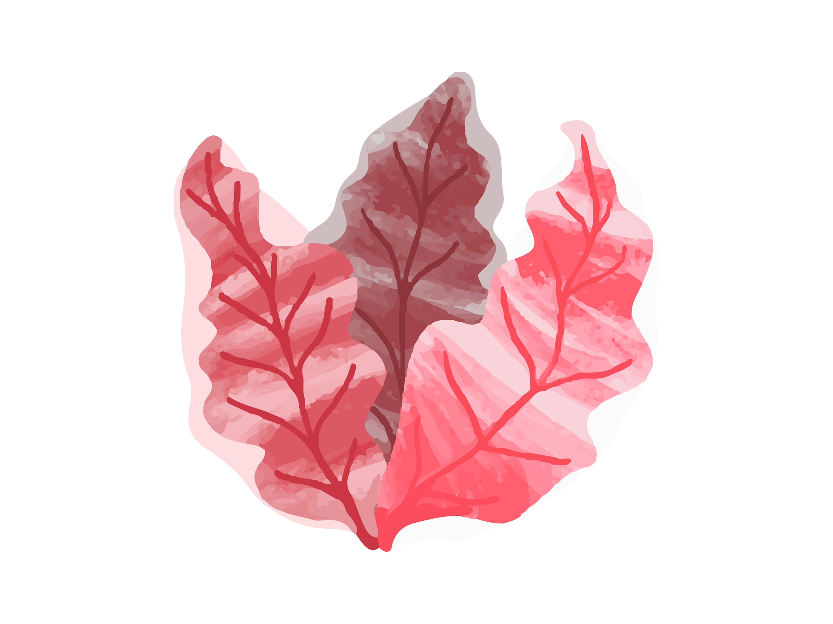
What else did we learn about Sulcata Tortoises?

Slide 15
Capybara

Slide 16


Slide 17
Capybaras are like overgown:
Guinea Pigs
Mice

Slide 18
Guinea Pig!

Slide 19
Do Capybaras like water:
Yes
No

Slide 20
Yes!

Slide 21
What kind of feet do Capybaras have?
Hooves
Webbed Feet

Slide 22
Capybaras have webbed feet!

Slide 23
Which is faster: horses or capybaras?

Slide 24
They run about the same speed!

Slide 25
What else did we learn about Capybaras?

Slide 26
Sloths

Slide 27


Slide 28
How many toes does Flash have?
2
3

Slide 29
Flash has 3 toes!

Slide 30
What are some of the foods that FLash eats?

Slide 31
What kind of insects live in sloth fur?
Beetles
Lice

Slide 32
Beetles!

Slide 33
What does the word “nocturnal” mean?
Very Hungry
Awake at night

Slide 34
Nocturnal means awake at night!

Slide 35
Where do sloths move faster?
In the water
In a tree

Slide 36
Sloths can swim 3x faster than they climb!

Slide 37
What else did we learn about Sloths?

Slide 38
Giant Pacific Octopus

Slide 39


Slide 40
What was the octopus’ name?
Bridget
Octavia

Slide 41
The octopus’ name was Octavia!

Slide 42
What part of Octavia’s body has taste buds?
Tentacles
Tongue

Slide 43
Octavia has taste buds on her tentacles!

Slide 44
How big can Giant Pacific Octopus’ get?
20 feet long
The size of a car

Slide 45
Giant Pacific Octopus’ can grow to be 20 feet long!

Slide 46
What do they use to keep Octavia in her exhibit?
A gate
Carpet

Slide 47
Carpet keeps Octavia from escaping!

Slide 48
What else did we learn about Giant Pacific Octopus?

Slide 49
Kinkajou

Slide 50


Slide 51
What are some snack Kinkajous might eat in the wild?

Slide 52
Honey, Termites, fruits & vegetables!

Slide 53
What is a group of kinkajous called?

Slide 54
A troop!

Slide 55
What else did we learn about Kinkajous?

Slide 56
Axolotl

Slide 57
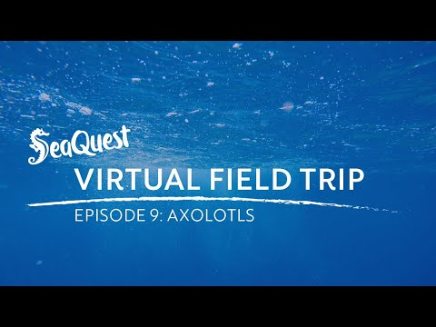

Slide 58
Axolotls are a “full aquatic ____”?
Snake
Salamander

Slide 59
Salamander!

Slide 60
Where is the only place you can find Axolotls?
Mexico
United States

Slide 61
Axolotls are found in a tiny lake in Mexico!

Slide 62
Axolotls are:
Carnivores
Herbivores

Slide 63
Axolotls are Carnivores!

Slide 64
What else did we learn about Axolotls?

Slide 65
Asian Small Clawed Otter

Slide 66
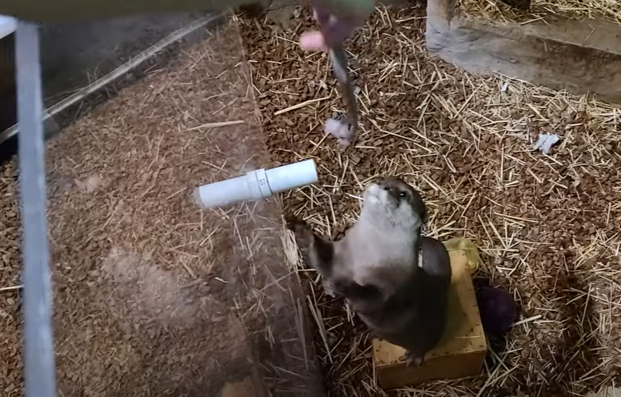

Slide 67
What do the otters get if they touch their nose to the red ball?
Pet
A treat

Slide 68
A treat!

Slide 69
Why do otters have an undercoat?
To keep them warm
Camouflage

Slide 70
Undercoats keep otters warm!

Slide 71
What else did we learn about Asian Small Clawed Otters?

Slide 72
Green Moray Eel

Slide 73
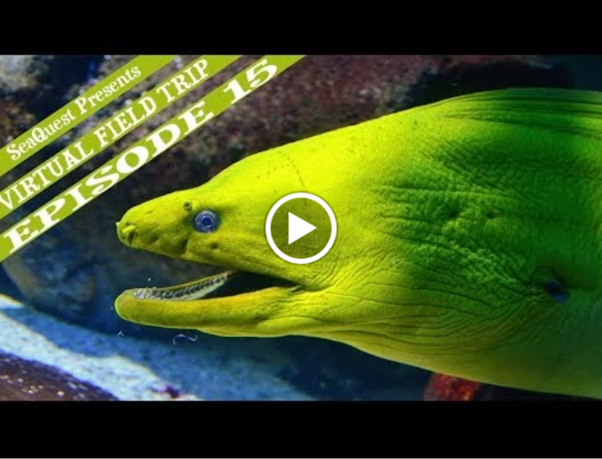

Slide 74
Do eels have scales?
Yes
No

Slide 75
No scales!

Slide 76
How do eels breathe?
Mouth
Nose

Slide 77
Eels breathe through their mouths!

Slide 78
Which is stronger for an eel?
Smell
Hearing

Slide 79
Eels have an amazing sense of smell!

Slide 80
What else did we learn about Green Moray Eels?

Slide 81
CUVIER DWARF CAIMANS

Slide 82
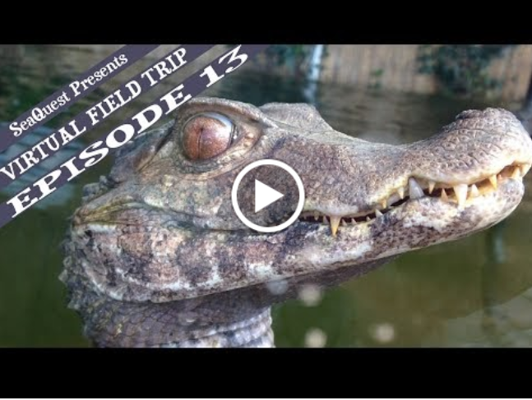

Slide 83
What makes Caimans different from alligators & crocodiles?

Slide 84
Osteoderms!

Slide 85
Why do Caimans have 2 sets of eyelids?
Protection
Underwater Vision

Slide 86
Their “goggles” help them see underwater!

Slide 87
What do Caimans have instead of teeth?

Slide 88
Stones & Pebbles!

Slide 89
What else did we learn about Cuvier Dwarf Caimans?

Slide 90
Snakes

Slide 91
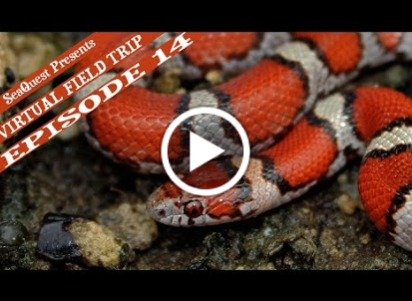

Slide 92
What is a king snake’s coloring for?
To be seen
To camouflage

Slide 93
To be seen!

Slide 94
Why are king snakes called that?
Their heads look like crowns
They eat other snakes

Slide 95
They eat other snakes!

Slide 96
Why are milk snakes called that?
They can be found in barns
They drink milk

Slide 97
They are found in barns!

Slide 98
What else did we learn about Snakes?

